Slide 1
Software Architecture & Patterns
(Refresher)

Slide 2
Design Thinking
Design – Process of developing a product or service, considering the needs & wants of users
Thinking – A mindset where users are kept in mind at each stage of development of a product or service
In summary, Design Thinking is human centrix approach to solve complex problems.

Slide 3
Design Thinking
Complex Problems Examples –
Improving Customer Satisfaction for Onboarding
Improving the adoption of Solar Energy in any country
Reducing the Attrition Rate in a Team to X%
Reducing the churn rate of customers in some retail platform

Slide 4
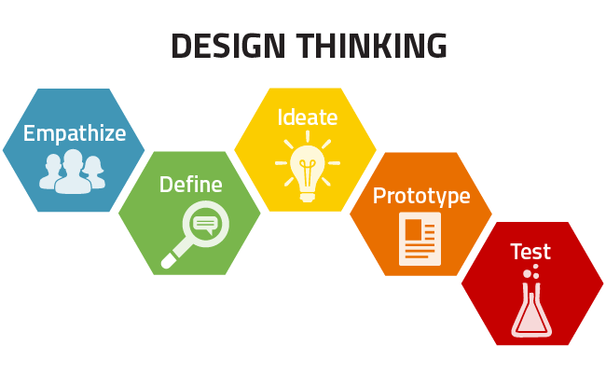
Design Thinking - Steps

Slide 5
Design Thinking - Steps
Empathize – During this stage, we empathize with the users to understand the real problem(s).
Key Points –
Focus to understand the user’s point of view
Ask users how they interact with the product and service
Engage with a diverse group of users(highly satisfied & highly dissatisfied), Mainstream users etc
The focus is on divergent thinking(creating choices)

Slide 6
Design Thinking - Steps
Define – During this stage, we define the problem statement by synthesizing all the observations we gathered during the Empathize phase.
Key Points –
Prioritize the major issues & frame the problem statement
Focus on solving the selected & most impactful issues instead of solving all in one single statement
Focus on convergent thinking(making choices)
The problem statement framed in this stage is also called “Point of View”

Slide 7
Design Thinking - Steps
Ideate – Brainstorming to come up with Solution Ideas.Gather as many solution ideas as possible and synthesize all of them for further brainstorming
Key Points –
Let the ideas flow, do not interrupt even if the ideas are irrelevant, instead accumulate the feasible ideas & build upon them
Do both create choices by divergent thinking(coming up with as many ideas as possible) & make choices through convergent thinking(concluding a few ideas)

Slide 8
Design Thinking - Steps
Prototype – Develop a prototype of the ideas. Usually a quick prototype but capable enough to interact with users & get their feedback. It’s more of Thinking with your hands. If a picture is worth of thousand words, a prototype is worth of thousand meetings.
Key Points –
Do not try to develop the final product itself
Objective here is to share it with users and get an early feedback
Focus on aesthetics

Slide 9
Design Thinking - Steps
Test – During this stage we share the prototype with the users and gather their feedback. This, helps in understanding if we are on the right track, or some correction is required. After getting the feedback we may need to go back to any of the first 4 stages.
Key Points –
Test the users with all the users we interacted in the 1st stage.
Gather feedback to make adjustments & even be ready to discard the idea
Maintain a history of all the prototypes for future reference

Slide 10
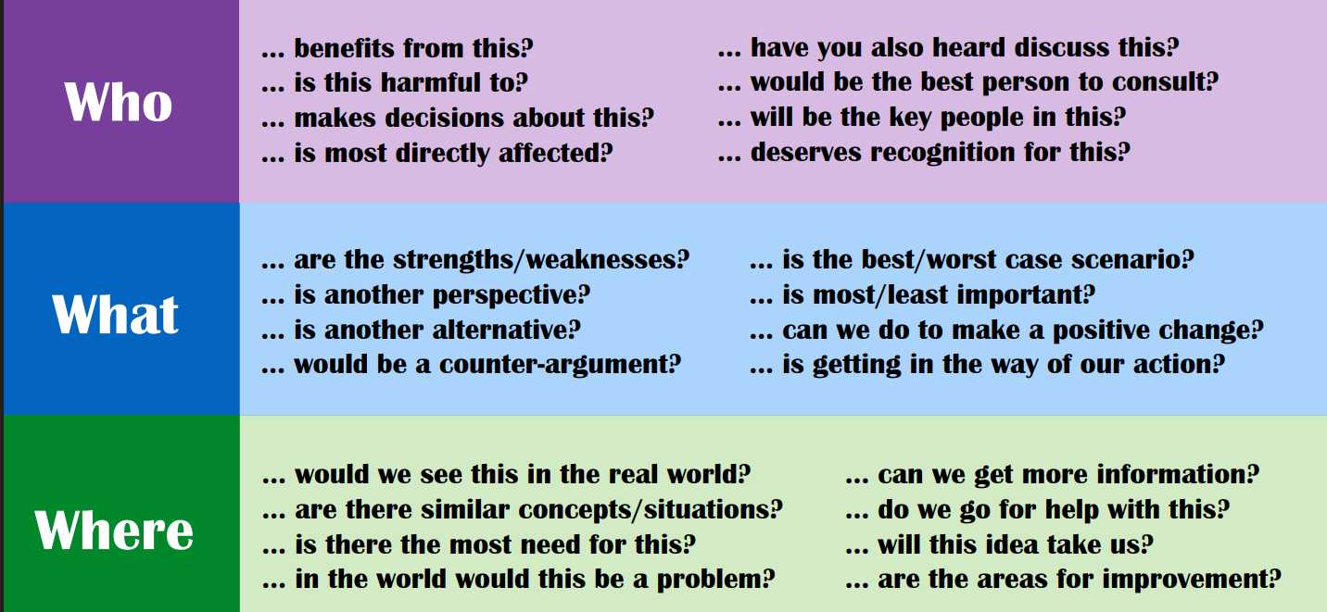
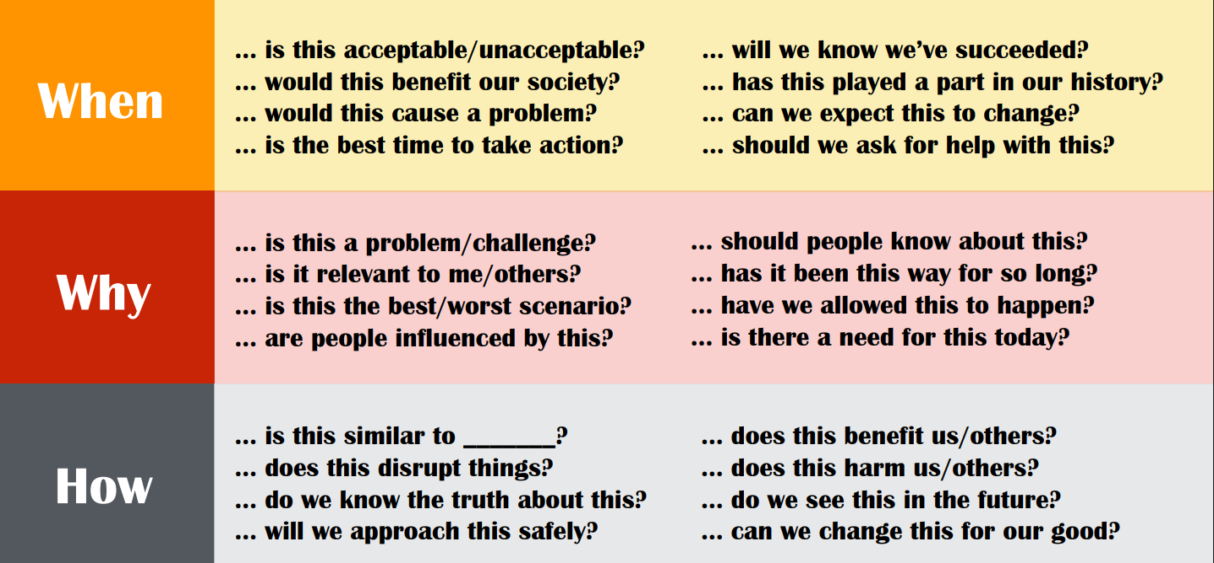
Critical Thinking – A Soft skill needed across almost any IT Role

Slide 11
Architectural Discovery Checklist
1. Business Context & Goals.
🎯 Business Objectives.
What are the core business goals or drivers for this initiative?
What business outcomes are expected (e.g., cost savings, scalability, new capabilities)?
How will success be measured (KPIs, OKRs)?
What are the critical timelines or milestones?
💼 Stakeholders.
Who are the key stakeholders (business, IT, operations, compliance)?
Who are the decision makers and approvers?
Who are the end users or consumers of the solution?
What are their pain points and expectations?
🧩 2. Current State (As-Is) Architecture.
🔍 Systems & Integrations.
What are the existing systems, services, and integrations involved?
What are their interfaces (APIs, events, files, message queues)?
What data flows currently exist between systems?
⚙️ Technology Landscape.
What technologies, languages, and frameworks are used today?
What infrastructure is in place (cloud, on-prem, hybrid)?
What are the dependencies and technical debt areas?

Slide 12
Architectural Discovery Checklist
📊 Operational Metrics.
What are the current performance, availability, and scalability metrics?
How are monitoring and alerting handled today?
What SLAs/SLOs/SLIs exist?
🧱 3. Target State (To-Be) Vision.
🧠 Strategic Direction.
What is the target vision for the system or platform?
What capabilities or features are required?
What architectural qualities (scalability, modularity, portability) are desired?
🧭 Non-Functional Requirements (NFRs).
Category Key Questions.
Performance Expected response times, throughput, latency?
Scalability Vertical/horizontal scaling needs? Auto-scaling?
Availability Required uptime, failover mechanisms?
Security Authentication, authorization, encryption, compliance?
Maintainability How easily can the system evolve?
Observability Logging, tracing, metrics collection requirements?
Cost Efficiency Budget limits, cost-optimization constraints?

Slide 13
Architectural Discovery Checklist
📊 🧰 4. Data & Integration Discovery.
📦 Data Landscape.
What are the key data entities and their relationships?
What is the volume, velocity, and variety of data?
What data sources (internal, external, streaming) are used?
What are the data quality and governance concerns?
🔄 Integration Patterns.
What integration mechanisms are required (APIs, events, ETL, messaging)?
Is there a need for real-time vs batch processing?
Are there legacy interfaces to modernize?
☁️ 5. Infrastructure & Deployment.
🧱 Environment Discovery.
Where will workloads run? (On-prem, Azure, AWS, GCP, Hybrid, Edge).
What environments exist (Dev/Test/Prod)?
How is infrastructure provisioned (manual, IaC – Terraform/Bicep)?
What are the network and connectivity constraints?
What compute, storage, and network resources are available?
🚀 Deployment & Operations.
What is the CI/CD pipeline strategy?
How are rollouts, rollbacks, and versioning handled?
What’s the monitoring, logging, and alerting setup?
Who handles incident response and SRE functions?

Slide 14
Architectural Discovery Checklist
🔐 6. Security, Compliance & Governance.
🔒 Security.
How is identity and access management (IAM) handled?
Are there encryption requirements (at rest, in transit)?
How are secrets managed?
Any known vulnerabilities or threats?
🧾 Compliance.
What regulatory frameworks apply (GDPR, HIPAA, ISO, RBI, etc.)?
What are the audit and logging requirements?
Are there data residency or sovereignty constraints?
🧠 7. People, Process & Change Management.
Who will own and maintain the solution post-deployment?
What skills are available in-house vs. need upskilling?
Are there existing DevOps/SRE or MLOps practices?
What change management or training plans are required?
📈 8. Risks, Constraints & Assumptions.
Category Example.
Risks Legacy dependency, integration complexity, unclear requirements.
Constraints Budget, licensing, regulatory, cloud choice.
Assumptions APIs available, data access permitted, team resources allocated.

Slide 15
Architectural Discovery Checklist
📊 9. Architecture Decision Inputs.
Prepare to capture Architecture Decision Records (ADRs) based on:
Chosen architecture style (Microservices, Event-driven, Data , etc.).
Key trade-offs (complexity vs flexibility, performance vs cost).
Tooling & framework selection rationale.
Cloud or platform strategy (Azure, AWS, hybrid).
🧩 10. Artifacts to Produce.
During or after discovery, architects should aim to deliver:
Current-State (As-Is) architecture diagram.
Target-State (To-Be) architecture diagram.
Strategy Diagram to transform from As-Is to To-Be
Context and container views (C4 model).
Integration/data flow diagrams.
NFR matrix.
Risk and mitigation log.
Architecture Decision Records (ADRs)

Slide 16
Requirement Analysis – Soft Skills
Is some As-Is(/Current-State) Architecture/Design/Implementation available?
If yes, how things are done currently – the whole process.
Is there any To-Be(/Target) diagram?
If needed, ask why transforming from As-Is to To-Be? And why now?
Being Customer Centric rather than just Requirements Centric i.e. if needed, modify the requirements for better customer satisfaction.
Proactively ask relevant queries in Requirements Analysis phase & envision (design) tasks which can turn out to be really very helpful to make the product/service better in the Product Engineering landscape.

Slide 17
Requirement Analysis – NFRs
QPS/RPS/TPS(Queries/Requests/Transactions per second) – As thumb rule, assume(/start with) 1K QPS can be handled by a standard server (& API(s) response time within 100ms in general).
Read/Write Ratio – Calculate the tentative/assumed Read/Write
Ratio. This can be helpful in scaling the reads & writes separately.
Infra Considerations - Number of Servers/VMs needed & CPU/Disk/RAM Size needed in each Server/Vm. Network Bandwidth considerations are also important here.
Storage Size – Evaluate the size of blobs, DBs etc needed.
YoY(Year on Year [including Day 0,1…N]) Growth[for all the above] – Can be helpful in capacity planning for initial cloud assessment or full on-premise assessment

Slide 18
Estimation
WBS(Work Breakdown Structure) – Used for normal User Stories in most agile projects. Infact when you do Story-Pointing, you are implicitly using WBS.
Use Case Estimation – Used for whole new or Enhancement projects. WBS can be used for each use case for better granularity.
Function Point Estimation – Used in some migration projects if source code of existing project is available.
N.B. -> If its some totally new concept/technology, do a PoC using Design Thinking approach and then give the overall estimate using WBS.
SAFe Estimation Techniques - Estimation & Prioritization : Agile & SAFe Framework | LinkedIn
Some Most Important “Common-Sense” points to keep in consideration while doing any estimate are(although common sense but sometimes we forget these the most) –
Work Load(as per Granular Scoping & Prioritization as per need of the hour), Complexity & Uncertainty.
Always consider 20-30% buffer on overall base estimates you give. It’s always better to commit less & deliver more than vice versa. Check Arpit Bhayani’s Post on Estimation| LinkedIn
Team Capacity or Timelines may be needed to be increased/decreased as per need of the hour.

Slide 19
Modelling & Documentation(& Tools)
UML –
Use Case & Activity Diagrams – Used for interaction between Dev team and BAs/POs.
Difference Between Use Case Diagram and Activity Diagram | Compare the Difference Between Similar Terms
Component Diagrams – To show how components/services interact with each other
What is Component Diagram?
Class Diagrams – To show how components/services are build using class(es)/interface(s).Can be helpful in Reverse Engineering as well.
UML Class Diagram Tutorial | Lucidchart

Slide 20
Modelling & Documentation(& Tools)
UML contd… –
Sequence(& Collaboration Diagrams) – Can be used to show interactions flow between classes/components/services.
Difference between Sequence diagram and Collaboration diagram – GeeksforGeeks
Other Diagramming Models –
C4 Model - Visualize Your Software Architecture With The C4 Model
BPMN - BPMN Specification - Business Process Model and Notation
Archimate - ArchiMate – Wikipedia
N.B. – Use Colour Coding(border or full box) for Legends for Architectural Components like “New”, “Existing To Be used”, “Modified” or “To be Decomissioned”

Slide 21
Modelling & Documentation(& Tools)
Important Architecture Diagrams and Documentation
Vision & Strategy using Roadmaps/Milestones/TimeLines
Enterprise Landscape – for overall high-level view of the entire Enterprise Landscape
Business Architecture – Shows the high-level Business Components & flows/interactions between them
Application Architecture – Various components(showing clearly what technologies are used to build the app) and interactions between them in project(s).
Technology Architecture – Showing the Infra & Deployment strategies

Slide 22
Modelling & Documentation(& Tools)
Important Architecture Diagrams and Documentation contd …
Integration Architecture – Showing the major internal/external integrations.
DB Architecture – Showing the conceptual, logical & physical DB models and ER diagrams & the DB Tables metadata structure.
Also important is to document the NFRs(Non Functional Requirements), ADRs(Architecture Decision Records) & AIRs(Architecture Improvement Logs). For ADRs & AIRs, do check the gotchas associated with any (new) Technology tool.
Other Stuffs to Document –
Architecture Principles
Governance Processes
Development Architecture
N.B. – In general, search/google/chatGPT for templates of the aforementioned docs & refer them to prepare your own project specific template.

Slide 23
Modelling & Documentation(& Tools)
A Good Modelling compilation Resource –
Modeling - Awesome Software Architecture
Software Architecture As Code Tools –
From Text to Models
Application Architecture as Code - The Architect Elevator
How to automate software-architecture, using architecture-as-code (SAaC) approach
Likec4
Reverse Engineering Tools –
UML - Are there good tools for C# reverse engineering? - Stack Overflow
Software Design Diagrams Using GitHub Copilot – YouTube
Other Related Tools –
Diagram to Code using Amazon Q | LinkedIn
How to use GitHub Copilot? A Detailed, Comprehensive Guide 2025

Slide 24
Buy vs Build
Deciding between building and buying involves evaluating cost, time-to-market, and strategic necessity. Buy when the solution is not a core differentiator, requires speed, and cheaper off-the-shelf options exist. Build when you need a unique competitive advantage, have specific customization needs, or proprietary data requires in-house control.
Key Decision Factors
Core Competency: If the solution is central to your business value (e.g., a proprietary algorithm), build it. If it is a utility (e.g., email, CRM), buy it.
Total Cost of Ownership (TCO): Compare upfront, subscription, and customization costs (Buy) against development, infrastructure, and long-term maintenance costs (Build).
Time-to-Market: Buying offers immediate implementation, while building requires significant time for development, testing, and deployment.
Customization & Control: Building offers complete control and flexibility. Buying often requires adapting your processes to the vendor's software.
Internal Expertise: Assess if your team has the skills and bandwidth to build and maintain the solution, or if outsourcing/hiring is required.
Decision Process
Define Requirements: Determine if a, "must-have" solution exists in the market.
Evaluate Strategy: Is this functionality crucial to your competitive advantage?
Calculate ROI: Factor in both direct costs and the cost of time (opportunity cost).
Assess Capabilities: Honestly evaluate if your team can build it better than a vendor

Slide 25
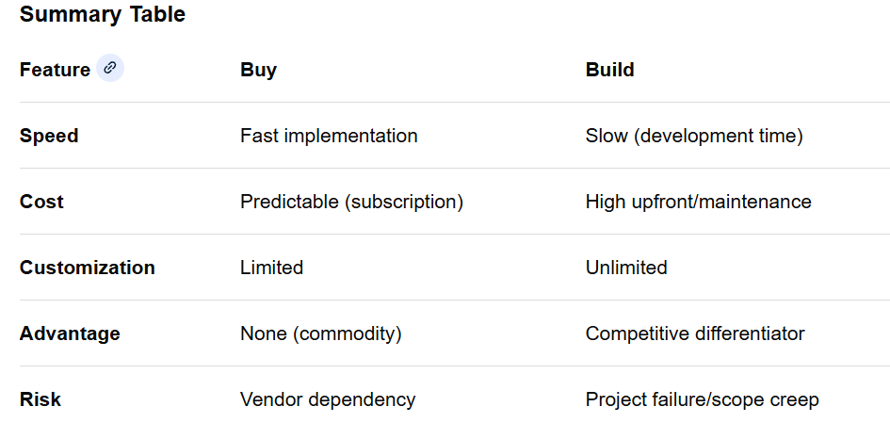
Buy vs Build
For Further Exploration
Buy Software or Build It? The 4-Step Framework That Prevents Costly Mistakes - YouTube

Slide 26
HLD vs LLD
Some closing points w.r.t Documentation -
Analyze the as-is & to-be system state e2e thoroughly from product requirements perspective. If needed, clarify all your queries/doubts, pro-actively.
Document the Business Architecture in as detail as possible for both as-is & to-be states based on 1 above (maybe using FlowCharts, State Diagrams, SwimLanes, Component/Sequence Diagrams etc.). Also check if the to-be processes can be made better, process-wise(maybe simpler or providing some tactical solution instead of strategic solution or providing additional capabilities).
Document the Application[including Integration] Architecture in as detail as possible(mainly for the to-be state) along-with associated NFRs(ideally both as-is & to-be). Try to use technologies(old or emerging) that suits your contextual requirements & not based on hype associated with some technology. Again, can use FlowCharts, State Diagrams, SwimLanes, Compoinent/Sequence Diagrams etc.
Document the Infra(also called Technology) Architecture[including DevSecOps & SRE] in as detail as possible(mainly for the to-be state) along-with associated NFRs(ideally both as-is & to-be with comparison if needed). Try to use technologies(old or emerging) that suits your contextual requirements & not based on hype associated with some technology. Again, can use FlowCharts, State Diagrams, SwimLanes, Component/Sequence Diagrams etc.
Document the Data Architecture[including Data Engineering & Data Science needs with explicit Data Models{ER Diagrams & DB Tables}], in as detail as possible(mainly for the to-be state) along-with associated NFRs(ideally both as-is & to-be with comparison if needed). Try to use technologies(old or emerging – e.g. NoSql/RDBMS) that suits your contextual requirements.
Maybe after all the above, document the ADRs & AIRs. We may need AIRs since we might be going for some tactical solution & thereby create technical debts.

Slide 27
Modelling & Documentation(& Tools)
For Further Exploration -
Documenting Software Architectures - by Dr Milan Milanović
The Ultimate Guide To Software Architecture Documentation
Architecture-Document-Template
High Level Design Template
WebMethods - Software AG Tech Community & Forums
Writing an effective End-to-End High-Level Design
System-Design-Templates-Excalidraw
Free Software architecture review template | Confluence
Practical-Architecture
Architecture-Decision-Record
Enterprise Architecture: How to Design Models & Diagrams
Communication Patterns[Book]
Practical Model-Driven Enterprise Architecture
Modeling Enterprise Architecture with TOGAF[Book]

Slide 28
Architecture(/Design) Principles
Architecture(/Design) Principles -
Architectural Design Principles - Awesome Software Architecture
Reactive Design-
Code repo for Functional and Reactive Domain Modeling
Reactive Design Patterns
Reactive Messaging Patterns with the Actor Model

Slide 29
Architecture(& Design) Trade-Offs
Architecture(/Design) is mainly taking decisions based on trade-offs wherein the goal is to build the Least Worst Architecture(/Design).
ATAM(Architecture Trade-Off Analysis Method) –
Architecture Tradeoff Analysis Method (ATAM) - GeeksforGeeks
Architecture Trade-Off Examples –
How to make software architecture trade-off decisions | by Alex Wauters | Medium
How do you evaluate and communicate the trade-offs of different architectural choices?

Slide 30
Architecture(& Design) Trade-Offs
For Further Exploration –
Fitness function-driven development | Thoughtworks
Enforcing Software Architecture With Architecture Tests
Software Architecture: Foundations, Theory, and Practice – Resources
The Semantic Design Toolbox - Semantic Software Design [Book]
Design It!: From Programmer to Software Architect by Michael Keeling
Building Evolutionary Architectures · GitHub
Evolutionary-Architecture-by-example
Evolutionary Architectures. This is a summary of some interesting…
Geek read: Building Evolutionary Architectures 2nd edition
Notes on Building Evolutionary Architectures. | Irrational Exuberance
Building Evolutionary Architectures
Software Architecture Metrics[Book]
Solutions-Architect-metrics-cheatsheet
Metrics For Software Architects and Designers
Designing Software Architectures – notes

Slide 31
Enterprise Architecture Process using TOGAF
What is TOGAF?
TOGAF (The Open Group Architecture Framework) is a framework for designing, planning, implementing, and governing enterprise architecture. The heart of TOGAF is the ADM (Architecture Development Method) — a step-by-step, iterative process for developing and evolving enterprise architecture.
ADM (Architecture Development Method) – Overview
The ADM is a cycle that you repeat continuously. Each iteration can update one layer or the entire architecture.
Preliminary
↓
A. Architecture Vision
↓
B. Business Architecture
↓
C. Information Systems Architecture
(Data + Application)
↓
D. Technology Architecture
↓
E. Opportunities & Solutions
↓
F. Migration Planning
↓
G. Implementation Governance
↓
H. Architecture Change Management
↺ (back to A/B/C etc.)
Additionally, the Requirements Management phase runs through all phases.

Slide 32
Enterprise Architecture Process using TOGAF
Preliminary Phase – Prepare & Set the Stage
Purpose
Define:
Why we are doing architecture
Scope of transformation
Architecture principles
Governance model
Tools and repository
Key Outputs
Organizational context
Architecture principles (e.g., reuse before buy before build)
Architecture governance framework
EA repository structure
Phase A: Architecture Vision
Purpose
Create a high-level vision to:
Align stakeholders
Secure funding and approval
Set initial scope and boundaries
Activities
Identify stakeholders
Define business context and drivers
Form a high-level Target Architecture (not detailed yet)
Develop the Business Case
Create Architecture Vision Document

Slide 33
Enterprise Architecture Process using TOGAF
Outputs
Statement of Architecture Work
Architecture Vision (with high-level diagrams)
Stakeholder maps and communication plan
Phase B: Business Architecture
Purpose
Define the Target Business Architecture:
Business capabilities
Processes
Organization structure
Value streams
Business rules
Inputs
Architecture Vision
Business strategies
Activities
Baseline Business Architecture (current state As-Is)
Target Business Architecture (future state To-Be)
Identify gaps (Gap Analysis)
Outputs
Business Capability Model
Value Stream Maps
Business Process Models
Business Domain/Data impact analysis

Slide 34
Enterprise Architecture Process using TOGAF
Phase C: Information Systems Architectures
Divided into:
Data Architecture
Application Architecture
C1. Data Architecture
Define:
Data entities & relationships
Data ownership
Data flows & lifecycle
Master data boundaries
C2. Application Architecture
Define:
Application components & services
Integration patterns (e.g., API, ESB, events)
Application-to-capability mapping
Outputs (combined)
Logical Data Model
Application Interaction Diagram
Data/Application Gap Analysis
Phase D: Technology Architecture
Purpose
Define the technical platform needed to realize the applications & data.
This includes:
Infrastructure
Networking

Slide 35
Enterprise Architecture Process using TOGAF
Security
Cloud Platforms (IaaS/PaaS)
DevOps / CI/CD environments
Runtime environments (EKS/AKS, App Service, VMs, Containers, etc.)
Outputs
Platform Reference Architecture
Infrastructure designs (logical > physical)
Tech standards and policies
Phase E: Opportunities & Solutions
Purpose
Convert architectures into solution direction.
Identify:
Projects
Work packages
Reusable building blocks
Technology enablers
Outputs
Solution Architecture Roadmap
Work Package Definitions
Phase F: Migration Planning
Purpose
Create a phased implementation roadmap based on:
Business priorities
Dependencies

Slide 36
Enterprise Architecture Process using TOGAF
Budget
Risk
Outputs
Prioritized Migration Roadmap (e.g., Phase 1, Phase 2…)
Implementation Plan aligned with PMO governance
Phase G: Implementation Governance
Purpose
Ensure that implementation follows the architecture.
Activities
Architecture review boards
Design approvals
Solution alignment checks
Outputs
Compliance assessment reports
Waivers / justification logs (when deviation required)
Phase H: Architecture Change Management
Purpose
Keep architecture live and relevant.
Actions
Monitor changes in business, technology, regulations
Decide whether to update architecture or start new ADM cycle
Outputs
Updated architecture repository
Architecture Change Requests
Requirements Management

Slide 37
Enterprise Architecture Process using TOGAF
Operates across all phases:
Collects, stores, traces, updates requirements
Ensures traceability from strategy → architecture → implementation
Artifacts (Documents) Produced Across ADM
Phase Key Deliverables
Preliminary Architecture Principles, Governance Model
A: Vision Architecture Vision, Statement of Work, Business Case
B: Business Capability Map, Value Streams, Business Process Models
C: Data/App Logical Data Model, Application Interaction Diagrams
D: Technology Platform Reference Architecture, Tech Standards
E: Opportunities Solution Building Blocks, Roadmap
F: Migration Migration Plan, Dependency Map
G: Governance Architecture Compliance Report
H: Change Change Request Log
How Iteration Works
TOGAF does not expect you to finish everything then move on.
Each phase:
Can be revisited
Can be done in domain-specific cycles (e.g., only Application Architecture)
Can be scaled (lightweight for small projects, detailed for large)
In Simple Terms
TOGAF Step Practical Meaning
Vision Why are we doing this? What is the high-level target?
Business Architecture What the business needs to do.
Data + Application What systems and data are needed.

Slide 38
Enterprise Architecture Process using TOGAF
TOGAF Step Practical Meaning
Technology Which platforms and tech we will use.
Opportunities & Solutions How to translate architecture to executable solutions.
Migration Planning When and in what order.
Governance Ensure execution follows design.
Change Management Keep architecture relevant over time.
Example - TOGAF EA Deliverables for BFSI Core Banking Modernization
Phase A – Architecture Vision
Objective: Define high-level target architecture, stakeholders, and business case.
Key Artifacts:
Architecture Vision Deck (PPTX) – includes:
Business drivers: legacy monolith, slow product launches, regulatory pressure, digital channels
Stakeholder map: CIO, CTO, Business Heads, Risk & Compliance, PMO
High-level Target Architecture Diagram (Cloud + Microservices + API layer)
Business case & KPIs (time-to-market, cost reduction, reliability)
Phase B – Business Architecture
Objective: Map current and target business capabilities.
Artifacts:
Business Capability Map (PPTX)
Key domains: Retail Banking, Corporate Banking, Treasury, Risk, Compliance, Payments
Highlight which capabilities are enhanced, migrated, or modernized
Value Streams & Process Models
Example: Account Opening, Loan Origination, Transaction Processing

Slide 39
Enterprise Architecture Process using TOGAF
Example - TOGAF EA Deliverables for BFSI Core Banking Modernization
Business Gap Analysis
Manual processes → automated microservices
Siloed product lines → integrated product platform
Phase C – Information Systems Architecture
Data Architecture
Canonical data model for Customer, Account, Transaction, Loan, Product, KYC
Master Data Management boundaries
Data flow diagrams showing source systems → microservices → reporting
Application Architecture
Domain-driven microservices mapped to business capabilities
API Gateway for internal/external integration
Event-driven architecture (Kafka, RabbitMQ)
Integration with legacy core for phased migration
Artifacts:
Logical Data Model Diagram (PPTX)
Application Interaction Diagram (PPTX)
Gap Analysis Table (XLSX)
Phase D – Technology Architecture
Objective: Define platform to support microservices and hybrid cloud.
Components:
Hybrid cloud: On-prem DC + Azure/AWS for microservices
Kubernetes (AKS/EKS) clusters for microservices
CI/CD pipeline with Jenkins/GitHub Actions

Slide 40
Enterprise Architecture Process using TOGAF
Example - TOGAF EA Deliverables for BFSI Core Banking Modernization
Security, IAM, monitoring, disaster recovery
Artifacts:
Technology Reference Architecture Diagram (PPTX)
Infrastructure Components Heatmap
Phase E – Opportunities & Solutions
Objective: Map architectures to executable projects.
Artifacts:
Solution building blocks
Work packages:
Domain microservices development (Customer, Account, Transaction, Loan)
API Gateway implementation
Hybrid cloud platform provisioning
Data migration & MDM rollout
Roadmap for each domain
Phase F – Migration Planning
Objective: Define phased implementation.
Artifacts:
Migration roadmap (XLSX)
Phase 1: Customer & Account services
Phase 2: Loan & Transaction services
Phase 3: Payments & Treasury services
Dependencies, cost estimates, resource planning
Phase G – Implementation Governance
Objective: Ensure compliance with architecture.

Slide 41
Enterprise Architecture Process using TOGAF
Example - TOGAF EA Deliverables for BFSI Core Banking Modernization
Artifacts:
Architecture compliance checklist
Review board schedule
Deviation approval templates
Phase H – Architecture Change Management
Objective: Ensure EA evolves with business.
Artifacts:
Change management log template (DOCX)
Architecture update guidelines
Periodic assessment metrics
Requirements Management
Central repository linking business drivers → capabilities → data → applications → technology → solutions
Traceability ensured for audit & regulatory compliance.

Slide 42
Enterprise Architecture Process using TOGAF
EACOE(Enterprise Architecture Centre of Excellence)
TODO

Slide 43
Enterprise Architecture Process using TOGAF
For Further Exploration -
Day One as an Enterprise Architect | LinkedIn
Enterprise Architecture Certifications And Solutions | EACOE
Standard 10.0 - Level 1 Enterprise Architect Course | Udemy
Standard 9.2 - Part 2 Certified Enterprise Architect Course | Udemy
Enterprise Architecture Practitioner with TOGAF 10 Standard | Udemy
Practical Solution Architecture | Udemy
The Practice of Enterprise Architecture (Part III) | Udemy
Enterprise Architecture by Example | Udemy
Enterprise Architecture Governance | The Definitive Guide | LeanIX
Enterprise Design Patterns Book — Enterprise Design Patterns
Enterprise Architecture at Work
TOGAF Skill Guide. When I started my TOGAF Learning…
CloudGAF - A Tailored TOGAF Framework for Cloud Adoption
Complex Enterprise Architecture: A New Adaptive Systems Approach
EAWheel
Fundamentals of Enterprise Architecture[Book]
Free Enterprise Architecture Resources – Conexiam
Realize Enterprise Architecture with AWS and SAFe
Technology Strategy Patterns[Book]

Slide 44
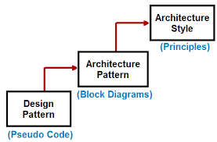
Architectural Styles vs Patterns
For Further Exploration –
Is ASP.NET MVC a framework, architecture, or a design pattern? – Quora
Are Architectural Styles, Patterns & Design Patterns Different | LinkedIn

Slide 45
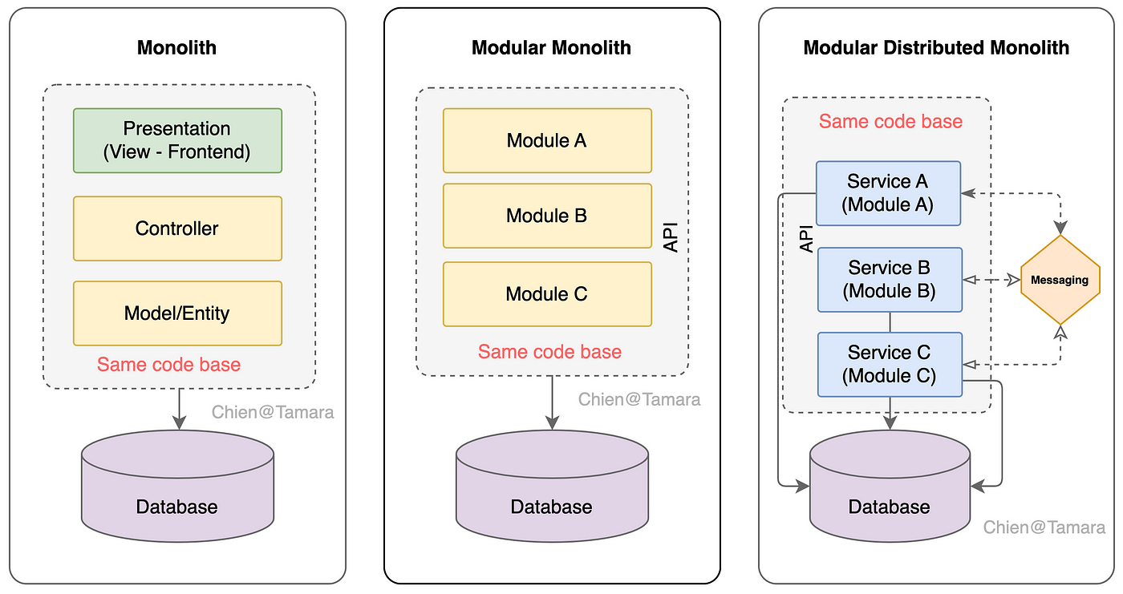
Architectural Styles
(Modular/Distributed) Monolith Architecture –
For Further Exploration –
Modular Monolith - Awesome Software Architecture /

Slide 46
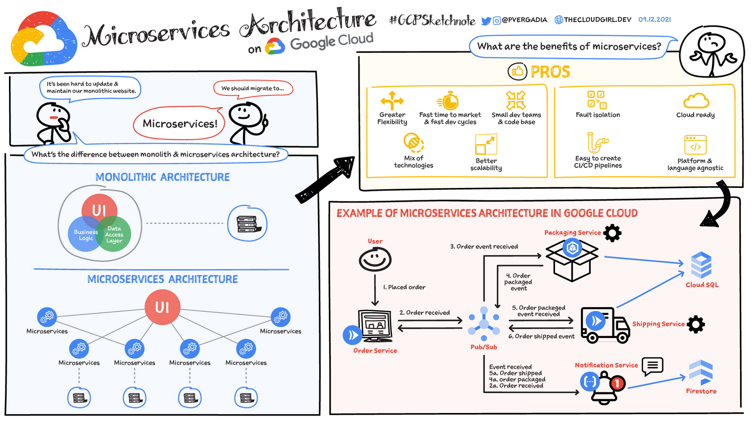
Architectural Styles
Microservices Architecture –

Slide 47
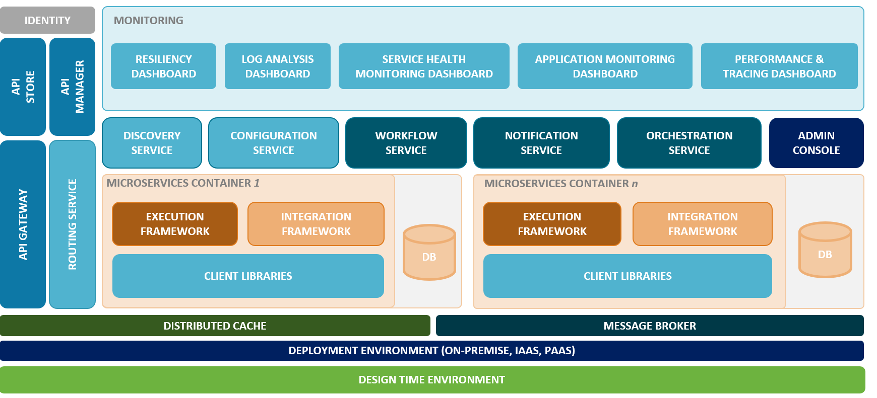
Architectural Styles
Microservices Architecture –
Reference Architecture -

Slide 48
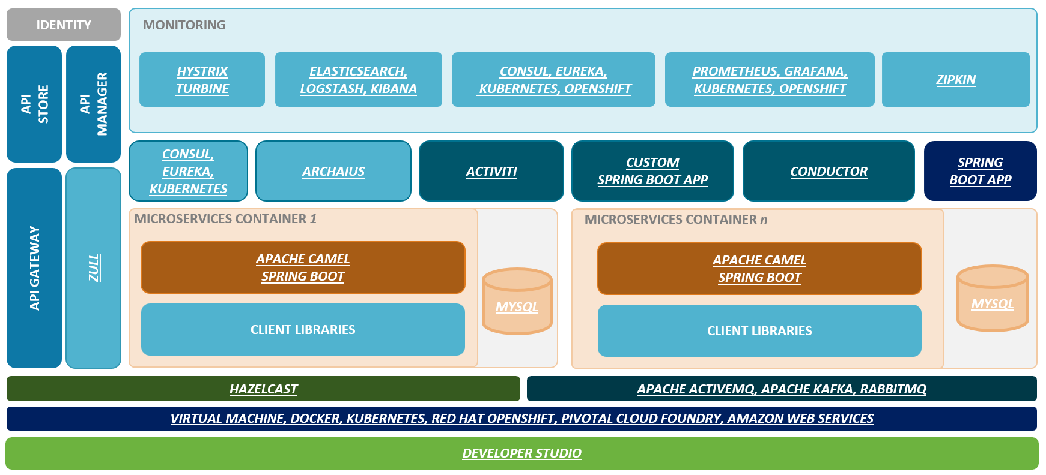
Architectural Styles
Microservices Architecture –
(Typical Java Based) Technology Architecture -
For Further Exploration –
Java Notes · GitHub
Perfect-Roadmap-To-Learn-Java-SpringBoot-In-2024
Microservices-with-Spring-Boot-and-Spring-Cloud
Practical-Microservices-Architectural-Patterns
Patterns' by Binildas Christudas
Architecture · OpenZipkin
Service Discovery with Zookeeper
Service discovery in .NET - .NET | Microsoft Learn

Slide 49
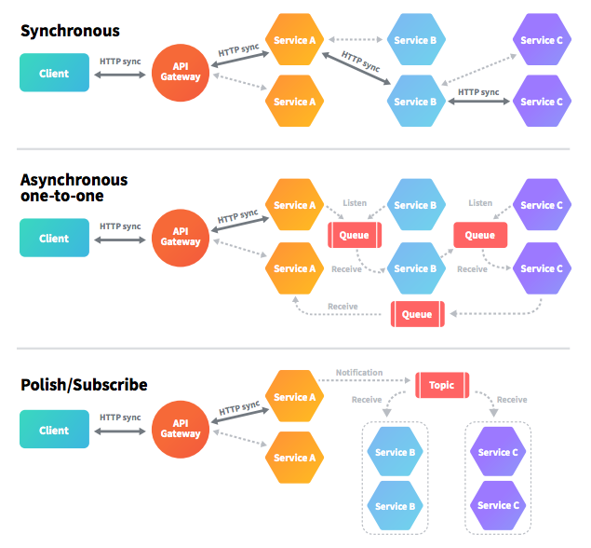
Architectural Styles
EDA(Event Driven Architecture) using Messaging –
Erratum – Polish/Subscribe above is a typo mistake. Should be Publish/Subscribe.
For Further Exploration
Message Broker vs. Event Broker: When to Use Each One Of Them | Riskified Tech
Bytebytego on X: "IBM MQ -> RabbitMQ -> Kafka ->Pulsar,
Azure Service Bus messaging - queues, topics, and subscriptions - Azure Service Bus | Microsoft Learn
Best practices for improving performance using Azure Service Bus - Azure Service Bus | Microsoft Learn
Service Bus asynchronous messaging - Azure Service Bus | Microsoft Learn
AMQP 1.0 in Azure Service Bus and Event Hubs - Azure Service Bus | Microsoft Learn
AMQP 0-9-1 Model Explained | RabbitMQ
Some EDA Notes

Slide 50
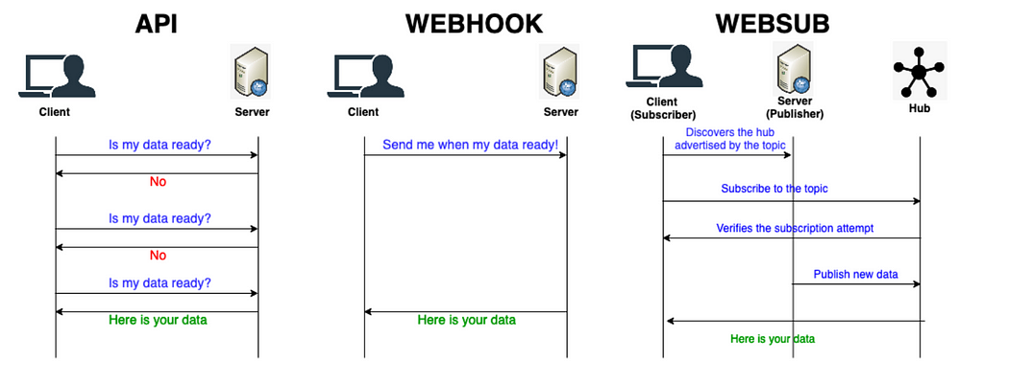
Architectural Styles
EDA(Event Driven Architecture) using WebHooks & WebSub –
Seems, most legacy/old MQ or Service bus based approaches can be replaced by WebHooks & WebSubs respectively as part of App Modernization, to do most of the tasks in event driven way.
For Further Exploration –
Event-Driven APIs With Webhook and WebSub
ASP.NET WebHooks Succinctly
Some WebHook and WebSub Notes

Slide 51
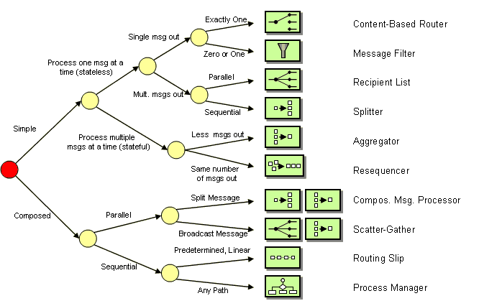
EAI(Enterprise Application Integration) Patterns -
For Further Exploration-
Enterprise Integration Patterns
Choosing a Message Exchange Pattern - WCF | Microsoft Learn
Enterprise Integration Patterns on Azure - Introduction | pacodelacruz.io
Implementing enterprise integration patterns with AWS messaging services

Slide 52
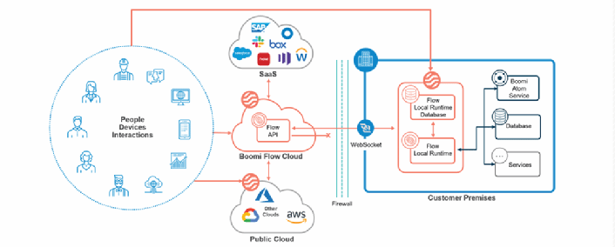
EAI(Enterprise Application Integration) Patterns -
iPaaS(Integration Platform as a Service) –
For Further Exploration –
What is iPaaS? Guide to Integration Platform as a Service

Slide 53
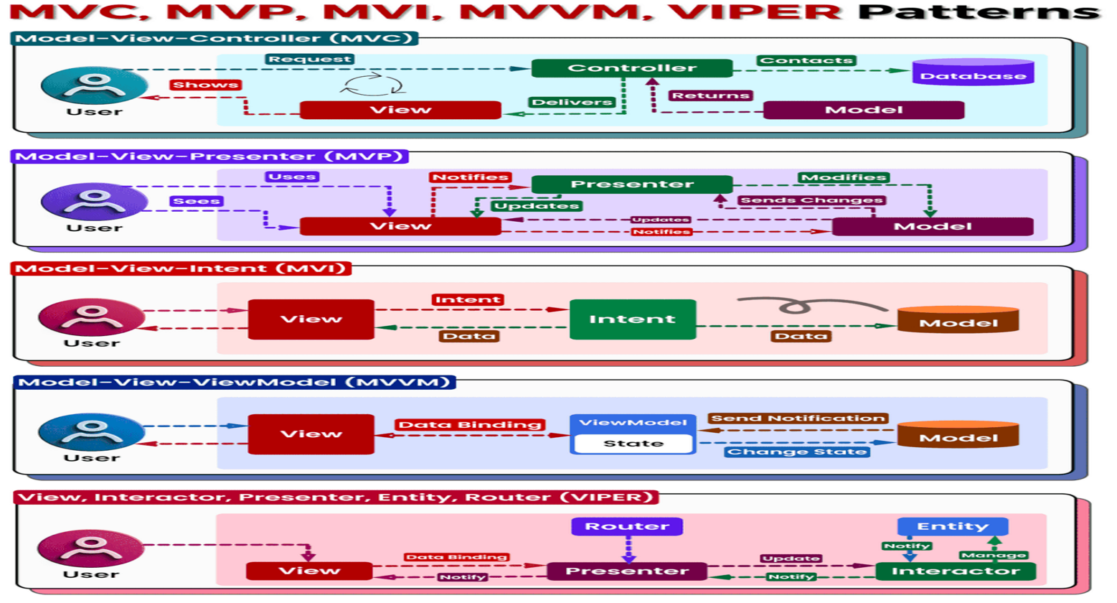
Application Architecture Patterns

Slide 54
Application Architecture Patterns
MVC vs MVP vs MVI vs MVVM vs VIPER contd… -
𝗠𝗩𝗖 (𝗠𝗼𝗱𝗲𝗹-𝗩𝗶𝗲𝘄-𝗖𝗼𝗻𝘁𝗿𝗼𝗹𝗹𝗲𝗿):
- Classic pattern separating code into three layers:
- 𝗠𝗼𝗱𝗲𝗹: Data and business logic
- 𝗩𝗶𝗲𝘄: Presentation of data to the user
- 𝗖𝗼𝗻𝘁𝗿𝗼𝗹𝗹𝗲𝗿: Handles user input and updates model/view - Simple and familiar, but can lead to tightly coupled components in complex applications.
- Can be used for normal Web based MVC Apps(e.g. ASP.NET MVC)
𝗠𝗩𝗣 (𝗠𝗼𝗱𝗲𝗹-𝗩𝗶𝗲𝘄-𝗣𝗿𝗲𝘀𝗲𝗻𝘁𝗲𝗿):
- Introduces a Presenter to mediate between view and model.
- Improves separation of concerns and testability.
- Requires additional boilerplate code compared to MVC.
- Can be used for Winforms based Apps
𝗠𝗩𝗜 (𝗠𝗼𝗱𝗲𝗹-𝗩𝗶𝗲𝘄-𝗜𝗻𝘁𝗲𝗻𝘁):
- Built for reactive programming.
- View emits intents, handled by the model, updating state and view.
- Promotes unidirectional data flow and simplifies UI logic.
- May require a steeper learning curve.
- Can be used for normal SPA based Web Apps

Slide 55
Application Architecture Patterns
MVC vs MVP vs MVI vs MVVM vs VIPER contd… -
𝗠𝗩𝗩𝗠 (𝗠𝗼𝗱𝗲𝗹-𝗩𝗶𝗲𝘄-𝗩𝗶𝗲𝘄𝗠𝗼𝗱𝗲𝗹):
- View binds to a ViewModel holding data and display logic.
- ViewModel updates by the model, then updates the view.
- Well-suited for reactive frameworks and complex UIs.
- Requires additional ViewModel setup compared to MVP.
- Can be used for WPF Apps & Mobile Native Apps
𝗩𝗜𝗣𝗘𝗥 (𝗩𝗶𝗲𝘄, 𝗜𝗻𝘁𝗲𝗿𝗮𝗰𝘁𝗼𝗿, 𝗣𝗿𝗲𝘀𝗲𝗻𝘁𝗲𝗿, 𝗘𝗻𝘁𝗶𝘁𝘆, 𝗥𝗼𝘂𝘁𝗲𝗿):
- Designed for large and complex applications.
- Five layers: View, Interactor (business logic), Presenter (data preparation), Entity (data models), Router (data flow coordination).
- Enhances modularity and maintainability for massive projects.
- Requires meticulous planning and understanding due to its complexity.
- Can be used for Real Time Web Apps(& Mobile Native Apps & Embedded Systems)

Slide 56
Application Architecture Patterns
MVC vs MVP vs MVI vs MVVM vs VIPER contd… -
𝗖𝗵𝗼𝗼𝘀𝗶𝗻𝗴 𝘁𝗵𝗲 𝗥𝗶𝗴𝗵𝘁 𝗣𝗮𝘁𝘁𝗲𝗿𝗻:
The optimal pattern depends on various factors, including:
- 𝗣𝗿𝗼𝗷𝗲𝗰𝘁 𝘀𝗶𝘇𝗲 𝗮𝗻𝗱 𝗰𝗼𝗺𝗽𝗹𝗲𝘅𝗶𝘁𝘆: MVC/MVP for simple apps, MVI/MVVM for reactive apps, VIPER for large projects.
- 𝗧𝗲𝗮𝗺 𝗲𝘅𝗽𝗲𝗿𝗶𝗲𝗻𝗰𝗲: Choose a pattern familiar to your team to avoid learning curves.
- 𝗣𝗲𝗿𝘀𝗼𝗻𝗮𝗹 𝗽𝗿𝗲𝗳𝗲𝗿𝗲𝗻𝗰𝗲: Experiment and find what works best for you and your team.
For Further Exploration-
MVVM-pattern-.NET-MAUI
Swift_VIPER_Demo: A Sample App Demoing the VIPER Architecture Pattern
The-Book-of-VIPER

Slide 57
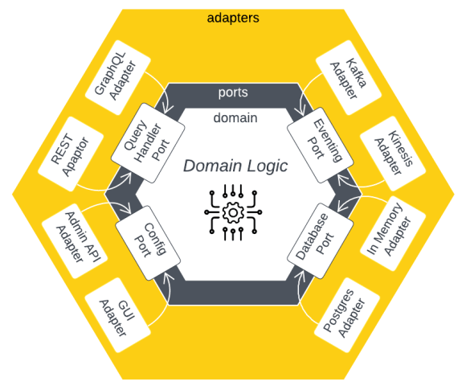
Application Architecture Patterns
Hexagonal Architecture –
For Further Exploration –
Hexagonal Architecture - Awesome Software Architecture

Slide 58
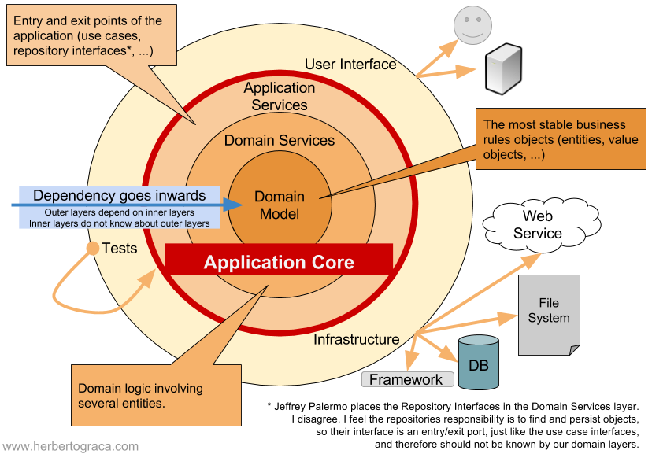
Application Architecture Patterns
Onion Architecture –
Onion Architecture adds layers to the core of Hexagonal Architecture with the rule that each layer can only depend on more central layers, and the most central layer – the domain model – only depends on itself.
For Further Exploration –
Onion Architecture - Awesome Software Architecture

Slide 59
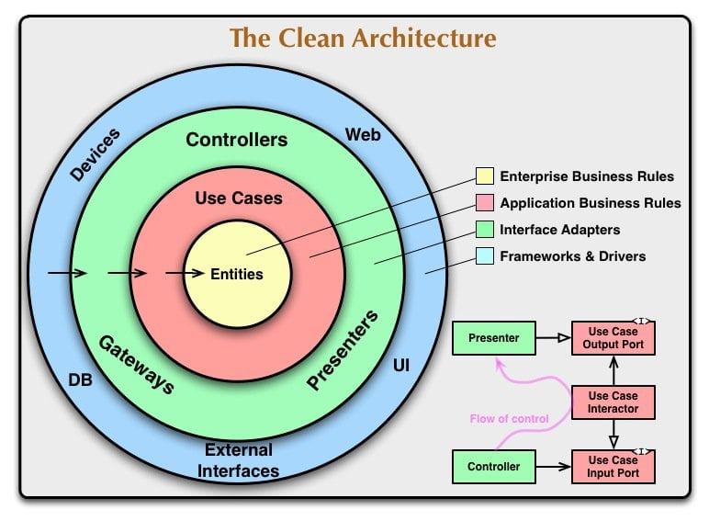
Application Architecture Patterns
Clean Architecture –
Clean Architecture almost equates Onion Architecture with some equivalent alternate names.
For Further Exploration –
Pragmatic Clean Architecture | Milan Jovanović
Clean Architecture - Awesome Software Architecture
Hexagonal vs Onion vs Clean Architecture | LinkedIn

Slide 60
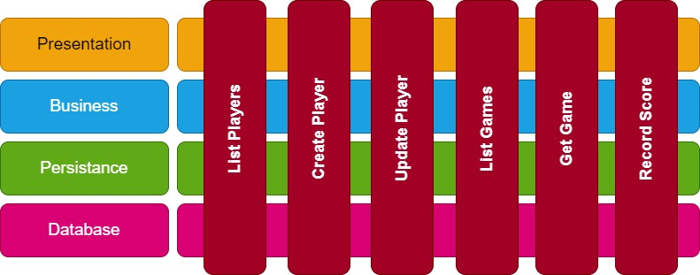
Application Architecture Patterns
Vertical Slice Architecture –
For Further Exploration –
Vertical Slice Architecture
Vertical Slice Architecture - Awesome Software Architecture

Slide 61
Application Architecture Patterns
DDD(Domain Driven Design) Concepts – 🔍 Understanding the Domain: At the heart of DDD is a deep dive into the business domain you're dealing with. It's all about comprehending the intricacies, rules, and intricacies of the problem space.
🧩 Ubiquitous Language: DDD encourages the development of a common, shared language between developers and domain experts. This shared vocabulary ensures everyone is on the same page, fostering better collaboration.
🏗️ Bounded Contexts: DDD suggests dividing complex systems into smaller, manageable "bounded contexts." These contexts have their own rules and definitions, providing a clean way to manage complexity.
📦 Aggregates and Entities: DDD promotes modeling the domain using aggregates and entities, which encapsulate business rules and ensure data integrity. This helps create maintainable and understandable code.
🛠️ Value Objects: Value objects, another DDD concept, represent immutable elements within the domain, such as currency, addresses, or date ranges. They promote simplicity and code reusability.
🌌 Repositories: Repositories provide a way to access domain objects without exposing their underlying details. They are crucial for abstracting data access.
🧬 Event-Driven Architecture: DDD aligns well with event-driven architectures, allowing systems to respond to domain events and changes.
For Further Exploration –
Understanding Domain Objects, Entities, DTOs & Models
Domain Driven Design - Awesome Software Architecture
DDD-Based-Enterprise-Application-Framework: A Domain Driven Design Based Enterprise Application Framework
Event Driven Architecture - Awesome Software Architecture

Slide 62
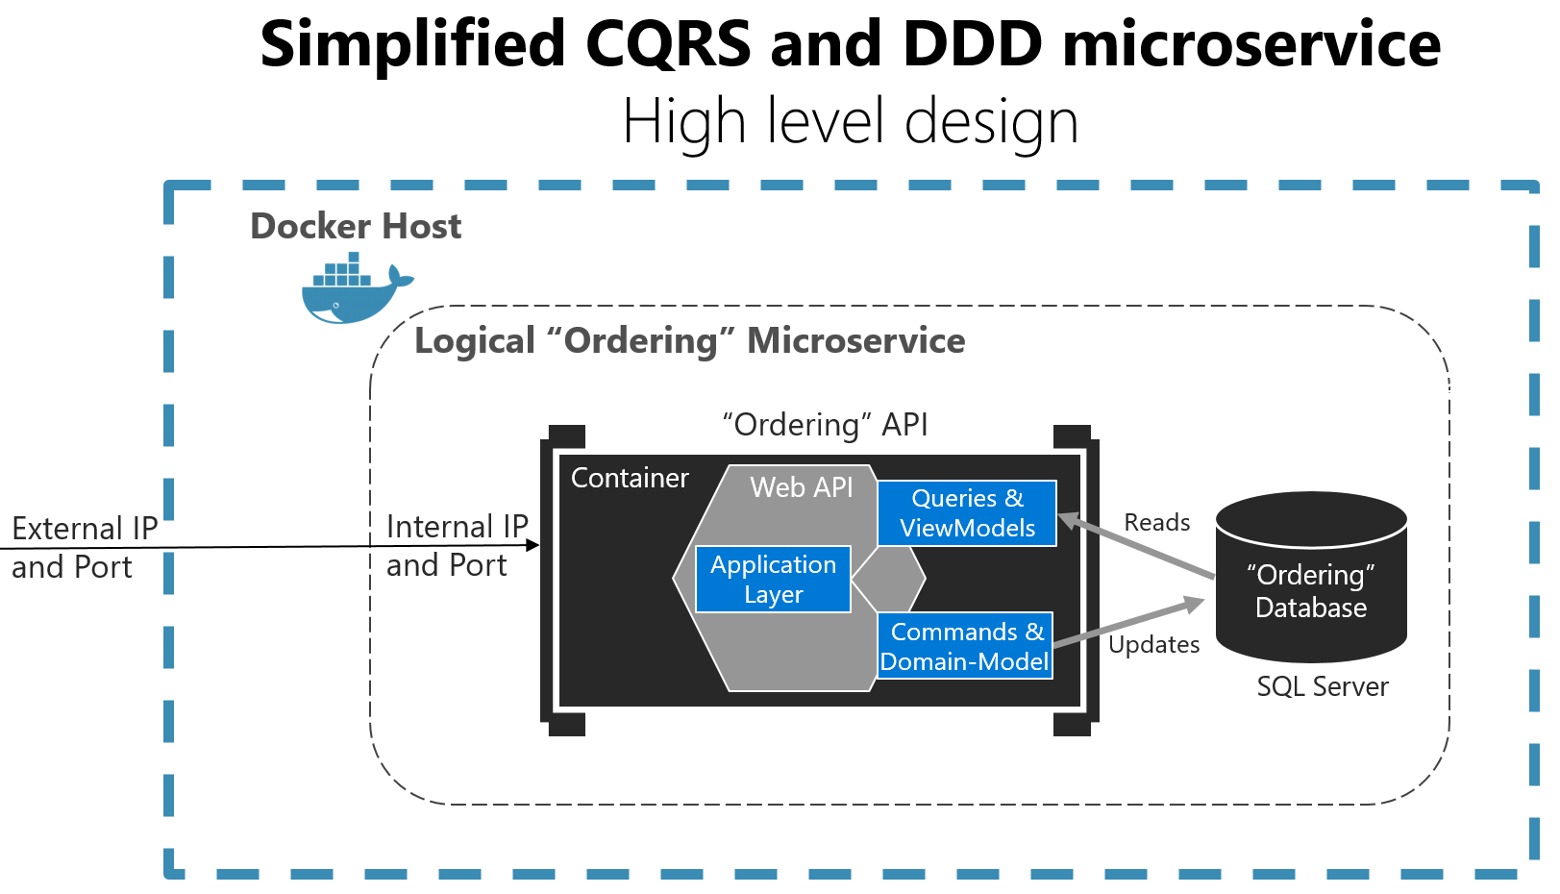
Application Architecture Patterns
CQRS(Command Query Responsibility Segregation) -
For Further Exploration –
Applying simplified CQRS and DDD patterns in a microservice - .NET | Microsoft Learn
CQRS - Awesome Software Architecture

Slide 63
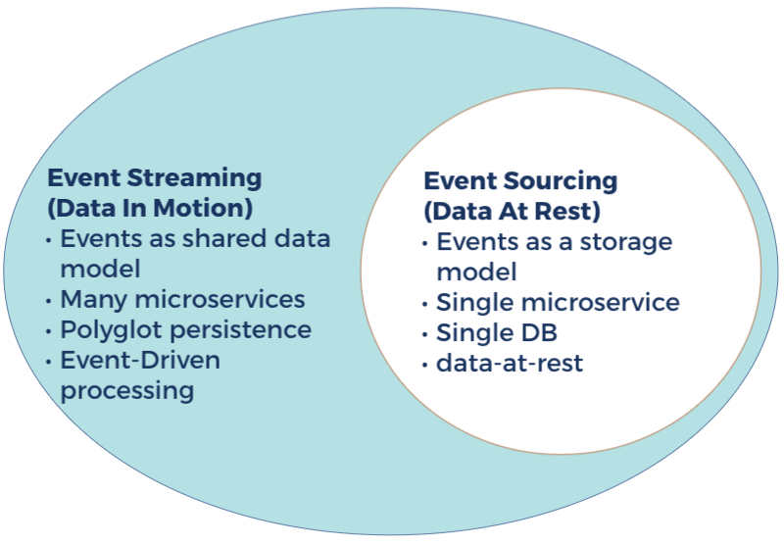
Application Architecture Patterns
Event Storming vs Event Sourcing -
For Further Exploration –
Event Storming - Awesome Software Architecture
Event Sourcing - Awesome Software Architecture

Slide 64
Application Architecture Patterns
For Further Exploration(some are legacy/old patterns though) –
Catalog of Patterns of Enterprise Application Architecture
Martin Fowler: eaaDev
Core J2EE Patterns
.NET application architecture guides | .NET

Slide 65
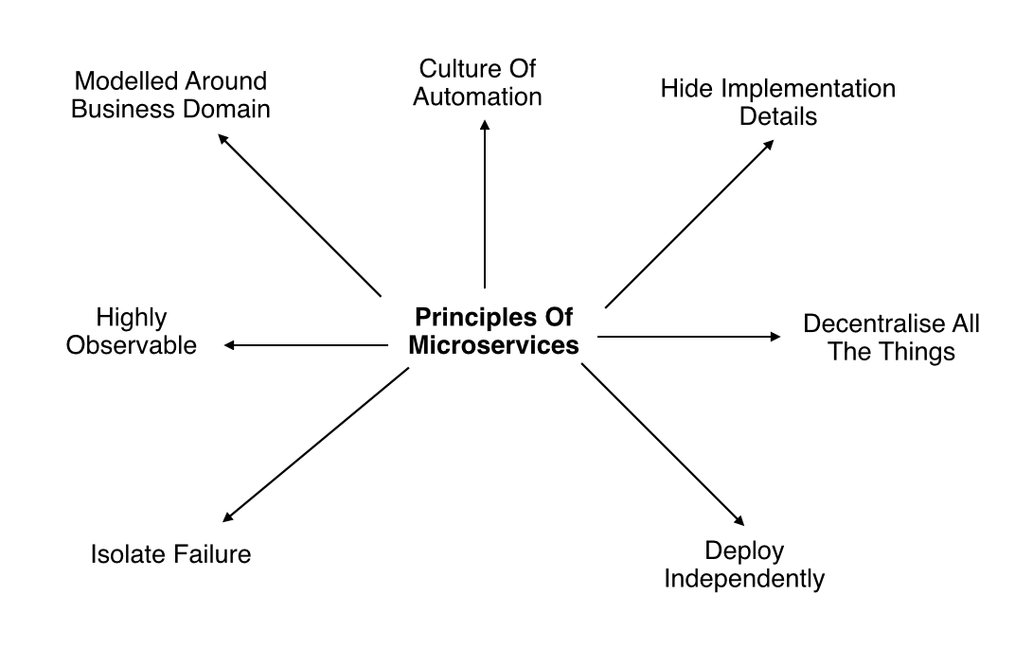
Microservices Architecture – A bit more in depth
For Further Exploration –
Microservices - Awesome Software Architecture
Microservices vs APIs - Difference Between Modular Software Design Approaches - AWS
Microservices vs Service-Oriented Architecture by Mark Richards | Goodreads

Slide 66
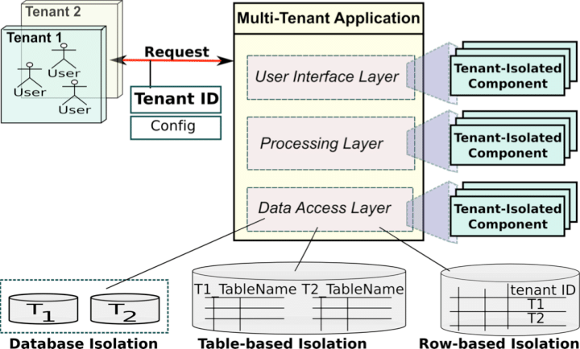
Microservices Architecture – A bit more in depth
Application Multitenancy -
For Further Exploration -
Inevitability of Multi-Tenancy & SAAS in Product Engineering | prashanthpanduranga
ASP.NET Multitenant Applications Succinctly
Building Multi-Tenant SaaS Architectures: Principles, Practices, and Patterns Using AWS
Commercial-Marketplace-Client-Dotne

Slide 67
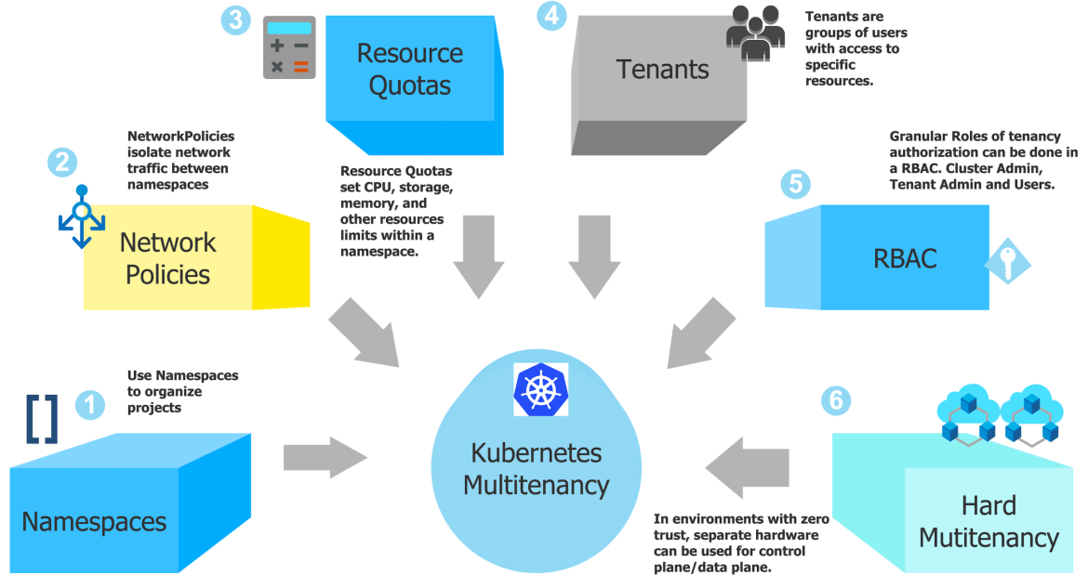
Microservices Architecture – A bit more in depth
Microservices Architecture – A bit more in depth
Infrastructure Multitenancy(using K8s) -
For Further Exploration –
Kubernetes Multi-tenancy Best Practices & Architecture Model..(2/2) - Vamsi Talks Tech
Multi-tenancy | Kubernetes
Multi-tenancy in Kubernetes: implementation and optimization | CNCF

Slide 68
Microservices Architecture – A bit more in depth
Monolith to Microservices Migration –
For Further Exploration –
Refactor a monolith into microservices | Cloud Architecture Center | Google Cloud
Monolith to Microservices — Migration patters | by Priyal Walpita | Medium

Slide 69
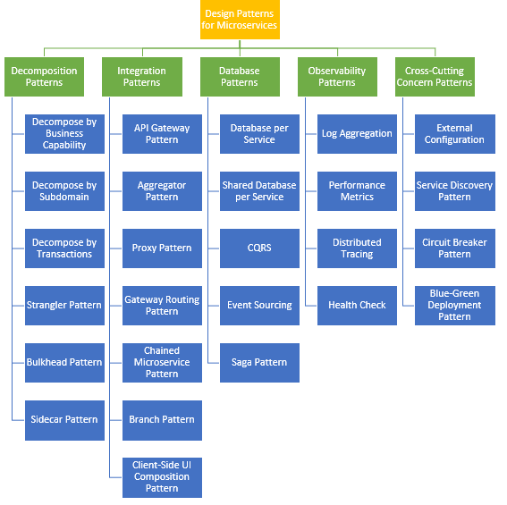
Microservices(& Cloud) Architecture Patterns
Microservices Architecture Patterns –
Cloud Architecture Patterns –
Cloud-design-patterns

Slide 70
Microservices(& Cloud) Architecture Patterns
For Further Exploration –
A pattern language for microservices
SOA: Patterns
Microservices with Netflix OSS, Spring Boot, and non-JVM applications
Ribbon
Service Discovery in Microservices with C# and .NET | LinkedIn
.NET Microservices with Steeltoe | Microsoft Learn
Resilient Microservices with Steeltoe
Fan-out/fan-in scenarios in Durable Functions - Azure | Microsoft Learn
Design Patterns for Cloud Native Applications[Book]
Design Patterns used Across Various Software Layers | LinkedIn
Cloud Native Architecture and Design: A Handbook for Modern Day Architecture and Design with Enterprise-Grade Examples | SpringerLink
Microservices And Orchestration Lessons | LinkedIn

Slide 71
NFR Matrix
Category Example Goals
Performance Response time, throughput, latency
Scalability Ability to handle increasing load
Availability System uptime, redundancy
Reliability Error tolerance, failover recovery
Security Encryption, authentication, authorization
Usability Ease of use, accessibility
Maintainability Ease of updates, code quality
Compliance Regulatory (GDPR, HIPAA, etc.)
Portability Works across OS/cloud environments
Observability Monitoring, logging, tracing.

Slide 72
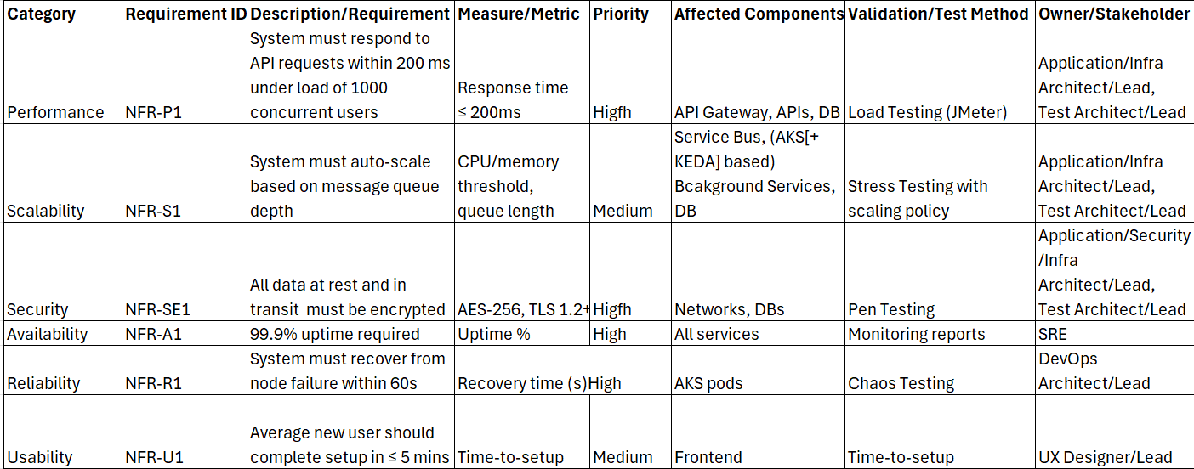
NFR Matrix
Common Structure of an NFR Matrix(Representative Example only and not any actual value from some actual prod App)
Correction: In the above slide, for row “Usability” and column “Validation/Test Method”, the value should be User Testing instead of Tme-to-setup. That’s a copy-paste error.

Slide 73
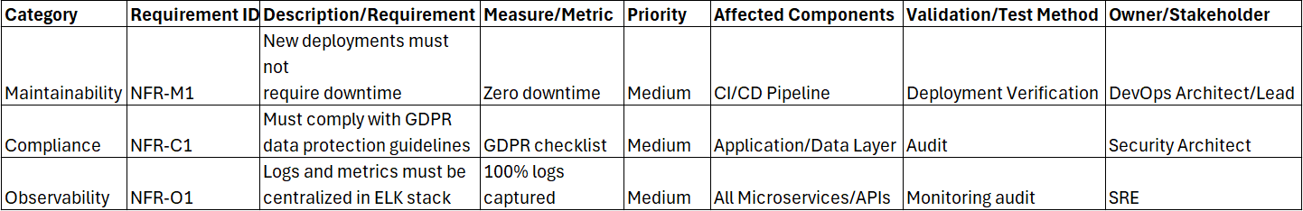
NFR Matrix
Common Structure of an NFR Matrix(Representative Example only and not any actual value from some actual prod App)
For Further Exploration -
Non-functional requirement – Wikipedia
REST API Development: Gentle checklist of NFRs
Non Functional Requirement | My Love with SQL Server
Mastering Non-Functional Requirements | Programming | eBook

Slide 74
Well Architected Framework & Runtime NFRs
Security -
Security Architecture Checklist
1️⃣ Identity, Authentication & Authorization (FOUNDATION)
✅ Authentication
Strong password hashing (argon2 / bcrypt)
MFA for humans (admins, support)
No shared accounts
Session expiration & idle timeout
Account lockout / throttling
Failure pattern
“We hash passwords but forgot MFA for prod admin panel”
✅ Authorization (Most breached layer)
Explicit authorization checks per action
RBAC / ABAC defined and documented
No “admin=true” flags in tokens
Object-level access checks (IDOR prevention)
Ask
“Can user A access resource owned by user B?”
✅ Tokens
Short-lived access tokens
Refresh token rotation

Slide 75
Well Architected Framework & Runtime NFRs
Security -
Security Architecture Checklist
1️⃣ Identity, Authentication & Authorization (FOUNDATION)
✅ Tokens
Audience + issuer validation
Token revocation strategy
2️⃣ Network Security & Segmentation
✅ Ingress
WAF enabled
Rate limiting
DDoS protection
TLS enforced
✅ East-West Traffic (microservices)
Private network only
mTLS between services
Service identity (SPIFFE / workload identity)
No “open by default” security groups
Failure pattern
“Internal services don’t need auth” ❌

Slide 76
Well Architected Framework & Runtime NFRs
Security -
Security Architecture Checklist
2️⃣ Network Security & Segmentation
✅ Egress (SSRF defense)
Egress firewall rules
Metadata IP blocked
Outbound allow-list
No raw user-supplied URLs
3️⃣ API Security
✅ API Gateway
Central auth enforcement
Schema validation
Rate limiting
Request size limits
✅ API Design
No mass assignment (POST /users)
Explicit field allow-lists
Idempotency keys for writes
Versioning strategy

Slide 77
Well Architected Framework & Runtime NFRs
Security -
Security Architecture Checklist
3️⃣ API Security
✅ Common API vulnerabilities
Check Prevents
Object-level auth IDOR
Rate limits Credential stuffing
Schema validation Injection
Pagination limits Data scraping
4️⃣ Input Handling & Injection Defense
✅ Universal rules
Never trust client input
Validate early, encode late
Reject unexpected fields
✅ SQL / NoSQL
Parameterized queries only
No string concatenation
DB user least privilege

Slide 78
Well Architected Framework & Runtime NFRs
Security -
Security Architecture Checklist
4️⃣ Input Handling & Injection Defense
✅ XSS
Output encoding everywhere
CSP enabled
No inline scripts
No untrusted HTML rendering
5️⃣ Secrets Management
✅ Storage
No secrets in source code
No secrets in Git history
Central secret manager
Per-service secrets
✅ Usage
Short-lived credentials
Automatic rotation
Scoped permissions
Access audit logs

Slide 79
Well Architected Framework & Runtime NFRs
Security -
Security Architecture Checklist
6️⃣ Data Protection & Privacy
✅ Data classification
PII / SPI identified
PCI separated
Encryption requirements defined
✅ At rest
Disk encryption
DB encryption
Column-level encryption where needed
✅ In transit
TLS everywhere (including internal)
Certificate rotation
✅ Data minimization
Store only what you need
Retention policies enforced
Right-to-delete supported

Slide 80
Well Architected Framework & Runtime NFRs
Security -
Security Architecture Checklist
7️⃣ Logging, Monitoring & Detection
✅ Logging
Auth events logged
Privilege changes logged
Admin actions logged
No sensitive data in logs
✅ Detection
Failed login alerts
Rate-limit alerts
Unusual access patterns
Token misuse detection
✅ Incident readiness
Centralized logs
Time-synced systems
Clear on-call escalation
Playbooks exist

Slide 81
Well Architected Framework & Runtime NFRs
Security -
Security Architecture Checklist
8️⃣ Security Headers & Browser Hardening
Content-Security-Policy
HSTS
X-Frame-Options
Referrer-Policy
SameSite cookies
Baseline
Strict-Transport-Security: max-age=63072000; includeSubDomains
X-Frame-Options: DENY
X-Content-Type-Options: nosniff
Referrer-Policy: no-referrer
9️⃣ CI/CD & Supply Chain Security
✅ Code
SAST enabled
Dependency scanning
License checks

Slide 82
Well Architected Framework & Runtime NFRs
Security -
Security Architecture Checklist
9️⃣ CI/CD & Supply Chain Security
✅ Build
Immutable artifacts
No secrets in build logs
Signed images
✅ Deploy
Infrastructure as Code
Manual approval for prod
Rollback strategy
🔟 Kubernetes / Cloud-Native (If Applicable)
✅ Kubernetes
RBAC enforced
No privileged containers
Pod security standards
Network policies enabled
Secrets not mounted globally

Slide 83
Well Architected Framework & Runtime NFRs
Security -
Security Architecture Checklist
🔟 Kubernetes / Cloud-Native (If Applicable)
✅ Cloud
IAM least privilege
No long-lived access keys
Resource-level permissions
Audit logs enabled
1️⃣1️⃣ Business Logic Security (MOST MISSED)
Ask these questions:
Can users skip steps?
Can discounts be stacked?
Can refunds be replayed?
Can state transitions be bypassed?
Are workflows idempotent?
Failure pattern
“Security passed—but logic allowed free money”

Slide 84
Well Architected Framework & Runtime NFRs
Security -
Security Architecture Checklist
1️⃣2️⃣ Threat Modeling (Lightweight but Effective)
For each system:
Entry points identified
Trust boundaries marked
High-value assets listed
Attacker goals imagined
Abuse cases written
Use STRIDE:
Spoofing
Tampering
Repudiation
Information Disclosure
DoS
Elevation of Privilege
1️⃣3️⃣ Pre-Production Go-Live Checklist
No debug endpoints
No test accounts
No open admin panels

Slide 85
Well Architected Framework & Runtime NFRs
Security -
Security Architecture Checklist
1️⃣3️⃣ Pre-Production Go-Live Checklist
Rate limits active
Secrets rotated
Monitoring tested
Incident drill done
🧠 Mental Model (Remember This)
Security is not a feature — it’s a system property
Layer Question
Identity Who are you?
AuthZ What can you do?
Network Where can you talk?
Data What can you see?
Observability Will we notice?
Response Can we recover?

Slide 86
Well Architected Framework & Runtime NFRs
Governance –
Accesses – Mainly from Dev perspective, who has what access.
Processes – Again mainly from Dev perspective, the processes that needs to be followed.
Regulatory Compliance – Mainly from App perspective. Compliance that needs to be followed as part of some Regulatory Authority(e.g. consents[EULA, Allow Cookies PopUps etc] )
Auditing - Can be from both App & Dev perspective. Who did what and When.
Archival & Purging - Mainly from App perspective. How much data & how often & for how long the data should be archived. How frequently & how much amount of data should be purged.
For Further Exploration –
Data Governance in a Digitally Intelligent World - a PoV | LinkedIn
Cross Industry RegTech Platform - a PoV | LinkedIn
Cloud Compliance - Amazon Web Services (AWS)
Security best practices and patterns - Microsoft Azure | Microsoft Learn

Slide 87
Well Architected Framework & Runtime NFRs
Manageability –
Mostly write-once through some control panel(can be some DevSecOps script as well) & read many times via the data plane.
Vaults – Mainly used for storing secrets(e.g. API keys, Symmetric/Asymmetric keys)
Configs – Mainly used for storing configuration settings. Can be used to store some desired state as well.
Feature Toggling – Although can be done via configs as well but special tools like below have been developed for the same –
LaunchDarkly: Feature Flags, Feature Management, and Experimentation
Feature Flags in .NET, from simple to more advanced
Test-Driven or Feature Flag-Driven Development: What’s Best for Your Team?
But in some sense, the Feature Flag tools are some sort of config only. Also, it might seem that such feature flag tools should not be needed in any Enterprise but when you have lots of (micro)services and you want complex centralized management of feature toggling then such tools turn out to be very useful.

Slide 88
Well Architected Framework & Runtime NFRs
Cost Optimisation (Techniques)
Cloud cost optimization involves techniques like rightsizing instances, shutting down idle resources, and using commitment-based savings plans or reserved instances for predictable workloads. Other strategies include implementing auto-scaling, leveraging spot instances for fault-tolerant tasks, and optimizing storage and data transfer costs.
Optimize resources and usage
Rightsize instances:
Match the size of your virtual machines and services to your actual workload requirements to avoid overspending on oversized instances.
Eliminate idle resources:
Identify and shut down unused or idle resources, such as virtual machines, storage, and other services.
Use autoscaling:
Automatically adjust the number of resources based on demand, scaling up during peak times and down during off-peak hours.
Use reserved instances and savings plans:
Commit to a one- or three-year term for stable workloads to get significant discounts compared to pay-as-you-go pricing.

Slide 89
Well Architected Framework & Runtime NFRs
Cost Optimisation (Techniques)
Leverage spot instances:
Use these deeply discounted instances for non-critical, fault-tolerant workloads like big data processing or development and test environments, as they can be terminated by the provider.
Optimize data and storage
Choose the right storage:
Select the most appropriate storage options for your data based on its access frequency and performance needs.
Limit data transfer fees:
Minimize unnecessary data transfers between cloud services or regions to reduce costs.
Delete unused snapshots:
Regularly clean up old or unnecessary snapshots to avoid incurring storage costs.
Release unused IP addresses:
Release idle or unused Elastic IP addresses, as they can incur costs when not attached to an instance.

Slide 90
Well Architected Framework & Runtime NFRs
Cost Optimisation (Techniques)
Implement better cost management practices
Monitor and tag resources:
Use tagging and cost allocation tools to tag resources and gain visibility into spending by department or project.
Set budgets and alerts:
Establish budgets and set up alerts to be notified when spending approaches or exceeds predefined limits.
Automate cost optimization:
Integrate cost optimization into your CI/CD pipelines and use automated tools to identify and remediate cost anomalies.
Conduct regular audits:
Perform periodic audits to review spending patterns, identify new optimization opportunities, and ensure policies are being followed.
Build a cost-aware culture:
Foster a culture where everyone on the team understands and is accountable for managing cloud costs.
For Further Exploration –
Awesome-Finops: Awesome FinOps Resources
Efficient Cloud FinOps | Cloud & Networking | Print
Cloud FinOps[Book]
Azure-Finops-Guide
FinOps-Handbook-for-Microsoft-Azure

Slide 91
Well Architected Framework & Runtime NFRs
Operational Excellence (Techniques)
Cloud operational excellence techniques include automation through infrastructure as code (IaC), continuous improvement of processes, and proactive monitoring and logging. Other key strategies are making frequent, small, and reversible changes to systems, anticipating failure, and learning from all operational failures.
Automation and standardization
Automate everything:
Use tools and processes to automate deployments, maintenance, and workflows, including using IaC for infrastructure and standardizing build and release processes.
Standardize processes:
Create standardized approaches for deployments, code management, and monitoring to ensure consistency and reduce errors.
Develop a "operations as code" mindset:
Apply coding principles to operations by treating operational tasks and procedures like code, making them repeatable and version-controlled.
Continuous improvement and learning
Make frequent, small changes:
Deploy updates in small, manageable batches to minimize the impact of any issues and make them easier to reverse if necessary.
Anticipate and plan for failure:
Identify potential points of failure and proactively test your ability to handle them through simulations or "game days".

Slide 92
Well Architected Framework & Runtime NFRs
Operational Excellence (Techniques)
Learn from failures:
Establish a process to document all operational failures and share the lessons learned across the organization to prevent future occurrences.
Refine processes:
Continuously review and improve operational procedures, seeking out opportunities to make them more efficient.
Monitoring and management
Implement comprehensive monitoring:
Set up detailed monitoring, alerting, and logging for both the platform and workloads to maintain visibility into system health.
Manage capacity:
Actively manage service quotas and perform capacity planning to ensure your cloud environment can handle current and future demand.
Establish roles and responsibilities:
Clearly define who is responsible for different operational tasks and decision-making to create accountability.
For Further Exploration
Continuous Delivery
Release It!

Slide 93
Well Architected Framework & Runtime NFRs
Sustainable Development (Techniques)
Sustainable cloud development combines green cloud practices with energy-efficient programming to minimize the environmental impact of technology. These techniques are crucial for reducing the energy consumption and carbon emissions generated by data centers, which are projected to double by 2030 due to increased demand for AI and other digital services.
Green cloud development techniques
These practices focus on optimizing the infrastructure side of cloud computing to reduce resource and energy use.
Choose a green cloud provider: Select a cloud service provider (CSP) that prioritizes sustainability. Leading providers like Amazon Web Services, Google Cloud Platform, and Microsoft Azure have made public commitments to power their data centers with renewable energy sources.
Optimize resource allocation: Use tools provided by your CSP to "right-size" your virtual machines, containers, and databases to match your workload needs. This prevents over-provisioning and reduces energy waste from idle resources.

Slide 94
Well Architected Framework & Runtime NFRs
Sustainable Development (Techniques)
Leverage serverless architectures: Serverless computing, such as AWS Lambda or Azure Functions, automatically allocates resources only when your code is running. This minimizes idle server time and can significantly reduce your carbon footprint.
Implement virtualization and containerization: Both virtualization and containerization allow multiple workloads to run on a single physical server, maximizing resource utilization and minimizing the number of servers required. Containers, like Docker, are especially lightweight and efficient.
Adopt edge computing: Process data closer to the user to reduce the energy consumed by transferring data over long distances.
Use sustainable data storage strategies: Efficient data management can reduce the need for excessive storage. Employ tiered storage to move infrequently accessed data to less energy-intensive archive tiers, and use compression and deduplication to reduce the volume of stored data.
Optimize data center location: When possible, strategically place workloads in regions with lower carbon intensity, where data centers are more likely to be powered by renewable energy sources.

Slide 95
Well Architected Framework & Runtime NFRs
Sustainable Development (Techniques)
Energy-efficient programming techniques
Also known as "green coding," these techniques focus on writing and optimizing software to consume less energy during execution.
Select energy-efficient algorithms and data structures: Choose algorithms that require fewer computational steps to complete a task. For example, a binary search is more efficient than a linear search for sorted data.
Refactor for efficiency: Regularly review and optimize code to eliminate unnecessary operations, redundant loops, and inefficient queries. This reduces the processing power needed to run the application.
Manage data transfer efficiently: Minimize the amount of data sent over networks by compressing files, reducing the size of media assets, and using efficient data serialization formats.
Use effective caching: Store frequently accessed data in a temporary, high-speed cache to reduce the need for repeated, resource-intensive server and database calls.
Optimize for different contexts: Adapt your application's behavior based on its operating conditions. For example, enable a "dark mode" for users with OLED

Slide 96
Well Architected Framework & Runtime NFRs
Sustainable Development (Techniques)
screens, which can reduce battery consumption on their devices.
Automate tasks wisely: Use automation to schedule resource-intensive tasks, such as batch processing or software updates, for off-peak hours when demand on the energy grid is lower.
Monitor and measure: Use tools from your CSP (e.g., Google Cloud's Carbon Footprint tool) or third-party solutions (e.g., Cloud Carbon Footprint) to track and analyze your application's energy consumption. Use this data to inform and prioritize optimization efforts.
Architectural principles for sustainability
For comprehensive sustainability, integrate these techniques into your overall development lifecycle.
Start with design: Incorporate sustainability goals into your software architecture and design patterns from the beginning. Consider resource efficiency, scalability, and modularity to build applications that are inherently greener.
Embrace sustainable DevOps: Optimize your Continuous Integration/Continuous Deployment (CI/CD) pipelines to reduce resource

Slide 97
Well Architected Framework & Runtime NFRs
Sustainable Development (Techniques)
screens, which can reduce battery consumption on their devices.
waste from unnecessary builds and inefficient testing. Use Infrastructure as Code (IaC) to automatically provision and decommission resources.
Manage the full lifecycle: Ensure responsible e-waste management and consider hardware longevity. For hardware you manage, follow clear policies for maintenance, recycling, and disposal.
Focus on continuous improvement: Track your metrics, educate your team, and continuously refactor to keep reducing your environmental footprint over time. A sustainable mindset should be a key part of your organization's culture.
For Further Exploration
Sustainable software architecture
Sustainable Cloud Development | Cloud & Networking | eBook

Slide 98
Well Architected Framework & Runtime NFRs
For Further Exploration
For Further Exploration
Announcing updates to the AWS Well-Architected Framework guidance | AWS Architecture Blog
How to use the Azure Well-Architected Framework documentation - Microsoft Azure Well-Architected Framework
Optimizing Azure Kubernetes Service (AKS) with the Well-Architected Framework | Microsoft Community Hub
Business criticality in cloud management - Cloud Adoption Framework | Microsoft Learn
Design-Practice-Repository

Slide 99
Capacity Planning
Also known as “Capacity Planning”/”Back of the Envelope” Calculations – ByteByteGo | Back Of the Envelope Estimation
TODO

Slide 100
Demand Driven Architecture
TODO

Slide 101
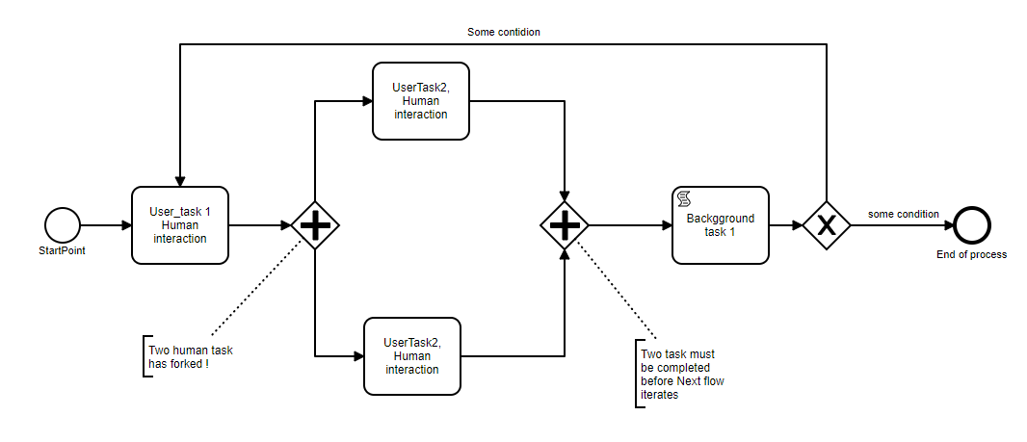
BPM & BRE
Some Terminologies –
STP(Straight Through Processing) & Non-STP
Hydration, De-Hydration & Re-Hydration
(Re-)Hosting
State Machine & FlowCharts

Slide 102
BPM & BRE
Microservices Orchestration – Building Blocks
WORKFLOWS
consist of
TASKS
SYSTEM TASKS
FORK
SIMPLE TASKS
JOIN
deployed on
registered with
DECISION
implement
start
WAIT
ORCHESTRATION SERVER
poll and update
WORKERS
HTTP
registered
with
complete or terminate
EVENT
EVENT HANDRS
listens to
MESSAGING INFRASTRUCTURE
publishes to
Typically use an FSM(Finite State Machine) based approach to implement orchestration. FSM can be implemented using various techniques including “DSL(Domain Specific Language) + Template Method Design Pattern(for workflows/operations/actions) + Chain Of Responsibility Design Pattern(for tasks/jobs/steps)”.Refer What is Netflix Conductor?, Conductor OSS Foundation and Conductor Documentation for further exploration

Slide 103
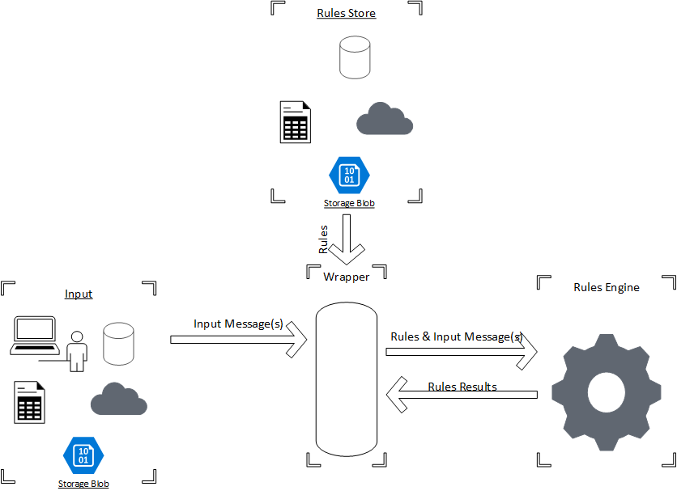
BPM & BRE
For Further Exploration –
8 Best Open Source Rule Engines in 2024 | Nected Blogs
RulesEngine | A Json based Rules Engine with extensive Dynamic expression support
Getting Started with Drools.NET- CodeProject
Check For Distributed BPM & Rules Engines as well for better Scalability & Availability

Slide 104
BPM & BRE
For Further Exploration
Workflow Patterns Home Page
Awesome-Workflow-Engines:
GeneratingRestAPIsWithProcessAndDataModel.pdf
Bernd Ruecker Books
Windows Workflow Foundation for .net Core - Stack Overflow
Rehosted-Workflow-Designe
.NET & .NET Core Workflow Engine, Workflow Server & Elsa-workflows
Orchestration vs Choreography
ASP.NETMVC - Using Workflow Foundation in MVC3 to handle Page Flow (as in a Wizard) - Stack Overflow
Orchestration Graphs
Orchestrating ELT in Airflow: Scheduling vs. Orchestrating
Workflow Engines Comparisons - Whats the best workflow Orchestration

Slide 105
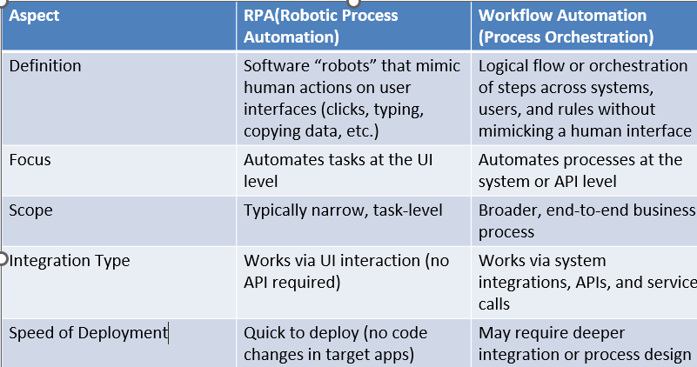
RPA(Robotic Process Automation)
RPA vs BPM/Workflows

Slide 106
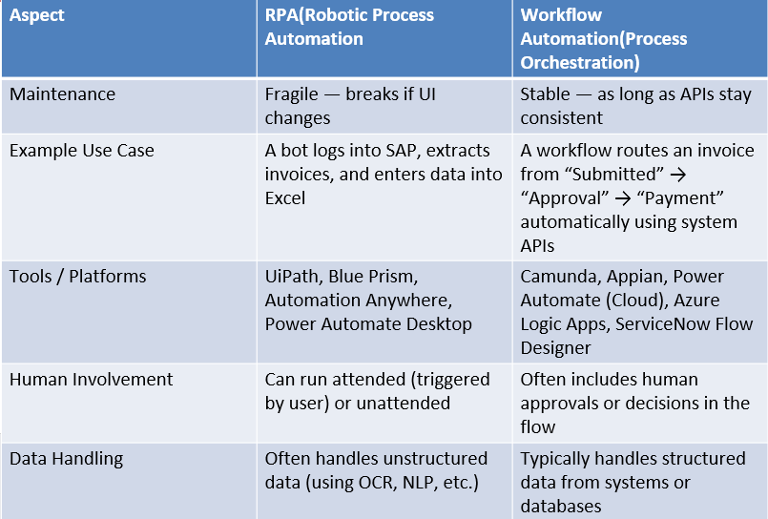
RPA(Robotic Process Automation)
RPA vs BPM/Workflows

Slide 107
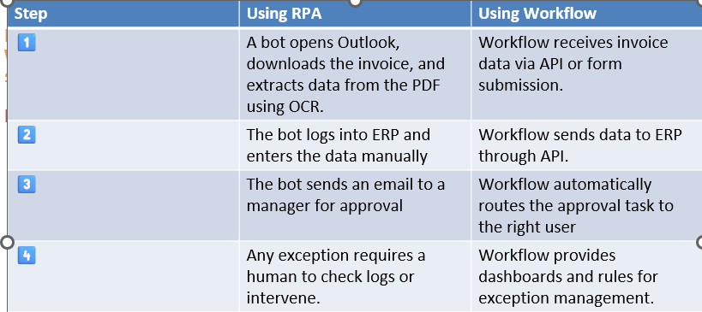
RPA(Robotic Process Automation)
RPA vs BPM/Workflows
🧠 In Simple Terms
RPA = Digital hands → Emulates what a human does on a computer screen.
Workflow = Digital brain → Controls the sequence of tasks and decisions between systems and people.
🧩 Example
Let’s take an Invoice Processing scenario:

Slide 108
RPA(Robotic Process Automation)
RPA vs BPM/Workflows
👉 In practice, RPA bots can perform the repetitive, UI-based steps inside a larger workflow orchestration.
🧩 When to Use What
Scenario Best Choice
No API access, legacy applications, repetitive UI tasks -> RPA
Modern systems with APIs, business rules, human approvals- > Workflow Automation
Need full process automation across both types of systems -> Combine RPA + Workflow Orchestration
🧠 Architectural Integration
In an Intelligent Automation architecture:
Workflow Orchestrator calls RPA bots when a task involves UI-based interaction.
RPA Bots return results to the orchestrator, which continues the business flow.
Example:
Workflow Engine (Camunda / Logic App) → triggers → RPA Bot (UiPath) → completes UI task → returns → workflow continues to next step.

Slide 109
RPA(Robotic Process Automation)
For Further Exploration –
Robotic Process Automation (RPA) Architecture
IBM RPA architecture - IBM Documentation
RPA Architecture | Complete Guide on RPA Architecture
RPA Architecture | A Complete Guide to How RPA Works
RPA_Developer_Roadmap
RPA Solution Architect's Handbook

Slide 110
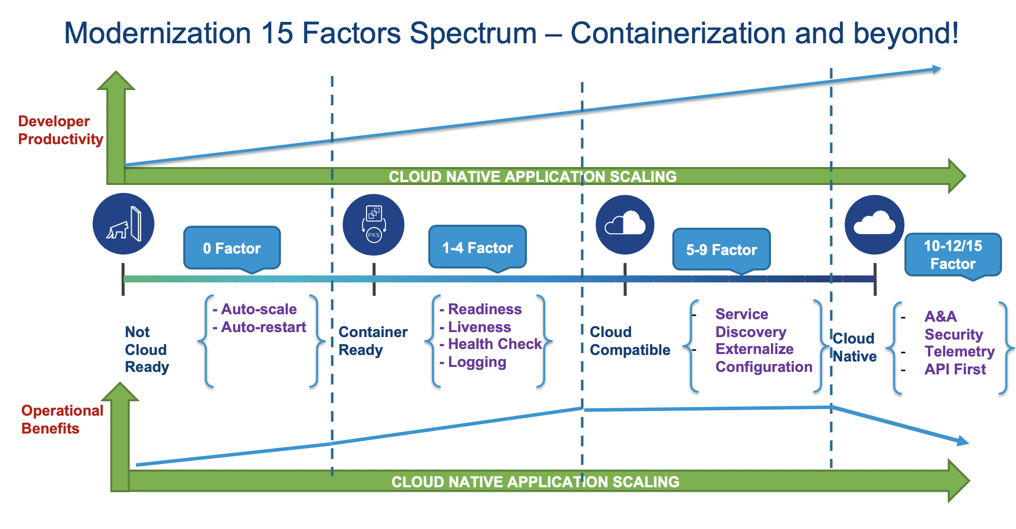
Development Architecture
15 Factors App
For Further Exploration –
12- Factor apps/15- Factor Apps of Modern Cloud Native application
Cloud native Fifteen Factor Apps - Nilesh Gule's Technical Blog

Slide 111
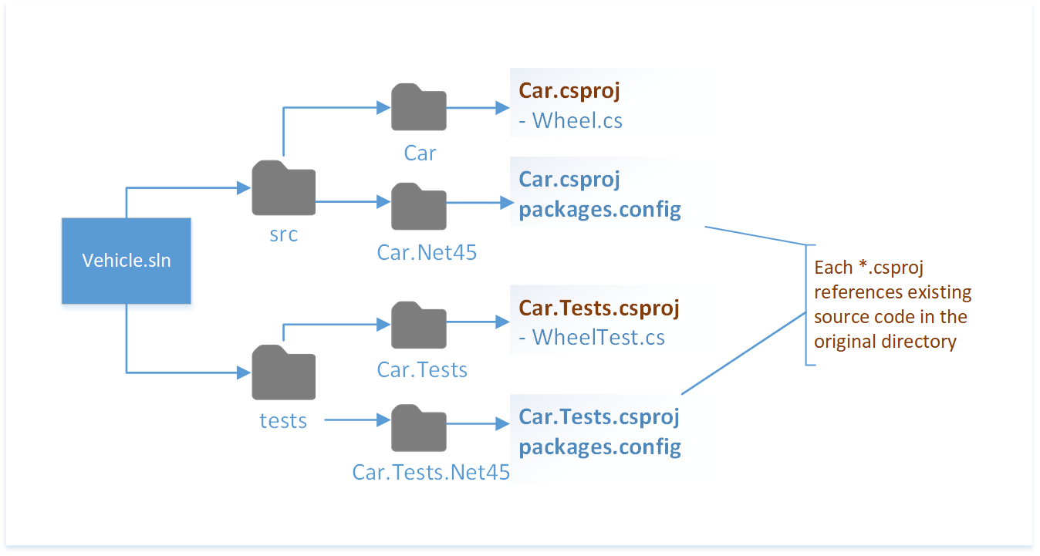
Development Architecture
Project Structure
For Further Exploration –
Organize projects for .NET Framework and .NET - .NET Core | Microsoft Learn

Slide 112
Development Architecture
Dependency Management Tools
Pip installs system and project-level Python packages.
Maven manages dependencies and the build process for Java projects.
Homebrew simplifies package installation for Mac and Linux operating systems.
Npm installs and tracks JavaScript dependencies.
NuGet manages dependencies for .NET projects.
Gradle manages dependencies and the build process for Java projects.
For Further Exploration –
How to Choose Between Package Managers: Maven, Gradle and More | Built In

Slide 113
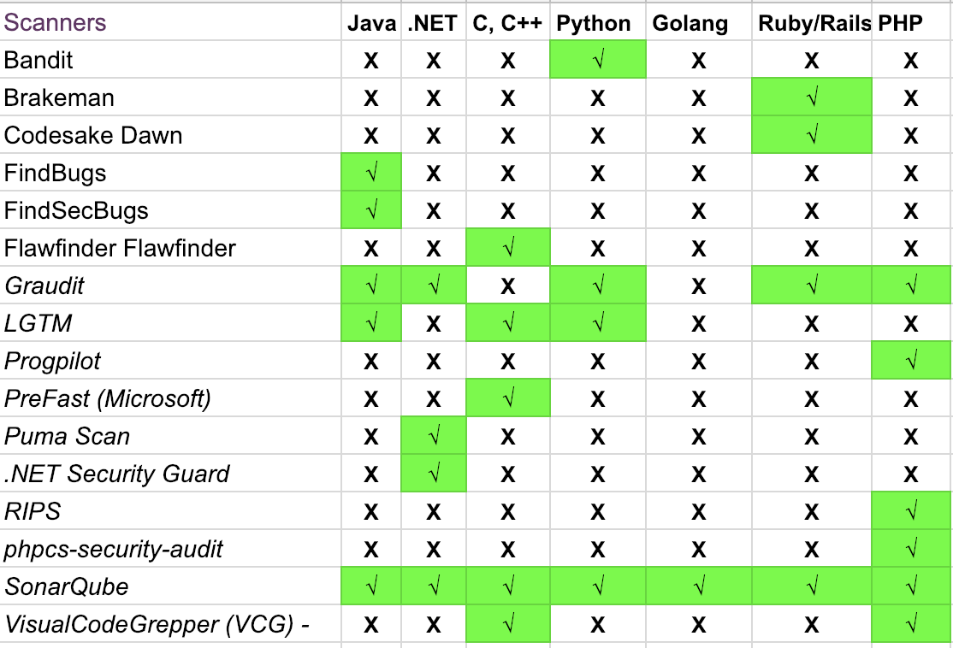
Development Architecture
Code Quality Tools

Slide 114
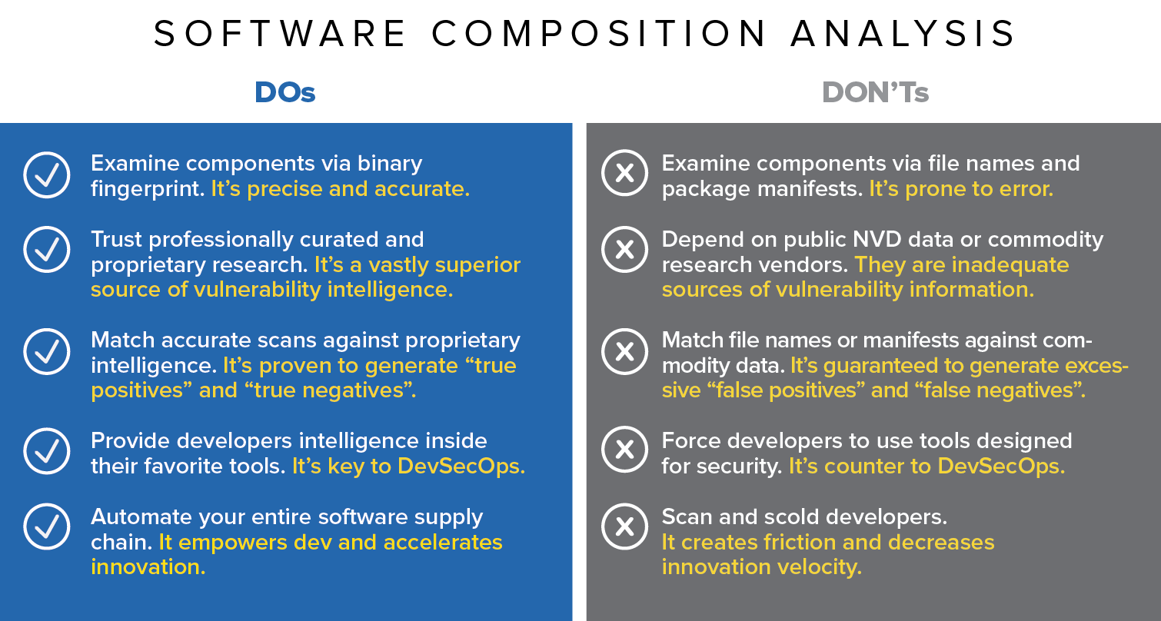
Development Architecture
SCA(Software Composition Analysis)
For Further Exploration -
What is Software Composition Analysis (SCA)? | Black Duck

Slide 115
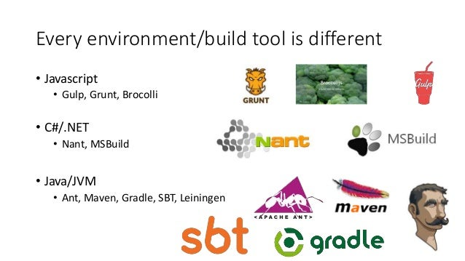
Development Architecture
Build Tools
For Further Exploration –
Top 10 Build Management Tools updated 2020 - DevOpsSchool.com
Use the MSBuild XML schema to control builds - MSBuild | Microsoft Learn

Slide 116
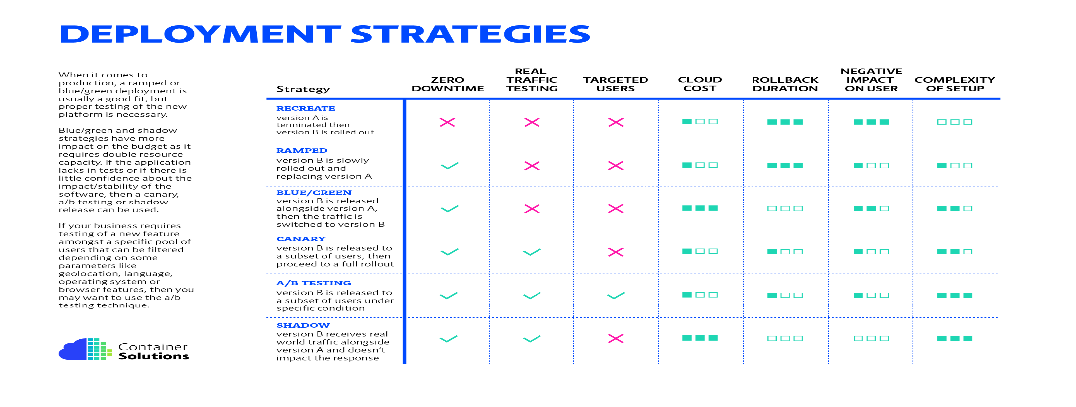
Development Architecture
K8s supports most of the deployment strategies above.
For Further Exploration -
Achieve Zero-Downtime Deployment: Strategies and Best Practices
Zero Downtime Deployment with a Database
Azure APIM ARM deployment and ongoing traffic - Microsoft Q&A

Slide 117
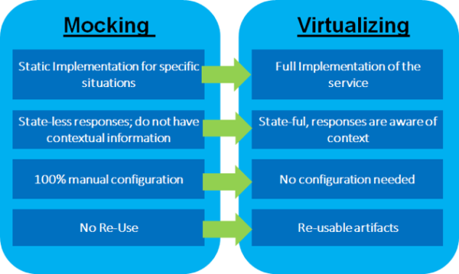
Development Architecture
Service Virtualization/ APIs Mocking -
For Further Exploration –
Service Virtualization. In the best of all possible worlds… | by Pradeep Kumar HK. | Medium
Configure and use a Postman mock server | Postman Learning Center

Slide 118
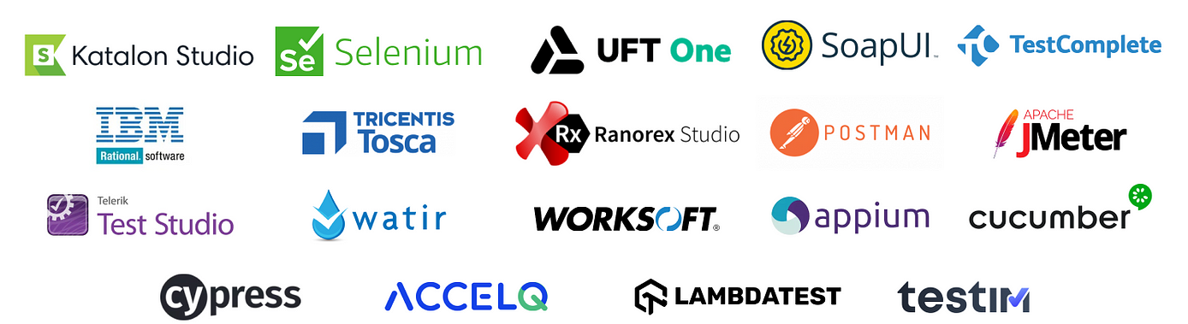
Development Architecture
Functional Testing -
The 3 most important things to address w.r.t any functional testing are Test Scenarios(what to test, less detailed & more broader), Test Cases(how to test, more detailed, less broader) & Test Data. Also Test cases are in general derived from Test Scenarios.
For Further Exploration-
Full Stack Testing: A Practical Guide for Delivering High Quality Software
DevOps Test Automation | Atlassian
Software Testing Strategies | Programming | eBook
Page Object Model and Page Factory in Selenium | BrowserStack
What are the common challenges and pitfalls of using Page Object Model and how do you overcome them?
Challenging the Page Object Model | by SebasViquez | Medium
How do you test APIs that use asynchronous communication?
Consumer-Driven Contract Testing (CDC) - Engineering Fundamentals Playbook
Playwright
Playwright-Python-and-Pytest-for-Web-Automation-Testing
Hands-On Test Management with Jira | Business & Other | eBook
Test Execution - Zephyr Standalone 6.1 & 6.2 – Confluence
Use scripts to add logic and tests to Postman requests | Postman Docs

Slide 119
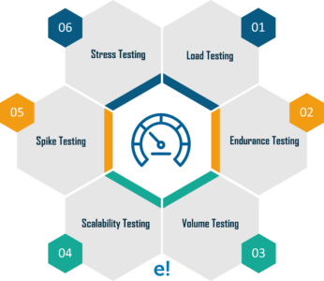
Development Architecture
Performance Testing -
For Further Exploration-
Why averages suck and percentiles are great
Load Testing
Measure performance in Visual Studio - Visual Studio (Windows) | Microsoft Learn
JMeter Tutorial: Getting Started with Jmeter
How you should be load testing your background services Asynchronous API Performance Testing with JMeter
BenchmarkDotNet: Powerful .NET library for benchmarking

Slide 120
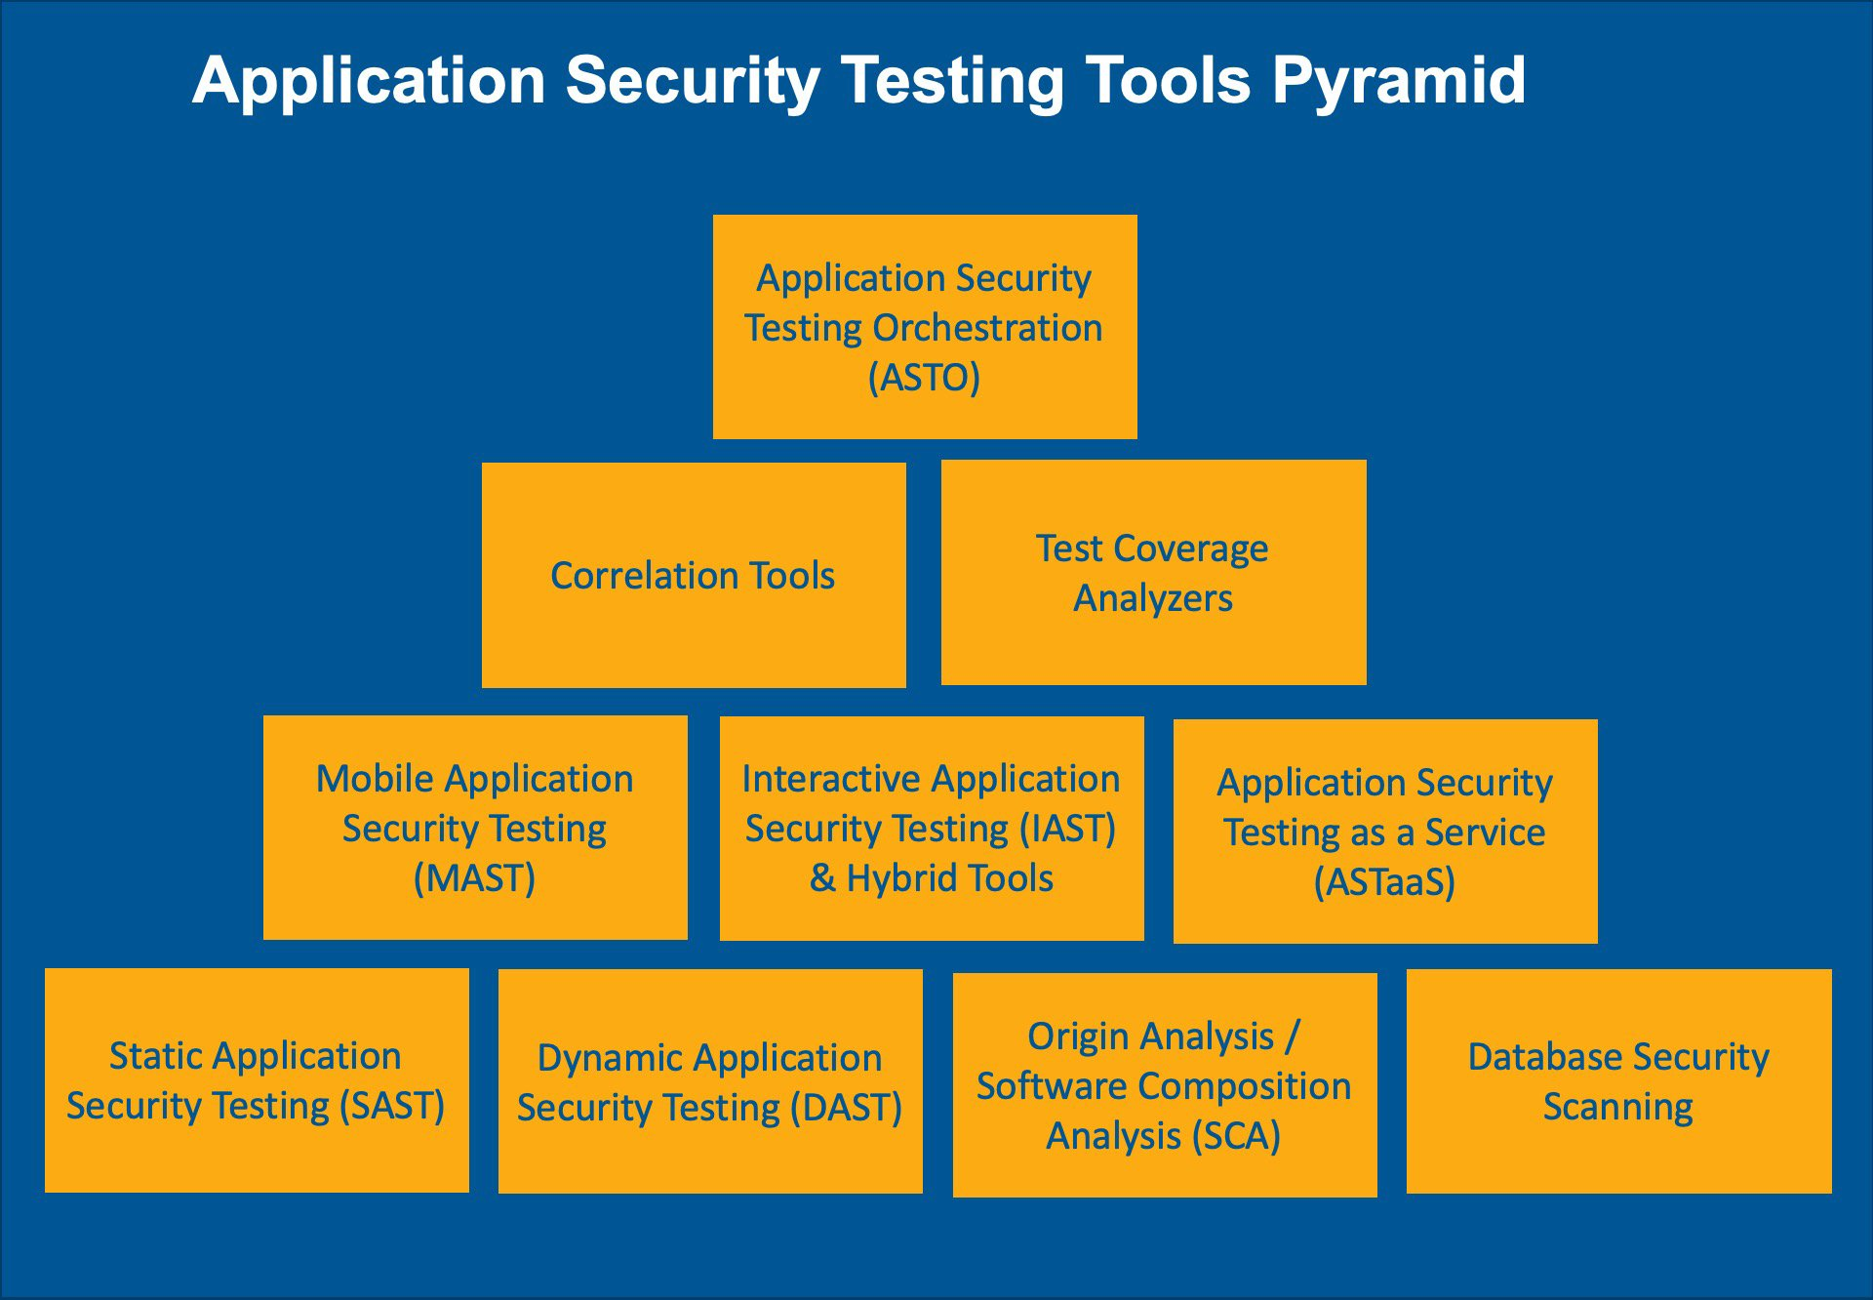
Development Architecture
Security Testing -
For Further Exploration -
Differences Between SAST, DAST, IAST, And RASP
10 Types of Application Security Testing Tools: When and How to Use Them
GitHub - iriusrisk/bdd-security: BDD Automated Security Tests for Web Applications
Security Scanning Tools: Enhancing Application Security

Slide 121
Development Architecture
Chaos Engineering –
Chaos Engineering is the use of experimental and potentially destructive failure testing into any part of the stack (compute, storage, network or application infrastructure) to uncover vulnerabilities and reduce uncertainty when building complex distributed systems.
At the most basic level, application chaos can be created by exposing some “/error”[fault injection] endpoint and giving access to the endpoint only to some specific service account/principal & then checking how the system behaves.
System Level real world chaos can be simulated by deleting resources or shutting down components & checking how the system behaves but that is very risky and should be done after following proper governance process around the same.
Chaos testing is very helpful to test Alerts(and relevant Runbooks pointed by the Alerts).Just like any other type of Testing, Chaos Testing can also be done manually or using unit/automation tests as well.

Slide 122
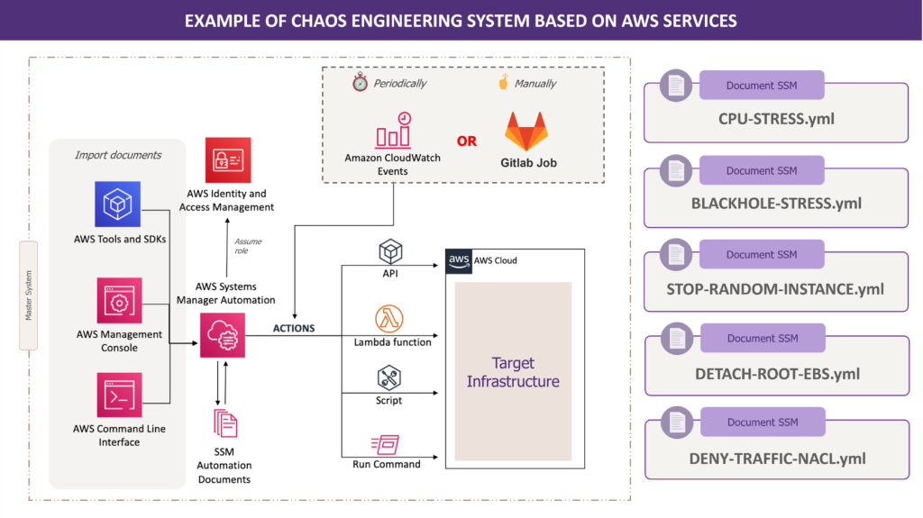
Development Architecture
Chaos Engineering –

Slide 123
Development Architecture
Chaos Engineering –
For Further Exploration –
Chaos Engineering: the history, principles, and practice
Building resiliency with chaos engineering | Thoughtworks Australia
The Chaos Engineering Maturity Model
Introducing Litmus 2.0 - Simplify Chaos Engineering - DEV Community
How to Test Your Fault Isolation Boundaries in the Cloud - InfoQ
Azure Chaos Studio - Chaos engineering experimentation | Microsoft Azure
Chaos Engineering using Azure Chaos Studio | Udemy
Kube-Monkey
Create an experiment using a Chaos Mesh fault with the Azure portal
Chaos Engineering with Chaos Toolkit | Udemy
Resilience and chaos engineering - .NET Blog(this resource is helpful mainly to chaos test the dependencies of a component e.g. some dependency API went down, while most of the other resources mentioned here are mainly to chaos test the component itself)
Start with chaos engineering in C# | by Jeroen Verhaeghe | Medium
UnmeshJoshi/Tickloom

Slide 124
Development Architecture
Technical Debt Management (Techniques)
Technical debt management involves a combination of preventative measures and remedial actions, such as establishing code quality standards, implementing automated testing and code reviews to prevent new debt, and creating a technical debt backlog to systematically address existing issues through refactoring and prioritization. A continuous approach is key, which includes allocating time for debt reduction within development sprints and fostering a culture of quality and continuous improvement among the team
Preventative techniques
Establish quality standards:
Define clear guidelines for code quality, architecture, and development practices to reduce the creation of new debt.
Implement code reviews:
Use peer reviews to catch and fix potential issues before they become technical debt.
Automate testing and integration:
Set up automated tests and continuous integration (CI) pipelines to catch bugs early and ensure new code doesn't introduce new debt.
Improve documentation:
Maintain up-to-date and accurate documentation to reduce knowledge gaps and facilitate maintenance and refactoring.
Regularly update systems:
Keep libraries and dependencies updated to prevent compatibility and security issues.
Conduct architecture reviews:
Periodically assess the system architecture to ensure it still meets business needs and is scalable.
Remedial techniques
Identify and prioritize:
Conduct audits to find technical debt and then create a register or backlog to track and prioritize issues based on their impact on performance, security, and maintainability.
Allocate time for repayment:
Integrate debt reduction into the development process, such as allocating a percentage of each sprint to tackle it.
Regular refactoring:
Make refactoring a regular habit to improve code quality and maintainability. This can involve "preparatory refactoring" where

Slide 125
Development Architecture
Technical Debt Management (Techniques)
you improve a section of code before adding new features.
Address high-impact issues first:
Prioritize fixing critical issues that cause performance failures or security flaws.
Cultural and process techniques
Foster a culture of continuous improvement:
Encourage a team-wide mindset of continuous learning and improvement, where quality is everyone's responsibility.
Educate and train the team:
Provide training on best practices and refactoring techniques to equip developers with the necessary skills.
Communicate with stakeholders:
Keep stakeholders informed about the state of technical debt and its impact on the project.
Integrate into workflows:
Incorporate debt management into daily routines and agile workflows, such as sprint planning and reviews.
For Further Exploration
Everything You NEED to Know About TECH DEBT
Types Of Technical Debt And How To Manage Them

Slide 126
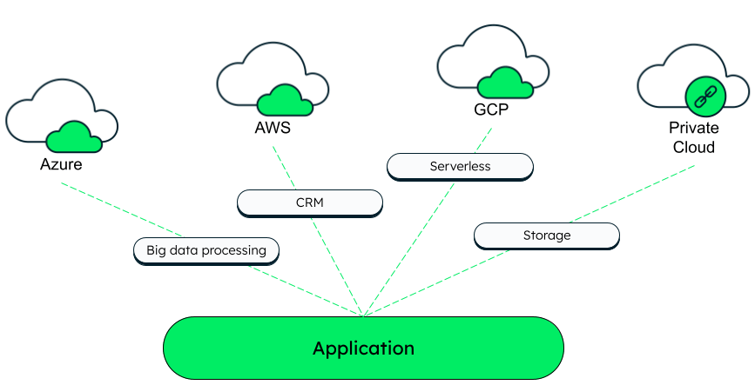
Cloud Computing
Cloud Computing –

Slide 127
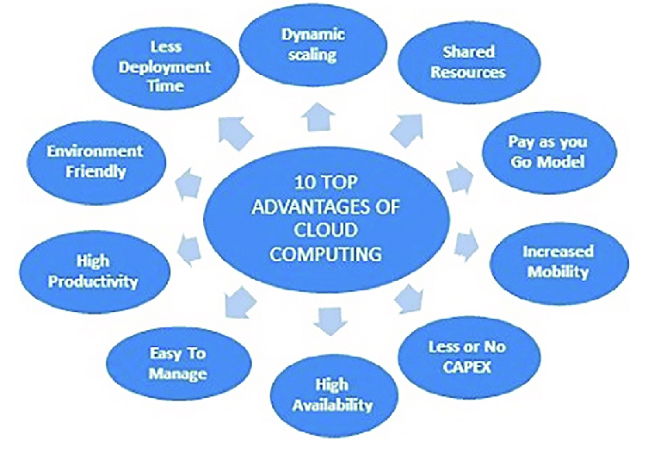
Cloud Computing
Cloud Computing(Benefits) –

Slide 128
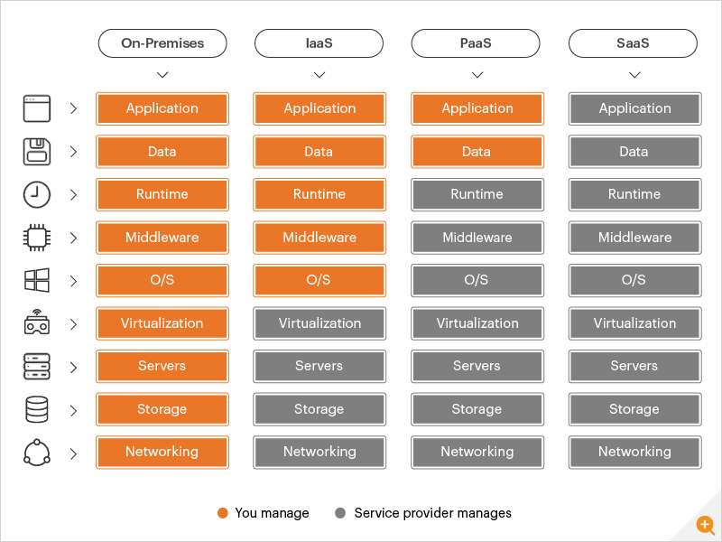
Cloud Computing
IaaS vs PaaS vs SaaS –

Slide 129

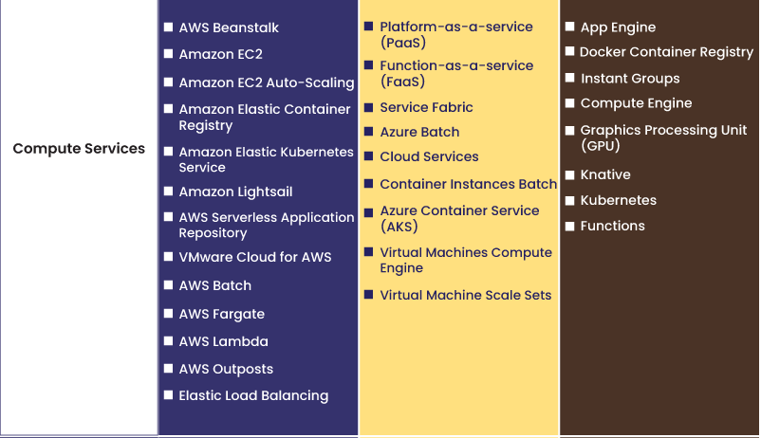
Cloud Computing
Compute -

Slide 130
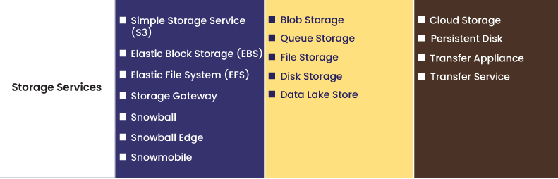
Cloud Computing
Storage -
For Further Exploration –
AWS Transfer Family Documentation
Ambry: Distributed object store

Slide 131
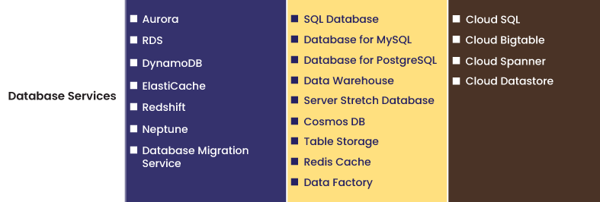
Cloud Computing
Database -

Slide 132

Cloud Computing
Serverless -
For Further Exploration –
Build ASP.NET Core APIs with Kubernetes and OpenFaaS | OpenFaaS - Serverless Functions Made Simple

Slide 133
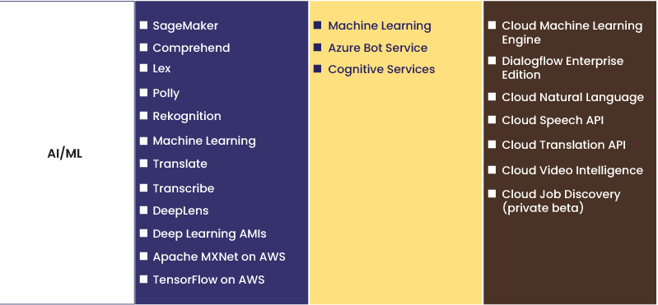
Cloud Computing
(Pre-Trained) AI Services -

Slide 134
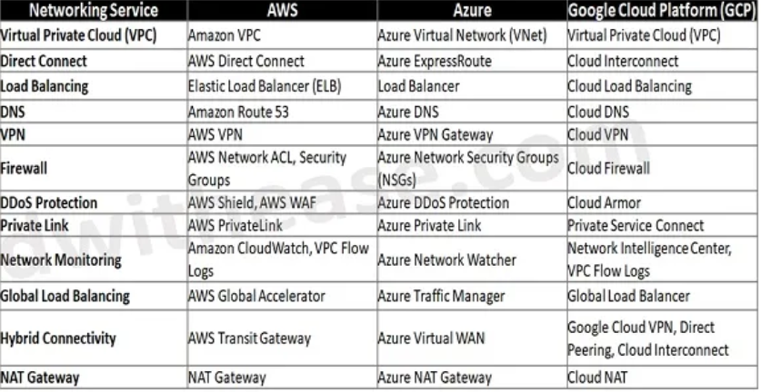
Cloud Computing
Networking –
Basics –
IP Address Format and Table – javatpoint
What is CIDR? - CIDR Blocks and Notation Explained – AWS
AWS Networking - AWS VPC, Subnets, Security Groups, NAT Gateway & IP Addresses

Slide 135

Cloud Computing
Networking –
AWS Network ACL & Security Groups –

Slide 136

Cloud Computing
Networking –
AWS Direct Connect & Transit Gateway -

Slide 137

Cloud Computing
Networking –
AWS PrivateLink -

Slide 138

Cloud Computing
Networking –
AWS VPC Peering -

Slide 139

Cloud Computing
Networking –
AWS Shield vs AWS WAF -

Slide 140

Cloud Computing
Networking –
AWS Shield(Standard vs Advanced) -

Slide 141

Cloud Computing
Governance via (High Level Structured) Resources –
For Further Exploration –
Organize your Azure resources effectively - Cloud Adoption Framework | Microsoft Learn

Slide 142

Cloud Computing
Governance via IAM –
For Further Exploration –
AWS, Azure and GCP: The Ultimate IAM Comparison - Blog | Tenable®
What is Privileged Identity Management?
Recommendations for identity and access management
Azure identity & access security best practices | Microsoft Learn

Slide 143

Cloud Computing
Governance via IAM –
N.B. -> The Principal can be a group(of users) or resource as well

Slide 144


Cloud Computing
Governance via IAM –

Slide 145

Cloud Computing
Governance via IAM –
A sample Policy Json

Slide 146

Cloud Computing
7 Rs -

Slide 147

Cloud Computing
Cloud Migration -
For Further Exploration –
CAF vs WAF: Key Differences in Cloud Adoption Strategies
App Modernization on Azure Succinctly

Slide 148

Cloud Computing
Cloud Native vs Cloud Agnostic –
For Further Exploration –
How to build cloud agnostic enterprise web applications | LinkedIn

Slide 149
Cloud Computing
Cloud Native vs Cloud Agnostic –
Features | Cloud Native | Cloud Agnostic
Portability | Difficult to move applications ported to different cloud providers. | Applications can be moved anywhere and never locked into a specific provider.
Performance | Components work on a small segment, increasing performance overall. | Wide range of features and options that customers can use to maximize performance.
Flexibility | Applications benefit from a cloud platform's built-in provisions for networking, monitoring, and other underlying architecture concerns that stymie large development efforts. | Developers are not restricted to one cloud platform's capabilities or tools and can incorporate open-source tools, libraries, and integrations.

Slide 150
Cloud Computing
Cloud Native vs Cloud Agnostic –
Features | Cloud Native | Cloud Agnostic
Resilience | Microservices enable resilience, meaning a component failure doesn’t affect the overall ecosystem. | Applications provide redundancy and improve recovery speed in the event of a failure; services can be switched to another platform if the initial platform experiences a disruption.
Costs | Customers are charged based on a combination of licensing and data storage requirements, following a pay-as-you-go model. | Cloud-agnostic architecture has greater accessibility to open-source tools, providing more direct control over costs and the ability to make spending adjustments as needed.
Implementation | Cloud native is a new paradigm that will require a cultural shift for successful implementation. | Cloud agnostic has to happen at the developer level, making implementation challenging.

Slide 151
Cloud Computing
Cloud Native vs Cloud Agnostic –
Features | Cloud Native | Cloud Agnostic
Time to Market | Pre-built templates, tools, and ready-to-use infrastructure speed up time to market for applications | The complexity of developing cloud-agnostic applications and features means that it can take longer for projects to get off the ground.
Scalability | Cloud-native systems are easy to scale up or down to meet business needs. | Cloud-agnostic apps and services can move across cloud platforms, which means they can quickly scale up to meet demand.

Slide 152
Cloud Computing
Cloud Security –
1️⃣ Cloud Security Mental Models (Foundation)
1. Shared Responsibility Model ⭐
Golden rule of cloud security
Layer Cloud Provider You
Physical DC ✅ ❌
Hardware ✅ ❌
Hypervisor ✅ ❌
OS (IaaS) ❌ ✅
Runtime, Data, IAM ❌ ✅
Intuition
Cloud ≠ secure by default.
Cloud = secure what you own.
Mistakes happen when teams secure what they don’t own and ignore what they do.
2. Cloud is API-Driven (Not Network-Driven)
Every attack eventually becomes:
API call → Permission → Resource mutation
So cloud security = IAM + API governance more than firewalls.
3. Assume Breach Model
Design assuming:
credentials will leak

Slide 153
Cloud Computing
Cloud Security –
2️⃣ Identity & Access Management (IAM) – The Core
Key Techniques
🔐 Least Privilege
Bad
{
"Action": "*",
"Resource": "*"
}
Good
Action: s3:GetObject
Resource: arn:aws:s3:::reports/*
Condition: IP / MFA / Time
🎭 Role-Based Access (RBAC)
Humans → roles
Services → roles
No long-lived keys
Pattern
Human → SSO → Temporary Role → Resource
Service → Identity → Role → Resource

Slide 154
Cloud Computing
Cloud Security –
2️⃣ Identity & Access Management (IAM) – The Core
⏳ Short-Lived Credentials
STS tokens
Managed identities
Workload identity federation
Why?
Stolen token expires → attack dies automatically
IAM Anti-Patterns ❌
Access keys in code
Shared admin accounts
Over-permissioned CI/CD roles
No MFA on privileged users
3️⃣ Network Security (Cloud-Native Way)
Cloud networking is software-defined.
Core Layers
Layer Purpose
VPC / VNet Isolation
Subnets Segmentation
Security Groups Stateful allow rules
NACLs Stateless coarse rules
Firewalls L7 control
Private Endpoints No public exposure

Slide 155
Cloud Computing
Cloud Security –
3️⃣ Network Security (Cloud-Native Way)
Key Patterns
🧱 Zero Trust Networking
Never trust network location
Private endpoints
Identity-based access
Mutual TLS
No flat networks
🔒 Default-Deny
Inbound: deny all
Outbound: restrict explicitly
🌐 Public Exposure Minimization
No public IP unless required
Use:
Load balancers
API gateways
Bastion hosts (temporary)
Cloud Network Anti-Patterns ❌
Everything in one subnet
Wide open 0.0.0.0/0
Public databases
SSH/RDP exposed to internet

Slide 156
Cloud Computing
Cloud Security –
4️⃣ Data Security (The Actual Asset)
Infrastructure is replaceable, data is not
Data States
State Protection
At Rest Encryption
In Transit TLS
In Use Isolation / TEEs
Core Techniques
🔑 Encryption
Cloud-managed keys (KMS)
Customer-managed keys (CMK)
Bring-your-own-key (BYOK)
Rule
Keys ≠ data ≠ access
🔐 Secrets Management
Never store:
passwords
tokens
certificates
In:
code
environment variables
git

Slide 157
Cloud Computing
Cloud Security –
4️⃣ Data Security (The Actual Asset)
🔐 Secrets Management
Use:
Secret Manager
Key Vault
Parameter Store
📊 Data Classification
Tag data:
Public
Internal
Confidential
Regulated (PII, PCI, HIPAA)
Then enforce controls automatically.
5️⃣ Application & Runtime Security
Cloud attacks mostly hit applications, not VMs.
Key Areas
🧩 Secure Software Supply Chain
Dependency scanning
SBOM
Image signing

Slide 158
Cloud Computing
Cloud Security –
5️⃣ Application & Runtime Security
Key Areas
🧩 Secure Software Supply Chain
Provenance checks
Most breaches start via compromised dependencies.
🐳 Container & Kubernetes Security
Minimal base images
No root containers
Pod Security Standards
Network policies
Admission controllers
Mental Model
Kubernetes security = IAM + network + runtime
🔍 Runtime Threat Detection
Behavioral analysis
Unexpected process execution
Crypto-mining detection
Privilege escalation detection

Slide 159
Cloud Computing
Cloud Security –
6️⃣ Cloud Security Posture Management (CSPM)
Prevent misconfiguration drift
What CSPM Does
Detect open buckets
Detect public DBs
Detect excessive permissions
Detect non-encrypted resources
Examples:
AWS Security Hub
Azure Defender
GCP Security Command Center
Shift-Left Pattern
Run CSPM:
during IaC PRs
during CI builds
before deployment

Slide 160
Cloud Computing
Cloud Security –
7️⃣ Infrastructure as Code (IaC) Security
Security becomes code, reviewable and testable
Techniques
Policy-as-Code (OPA, Sentinel)
IaC scanning (Terraform, ARM, CloudFormation)
Golden templates
Drift detection
Example Policy (Intuition)
“No resource can be public unless explicitly justified”
8️⃣ Logging, Monitoring & Detection
If you can’t see it, you can’t secure it
Critical Logs
Type Why
IAM logs Credential abuse
API audit logs Unauthorized changes
Network flow logs Lateral movement
Application logs Logic abuse
Detection Patterns
Impossible travel
Privilege escalation
Sudden policy changes
Data exfiltration spikes

Slide 161
Cloud Computing
Cloud Security –
9️⃣ Incident Response & Resilience
Assume failure.
Cloud-Native IR
Snapshot & isolate compromised resources
Revoke credentials instantly
Rotate keys automatically
Infrastructure redeploy instead of repair
Disaster Recovery Security
Encrypted backups
Separate accounts/subscriptions
Immutable storage
Cross-region replication
🔟 Governance, Risk & Compliance (GRC)
Security at scale requires automation + guardrails.
Governance Patterns
Multi-account strategy
Landing zones
Org-level policies
Central security account

Slide 162
Cloud Computing
Cloud Security –
🔟 Governance, Risk & Compliance (GRC)
Compliance ≠ Security
Compliance proves:
“We followed controls”
Security ensures:
“We survive attacks”
1️⃣1️⃣ Advanced Patterns (Senior / Architect Level)
🔐 Confidential Computing
Encrypted memory
Trusted execution environments
🔄 Just-In-Time Access
No standing admin
Temporary elevation
Approval workflows
🤖 Autonomous Remediation
Detect → fix → notify
Example: close open port automatically

Slide 163
Cloud Computing
Cloud Security –
1️⃣2️⃣ Common Cloud Breach Root Causes
Cause %
Misconfigured IAM 🔥🔥🔥
Exposed secrets 🔥🔥
Public storage 🔥🔥
Vulnerable apps 🔥
Insider mistakes 🔥
🧠 Final Cloud Security Mindset
Cloud security is not a product — it’s a system
If you remember only 5 rules:
IAM is everything
Default deny everywhere
Encrypt and rotate
Observe continuously
Automate remediation
For Further Exploration –
Cloud Security Comparison: AWS vs Azure vs GCP
AWS vs. Azure vs. Google Cloud: Security comparison
Cloud security comparison: AWS vs. Azure vs. GCP

Slide 164
Cloud Computing
Cloud E2E Transformation and Operations
🧭 Phase 1 — Build the Cloud Landing Zone
This phase establishes secure, scalable, compliant cloud foundations.
Core Capabilities
✅ Architecture & Accounts
Multi-account / multi-subscription strategy
Hub–spoke or landing-zone topology
Identity federation (SSO, IAM, RBAC)
Network segmentation (VPC/VNET, subnets)
✅ Security Baseline
Zero Trust principles
Encryption at rest & transit
Centralized secrets management
Security posture management (CSPM)
✅ Connectivity
VPN / ExpressRoute / DirectConnect
Hybrid DNS
On-prem ↔ cloud integration

Slide 165
Cloud Computing
Cloud E2E Transformation and Operations
🧭 Phase 1 — Build the Cloud Landing Zone
Core Capabilities
✅ Platform Services
Shared services (logging, monitoring)
Container platforms (Kubernetes)
Image registries
CI/CD tooling
Deliverables
Landing Zone Reference Architectures
Guardrails
Account Factory
Golden Images
Network & Security Blueprints

Slide 166
Cloud Computing
Cloud E2E Transformation and Operations
🚚 Phase 2 — Modernize & Migrate Applications
Here you move workloads and transform architectures.
Migration Strategies (Rs)
Strategy Meaning
Rehost Lift & shift
Replatform Minor optimizations
Refactor Cloud-native redesign
Rearchitect Major redesign
Retire Decommission
Retain Keep on-prem
Application Modernization
🔧 Infrastructure
VM → Containers
Monolith → Microservices
Static → Auto-scaling
🔧 Platform
Managed DBs
Message queues
Serverless functions

Slide 167
Cloud Computing
Cloud E2E Transformation and Operations
🚚 Phase 2 — Modernize & Migrate Applications
🔧 DevOps
CI/CD pipelines
IaC (Terraform/Bicep/CloudFormation)
Blue–green / canary deployments
Data Migration
Database replication
Data lake ingestion
ETL/ELT pipelines
Deliverables
Migration Factory
Wave plans
Application rationalization
Modernized architectures
Cutover playbooks

Slide 168
Cloud Computing
Cloud E2E Transformation and Operations
⚙️ Phase 3 — Manage & Run in Cloud (Day-2 Operations)
This is where production excellence lives.
🛠 Operations
Observability
Metrics
Logs
Traces
APM
Reliability
SRE practices
SLIs / SLOs
Chaos engineering
DR automation
Automation
Auto-healing
Patch management
Configuration drift detection

Slide 169
Cloud Computing
Cloud E2E Transformation and Operations
⚙️ Phase 3 — Manage & Run in Cloud (Day-2 Operations)
🔁 DevSecOps
Security scanning in pipelines
Policy as code
Secret rotation
Image vulnerability scanning
🧩 Platform Engineering
Internal developer portals
Golden paths
Self-service infrastructure
Deliverables
Runbooks
SRE dashboards
Incident response playbooks
Automated remediation

Slide 170
Cloud Computing
Cloud E2E Transformation and Operations
💰 Phase 4 — Governance + FinOps (Continuous Control Layer)
This layer spans ALL phases.
🛡 Governance
Policy
Naming standards
Resource tagging
Data residency
Compliance mapping (ISO, SOC2, HIPAA etc.)
Controls
Policy as Code
Budget thresholds
Resource quotas
💸 FinOps (Financial Operations)
Inform
Cost allocation
Chargeback / showback
Unit economics
Optimize

Slide 171
Cloud Computing
Cloud E2E Transformation and Operations
💰 Phase 4 — Governance + FinOps (Continuous Control Layer)
💸 FinOps (Financial Operations)
Rightsizing
Reserved instances / savings plans
Storage tiering
Idle resource cleanup
Operate
Budget alerts
Forecasting
Business KPIs
👥 Organizational Model
Cloud Center of Excellence (CCoE)
Product-aligned teams
FinOps practitioners
Security champions
Deliverables
Governance framework
Cost dashboards
Optimization backlog
Executive KPIs

Slide 172
Cloud Computing
Cloud E2E Transformation and Operations
💰 Phase 4 — Governance + FinOps (Continuous Control Layer)
🧱 Cross-Cutting Pillars (Apply Everywhere)
Security | Identity | Networking | Automation | Observability | Cost | Compliance
These exist horizontally across all phases.
🧠 Simple Mental Model
Build → Move → Improve → Operate → Optimize
or more formally:
Foundation
↓
Migration + Modernization
↓
Operations Excellence
↓
Governance + FinOps (always-on)

Slide 173
Cloud Computing
Cloud Landing Zone –
A cloud landing zone is a pre-configured, secure, and scalable environment within a cloud provider (like AWS, Azure, or Google Cloud) that serves as a foundation for deploying cloud resources and applications. It's a best-practice starting point that includes foundational elements like identity and access management, networking, security, and governance to ensure workloads can be deployed quickly, safely, and in a way that meets compliance requirements.
Key characteristics
Pre-configured environment: A landing zone is set up with specific configurations, making it a ready-to-use "base camp" for cloud projects.
Security and compliance: It's built with security and compliance policies in mind from the start, which helps avoid potential issues later on.
Scalability: A landing zone is designed to grow with your organization as you adopt more cloud-based services over time.
Multi-account structure: For environments like AWS, a landing zone often involves setting up multiple accounts to provide resource and security isolation, as explained in AWS Prescriptive Guidance.

Slide 174
Cloud Computing
Cloud Landing Zone –
Components of a landing zone
Identity and access management: Controls who can access what resources.
Networking: Designs the network architecture, including connectivity to on-premises environments and segmentation between different workloads.
Security: Implements security controls, logging, and threat detection.
Resource management and governance: Establishes a framework for managing resources, applying policies, and monitoring costs.
Logging and monitoring: Sets up systems for collecting and analyzing logs to ensure visibility and compliance.
For Further Exploration
Landing zone - AWS Prescriptive Guidance
What is an Azure landing zone
Landing zone design in Google Cloud

Slide 175

Cloud Computing
Private Cloud –
🧭 PART 1 — Grouped by Use Case
🏢 Enterprise Private Clouds
The focus is on scalability, security, compliance, and hybrid cloud integration.

Slide 176

Cloud Computing
Private Cloud –
🧭 PART 1 — Grouped by Use Case
🏭 Medium / SMB Private Clouds
Simpler, open-source, and cost-effective alternatives to enterprise suites.

Slide 177

Cloud Computing
Private Cloud –
🧭 PART 1 — Grouped by Use Case
☁️ Kubernetes / Developer-Focused Private Clouds
Ideal for cloud-native applications, DevOps, and microservices.

Slide 178

Cloud Computing
Private Cloud –
🧭 PART 1 — Grouped by Use Case
🌐 Hybrid & Multi-Cloud Private Environments
Used when organizations want unified control across multiple environments (on-prem + public cloud).

Slide 179

Cloud Computing
Private Cloud –
🧭 PART 1 — Grouped by Use Case
⚙️ Specialized / Edge Private Clouds
Lightweight private clouds for remote sites, IoT, or edge compute.

Slide 180

Cloud Computing
Private Cloud –
⚙️ PART 2 — Grouped by Architecture Layer
🧱 Layer 1 – Virtualization / Compute Layer

Slide 181

Cloud Computing
Private Cloud –
⚙️ PART 2 — Grouped by Architecture Layer
🌐 Layer 2 – Networking (SDN) Layer

Slide 182

Cloud Computing
Private Cloud –
⚙️ PART 2 — Grouped by Architecture Layer
💾 Layer 3 – Storage Layer (SDS)

Slide 183

Cloud Computing
Private Cloud –
⚙️ PART 2 — Grouped by Architecture Layer
🧩 Layer 4 – Orchestration / Automation Layer

Slide 184

Cloud Computing
Private Cloud –
⚙️ PART 2 — Grouped by Architecture Layer
🧠 Layer 5 – Management, Monitoring & Governance

Slide 185

Cloud Computing
Private Cloud –
⚙️ PART 2 — Grouped by Architecture Layer
🔐 Layer 6 – Security & Access

Slide 186
Cloud Computing
Private Cloud –
Summary Mapping
Use Case | Recommended Stack
Enterprise hybrid | VMware Cloud Foundation + NSX + vRealize + Tanzu
Open-source enterprise | Red Hat OpenStack + Ceph + Ansible + Prometheus
SMB / cost-efficient | Proxmox + Ceph + Terraform + Zabbix
Cloud-native / DevOps | OpenShift / Rancher + Longhorn + Vault
Edge / lightweight | K3s + OpenNebula Edge + Prometheus Lite
Multi-cloud orchestration | Anthos / Azure Arc / HashiCorp Suite

Slide 187
Cloud Computing
Enterprise Private Cloud –
1️⃣ What “Enterprise-Grade Private Cloud” REALLY Means
A private cloud is not just “VMware + some VMs”.
Enterprise-grade means:
Dimension Requirement
Multi-tenancy Business units isolated but share infra
Self-service Developers provision without tickets
Elasticity Scale on demand
Security Zero-trust, compliance, audit
Reliability HA, DR, fault tolerance
Governance Cost, policy, approvals
Automation No manual server work
Observability Logs, metrics, traces
Lifecycle mgmt Patch, upgrade, decommission
2️⃣ Reference Architecture (Bird’s-Eye View)
┌────────────────────────────────────────────┐
│ Enterprise Portal │
│ (Self-service, approvals, cost visibility) │
└────────────────────────────────────────────┘
↓

Slide 188
Cloud Computing
Enterprise Private Cloud –
2️⃣ Reference Architecture (Bird’s-Eye View)
↓
┌────────────────────────────────────────────┐
│ Cloud Management Platform (CMP) │
│ (VMware Aria / OpenStack Horizon / Morpheus│
│ / ServiceNow + Terraform) │
└────────────────────────────────────────────┘
↓
┌────────────────────────────────────────────┐
│ Control Plane (K8s + Virtualization) │
│ - Kubernetes (AKS-HCI / OpenShift / TKG) │
│ - VM Platform (vSphere / KVM) │
└────────────────────────────────────────────┘
↓
┌────────────────────────────────────────────┐
│ Software-Defined Infrastructure (SDI) │
│ - Compute (Bare metal) │
│ - Storage (Ceph / vSAN) │
│ - Network (NSX / Calico / OVN) │
└───────────────────────────────────────

Slide 189
Cloud Computing
Enterprise Private Cloud –
2️⃣ Reference Architecture (Bird’s-Eye View)
↓
┌────────────────────────────────────────────┐
│ Physical Datacenter │
│ - Racks, Power, Cooling, Network │
└────────────────────────────────────────────┘
3️⃣ Step-by-Step E2E Implementation (Real Example)
Let’s assume a bank building its own private cloud.
STEP 1: Physical Infrastructure Layer
Hardware
Compute: Dell PowerEdge / HPE ProLiant
CPU: Dual Xeon / EPYC
RAM: 512 GB per node
NICs: Dual 25/40 Gbps
Disk: NVMe + SSD
Network
Leaf-Spine topology
Redundant TOR switches
Separate VLANs:
Management
Storage

Slide 190
Cloud Computing
Enterprise Private Cloud –
3️⃣ Step-by-Step E2E Implementation (Real Example)
STEP 1: Physical Infrastructure Layer
Network
Separate VLANs:
Tenant traffic
Backup
OOB (IPMI)
STEP 2: Software-Defined Infrastructure (SDI)
Compute Virtualization
Choose one:
VMware vSphere (most enterprises)
KVM (OpenStack)
Hyper-V (Windows heavy shops)
Example:
Bare metal → ESXi → Resource Pools
Storage (Enterprise Pattern)
Ceph or vSAN
Replication factor = 3
Encryption at rest
Snapshots + clones

Slide 191
Cloud Computing
Enterprise Private Cloud –
3️⃣ Step-by-Step E2E Implementation (Real Example)
STEP 2: Software-Defined Infrastructure (SDI)
Networking
SDN (VMware NSX / OVN)
Features:
Micro-segmentation
East-West firewalling
Load balancing
NAT & VPN
STEP 4: Identity, Access & Zero Trust
Identity
Azure AD / LDAP / AD
SSO everywhere
RBAC Model
Org
├── BU
│ ├── Project
│ │ ├── Namespace

Slide 192
Cloud Computing
Enterprise Private Cloud –
3️⃣ Step-by-Step E2E Implementation (Real Example)
STEP 4: Identity, Access & Zero Trust
Zero Trust
No flat network
mTLS
Service identity (SPIFFE)
Just-in-time access
STEP 5: Cloud Management Platform (CMP)
This is what makes it feel like AWS.
Capabilities
Self-service catalog
Approval workflows
Cost tracking
Quotas
Policy enforcement
Tools
VMware Aria
OpenStack Horizon
Morpheus
ServiceNow + Terraform

Slide 193
Cloud Computing
Enterprise Private Cloud –
3️⃣ Step-by-Step E2E Implementation (Real Example)
STEP 5: Cloud Management Platform (CMP)
Example Catalog Items
“Create Kubernetes Namespace”
“Provision VM (Standard)”
“Create PostgreSQL DB”
“Deploy App Template”
STEP 6: Infrastructure as Code (IaC)
Terraform
module "k8s_namespace" {
name = "payments-prod"
quota = "high"
}
GitOps (Critical)
ArgoCD / Flux
Git = source of truth
No manual kubectl in prod

Slide 194
Cloud Computing
Enterprise Private Cloud –
3️⃣ Step-by-Step E2E Implementation (Real Example)
STEP 7: Platform Services Layer (PaaS)
What Enterprises Provide
Service Tool
DB PostgreSQL Operator
Cache Redis Operator
Messaging Kafka
API Gateway Kong / Apigee
Secrets Vault
Certs cert-manager
CI/CD GitLab / Azure DevOps
STEP 8: Security (Enterprise-Grade)
Defense-in-Depth
WAF
Runtime security (Falco)
Image scanning (Trivy)
Admission controllers
DLP
Compliance
CIS benchmarks
PCI-DSS / HIPAA
Audit logs immutable

Slide 195
Cloud Computing
Enterprise Private Cloud –
3️⃣ Step-by-Step E2E Implementation (Real Example)
STEP 9: Observability & Operations
Metrics
Prometheus
SLO-based alerts
Logs
FluentBit → OpenSearch
Traces
OpenTelemetry
Example SLO
99.95% availability
p95 latency < 200ms
STEP 10: DR & Business Continuity
Design
Multi-AZ inside DC
Secondary DC
Active-Passive or Active-Active
Tools
Velero (K8s backups)
Storage replication
DNS failover

Slide 196
Cloud Computing
Enterprise Private Cloud –
4️⃣ Example Application E2E Flow
Developer Journey
Login to portal
Request “Payment App Namespace”
Auto-approval via policy
Namespace created
CI pipeline deploys app
Secrets auto-injected
Traffic routed via ingress
Logs + metrics visible
Cost allocated to BU
5️⃣ How This Differs from Public Cloud
Private Cloud Public Cloud
CapEx heavy OpEx
Full control Shared responsibility
Compliance friendly Faster innovation
Slower scale Infinite scale

Slide 197
Cloud Computing
Enterprise Private Cloud –
6️⃣ Enterprise Anti-Patterns (Avoid These)
❌ VM sprawl
❌ Ticket-based provisioning
❌ No GitOps
❌ Flat networks
❌ Manual security
❌ “Kubernetes without platform services”
7️⃣ When Private Cloud Makes Sense
✅ Banking
✅ Defense
✅ Healthcare
✅ Low-latency trading
✅ Data sovereignty
✅ Predictable workloads

Slide 198
Cloud Computing
Enterprise Private Cloud(Openstack +K8s Example) –
1. Target Outcomes (Design Goals)
This design must deliver:
AWS-like self-service
Strong tenant isolation
Kubernetes-first platform
Zero-trust security
HA + DR
GitOps + IaC
Regulatory compliance
Predictable performance
Together they replicate AWS-like layers:
AWS Private Cloud
EC2 Nova
EBS Cinder
S3 Swift / Ceph RGW
VPC Neutron
EKS Kubernetes on OpenStack
IAM Keystone + RBAC

Slide 199
Cloud Computing
Enterprise Private Cloud(Openstack +K8s Example) –
2. High-Level Architecture
┌─────────────────────────────────────────────────────┐
│ Enterprise Service Portal │
│ (Horizon / ServiceNow / Custom UI) │
└─────────────────────────────────────────────────────┘
↓
┌─────────────────────────────────────────────────────┐
│ Cloud Management & Automation │
│ (OpenStack APIs + Terraform + GitOps) │
└─────────────────────────────────────────────────────┘
↓
┌───────────────────────────────────────────────┐
│ OpenStack Control Plane (HA) │
│ Keystone | Nova | Neutron | Cinder | Glance │
│ Heat | Barbican | Placement │
└───────────────────────────────────────────────┘
↓

Slide 200
Cloud Computing
Enterprise Private Cloud(Openstack +K8s Example) –
2. High-Level Architecture
↓
┌───────────────────────────────────────────────┐
│ Kubernetes Platform (HA) │
│ K8s Control Plane + Worker Nodes │
│ Ingress | CNI | CSI | Operators │
└───────────────────────────────────────────────┘
↓
┌─────────────────────────────────────────────────────┐
│ Software-Defined Infrastructure (SDI) │
│ Compute | Network (OVN) | Storage (Ceph) │
└─────────────────────────────────────────────────────┘
↓
┌─────────────────────────────────────────────────────┐
│ Physical Datacenter │
│ Bare Metal | Switches | Power | Cooling │
└─────────────────────────────────────────────────────┘

Slide 201
Cloud Computing
Enterprise Private Cloud(Openstack +K8s Example) –
3. Physical & Network Foundation (Critical)
Hardware
Role Nodes
Controllers 3 (HA)
Compute N
Storage 3–7
K8s Workers Shared with Compute
Datacenter Network (Non-Negotiable)
Leaf-Spine topology
25/40/100 Gbps
BGP EVPN
Mandatory Networks
Network Purpose
OOB IPMI / BMC
Management OpenStack control
Storage Ceph replication
Tenant VM / Pod traffic
External North-South

Slide 202
Cloud Computing
Enterprise Private Cloud(Openstack +K8s Example) –
4. OpenStack Design (Infrastructure Cloud)
4.1 OpenStack Core Services
Service Role
Keystone Identity
Nova Compute
Neutron (OVN) Networking
Cinder Block storage
Glance Images
Heat Orchestration
Horizon Self-service UI
Enterprise Add-Ons
Service Why
Heat Infra templates
Barbican Secrets
Designate DNS
Octavia L7 LB
Placement Scheduling

Slide 203
Cloud Computing
Enterprise Private Cloud(Openstack +K8s Example) –
4. OpenStack Design (Infrastructure Cloud)
4.2 OpenStack HA Layout
3x Controller Nodes
- Keystone
- Neutron
- Nova API
- HAProxy + Keepalived
N Compute Nodes
- Nova Compute
OVN agents
4.2 OpenStack HA Layout
Ceph Cluster
- 3/5 MON
- OSDs on compute or dedicated

Slide 204
Cloud Computing
Enterprise Private Cloud(Openstack +K8s Example) –
4. OpenStack Design (Infrastructure Cloud)
4.3 Multi-Tenancy Model
OpenStack Domain
├── Project (Tenant)
│ ├── Networks
│ ├── Subnets
│ ├── Security Groups
│ └── VMs
Network isolation via OVN
Quotas enforced per project
RBAC integrated with LDAP / AD
5. Kubernetes on OpenStack (Cloud-Native Layer)
5.1 Cluster Provisioning Pattern
DO NOT manually create clusters.
Use:
Cluster API (CAPI)
Magnum (optional, legacy)
Rancher / OpenShift
Control Flow
Git → Cluster API → OpenStack APIs → VMs → K8s cluster

Slide 205
Cloud Computing
Enterprise Private Cloud(Openstack +K8s Example) –
5. Kubernetes on OpenStack (Cloud-Native Layer)
5.2 Kubernetes Cluster Architecture
OpenStack Project
├── K8s Control Plane VMs (3)
├── K8s Worker VMs (Auto-scaled)
├── Load Balancer (Octavia)
└── Floating IP
Components
etcd (HA)
kube-apiserver
kube-scheduler
kube-controller-manager

Slide 206
Cloud Computing
Enterprise Private Cloud(Openstack +K8s Example) –
5. Kubernetes on OpenStack (Cloud-Native Layer)
5.3 Kubernetes Networking
Option A (Most Common)
Neutron + OVN
Calico (policy only)
CNI routed via Neutron
Option B (Advanced)
Kuryr-Kubernetes (Pods = Neutron ports)
True OpenStack-native networking
6. Storage Integration (Ceph provides backbone)
Ceph provides block, object, and file storage.
Ceph Service Used By
RBD OpenStack Cinder
RGW Swift / S3
CephFS Shared volumes
CSI Kubernetes PVCs
Enterprise Features
Replication factor = 3
Encryption at rest
Snapshot + clone
Multi-pool isolation

Slide 207
Cloud Computing
Enterprise Private Cloud(Openstack +K8s Example) –
6. Storage Integration (Ceph provides backbone)
OpenStack
Cinder → Ceph RBD
Glance → Ceph
Nova ephemeral → Ceph
Kubernetes
CSI RBD
CSI CephFS
Storage Classes
gold → NVMe, 3 replicas
silver → SSD, 2 replicas
bronze → HDD, erasure coded
7. Platform Services on Kubernetes (PaaS Layer)
Capability Tool
Ingress NGINX / HAProxy
API Gateway Kong
Secrets Vault
Certs cert-manager
DB PostgreSQL Operator
Messaging Kafka
CI/CD GitLab
Service Mesh Istio / Linkerd

Slide 208
Cloud Computing
Enterprise Private Cloud(Openstack +K8s Example) –
8. Identity, Security & Zero Trust
Identity Flow
User → SSO (AD/LDAP)
→ Keystone
→ Kubernetes RBAC
Tenant Model
OpenStack Project
└── Kubernetes Cluster
└── Namespace
Security
OIDC for K8s
Namespace isolation
Network Policies enforced
8.2 Network Security
Neutron security groups
Kubernetes NetworkPolicies
mTLS between services
No flat networks
8.3 Runtime Security
Image scanning (Trivy)
Admission control (OPA Gatekeeper)
Runtime detection (Falco)
Immutable nodes

Slide 209
Cloud Computing
Enterprise Private Cloud(Openstack +K8s Example) –
9. Automation & GitOps (Mandatory)
Promotion via PRs
9.1 IaC Stack
Layer Tool
Bare metal Ironic
OpenStack Terraform
K8s clusters Cluster API
Apps Helm
Sync ArgoCD
9.2 Repo Structure
infra/
├── openstack/
├── ceph/
├── clusters/
│ ├── prod/
│ └── dev/
└── policies/
apps/
├── payments/
├── auth/

Slide 210
Cloud Computing
Enterprise Private Cloud(Openstack +K8s Example) –
10. Observability & Operations
Metrics
Prometheus
Thanos (long-term)
Logs
FluentBit → OpenSearch
Traces
OpenTelemetry
Alerts
SLO-based, not host-based
SLOs
Error budgets
Chaos testing
11. DR & Failure Scenarios
Failure Handling
Controller down HAProxy failover
Compute node lost VM rescheduled
Pod crash K8s restart
AZ failure Multi-AZ clusters
DC loss Secondary OpenStack

Slide 211
Cloud Computing
Enterprise Private Cloud(Openstack +K8s Example) –
12. Security Architecture
Defense-in-Depth
Neutron security groups
K8s Network Policies
Image scanning
Runtime security (Falco)
Admission controllers
Compliance
CIS OpenStack Benchmarks
CIS Kubernetes
Immutable audit logs
13. Developer E2E Flow
Login to Horizon
Create project
Request K8s cluster
Cluster auto-provisioned
Git repo created
CI deploys app
Traffic routed
Metrics visible
Cost tracked

Slide 212
Cloud Computing
Enterprise Private Cloud(Openstack +K8s Example) –
13. Common Enterprise Mistakes
❌ Kubernetes without Ceph
❌ No Cluster API
❌ Manual provisioning/ Manual cluster creation
❌ Treating OpenStack as VMware
❌ No GitOps
❌ Weak/Flat networking
❌ No platform services
❌ Ignoring developer experience
❌ Ignoring developer experience
14. When This Architecture Wins
✅ Regulated industries
✅ On-prem compliance
✅ Data sovereignty
✅ Predictable workloads
✅ Hybrid cloud future

Slide 213
Cloud Computing
Enterprise Private Cloud(Openstack +K8s Example) –
15. When This Design is Used
✅ Banks
✅ Telecoms
✅ Govt / Defense
✅ Large SaaS (data sovereignty)
✅ AI / HPC
For Further Exploration –
Private Cloud Computing
OpenStack Docs: 2025.2
Apache CloudStack’s Documentation
Azure Stack documentation
openQRM Data Centre Solution Deployment Software Provider

Slide 214
Cloud Computing
Hybrid Cloud –
The common reasons for setting up a hybrid cloud may include the following:
- You need to keep part of the application on-premise due
to compliance requirements.
- You want to have operating legacy applications in an on-premise environment
while you refactor and deploy in the cloud with a blue-green deployment
model.
- A legacy application such as a mainframe may not have a compatible cloud
option and has to continue running on premise. You need time to refactor the
tech stack.
- To speed up migration, keep the database on-premise and move the application
server to the cloud.
- The customer wants to have more granular control of part of the application.
For Further Exploration –
Achieving Digital Transformation Using Hybrid Cloud | Cloud & Networking | Print
Hybrid-Cloud-Security-Patterns

Slide 215
Cloud Computing
Multi-Cloud –
The common reasons of setting up a multi cloud may include the following:
- Best of the breed technical capabilities handling amongst the cloud providers
- Avoid Vendor Lock-in
- Geographical Availability
- Cost
NFRs Handling in Multi and Hybrid Cloud Environments
General Techniques Across NFRs
Establish a Robust Governance Model: Define clear policies for resource allocation, data management, access control, and security that apply consistently across all on-premises and cloud environments.
Adopt a Unified Security Framework: Implement consistent security policies, identity and access management (IAM) systems (e.g., Single Sign-On, MFA), and a Zero-Trust security model across all platforms.
Automate Processes: Leverage automation for security checks, compliance monitoring, provisioning, and policy enforcement using tools like Infrastructure as Code (IaC) templates.

Slide 216
Cloud Computing
NFRs Handling in Multi and Hybrid Cloud Environments
General Techniques Across NFRs
Invest in Cloud Management Tools: Use a centralized platform (e.g., SIEM or CSPM solutions) that provides a "single pane of glass" for visibility, monitoring, and management across different cloud providers.
Design for Interoperability: Use standardized APIs, containers (like Kubernetes), and orchestration platforms to ensure seamless data flow and application portability across clouds.
Key Techniques for NFRs Compliance
Security and Compliance
Unified Security Framework: Establish a consistent security posture across all platforms, including on-premises, private cloud, and multiple public clouds.
Centralized IAM: Implement a unified identity and access management (IAM) system (like Azure AD or AWS IAM) that uses role-based access control (RBAC) and multi-factor authentication (MFA) across all environments.
Adopt a Zero-Trust Model: Assume no user or service is trusted by default, regardless of its location (inside or outside the network), and continuously verify identities and access.
Consistent Encryption: Enforce strong, industry-grade encryption for all data, both at rest and in transit, with a consistent key management policy across all clouds.
Automated Compliance Monitoring: Leverage automated tools (like AWS Config or Azure Policy) to continuously monitor configurations, detect non-compliance issues in real-time, and automate remediation actions.
Regular Audits and Testing: Conduct frequent security audits, vulnerability assessments, and penetration testing to identify and mitigate risks proactively.

Slide 217
Cloud Computing
NFRs Handling in Multi and Hybrid Cloud Environments
Key Techniques for NFRs Compliance
Performance and Scalability
Vendor-Agnostic Design: Use open-source tools and platforms, containerization (Docker, Kubernetes), and abstract cloud-specific functionalities to minimize vendor lock-in and allow flexibility in workload placement.
Horizontal Scaling Architecture: Design applications for horizontal scaling by using microservices and stateless components, allowing the system to scale out (add more instances) on demand across different cloud environments.
Global Load Balancing: Implement global load balancing to efficiently distribute traffic and user requests across multiple regions or cloud providers based on performance or proximity, reducing latency and ensuring high availability.
Data Management and Synchronization: Use distributed databases and real-time data replication/synchronization between clouds to ensure data consistency and availability, crucial for performance in data-intensive applications.
Caching and CDNs: Utilize caching strategies (e.g., Redis, Memcached) and Content Delivery Networks (CDNs) to store frequently accessed data closer to end-users, reducing latency and backend load.
Reliability and Availability
Automated Failover: Deploy applications across multiple cloud providers and implement automated failover mechanisms to switch traffic to a healthy environment in case of an outage in one region or provider.
Robust Incident Response Plan: Develop a single, comprehensive incident response strategy that outlines procedures for detecting, containing, and recovering from incidents across all cloud environments.

Slide 218
Cloud Computing
NFRs Handling in Multi and Hybrid Cloud Environments
Key Techniques for NFRs Compliance
Reliability and Availability
Data Backup and Disaster Recovery (DR): Establish consistent backup and DR plans, replicating critical data and applications across different clouds or to an on-premises data center to ensure business continuity and minimal downtime.
Manageability and Cost Optimization
Centralized Management and Observability: Use multi-cloud management platforms (CMPs) or SIEM tools to gain a unified view and centralized control over resource management, monitoring, and logging across all environments.
Infrastructure as Code (IaC): Use IaC tools (e.g., Terraform) to automate the provisioning and management of resources, ensuring consistency, repeatability, and error reduction across disparate environments.
Cost Management and Optimization Tools: Implement cloud cost management tools to monitor spending, analyze usage, and use cost-saving mechanisms (like spot instances or reserved instances) across all platforms.
Defined SLAs and KPIs: Clearly define Service Level Agreements (SLAs) and Key Performance Indicators (KPIs) for applications running in hybrid/multi-cloud setups to measure performance and ensure accountability.

Slide 219
Cloud Computing
NFRs Handling in Multi and Hybrid Cloud Environments
For Further Exploration –
7 Multi-Cloud Architecture Designs for Effective Cloud Strategy
Multi-Cloud Management: Tools, Challenges and Best Practices
Hybrid and multicloud architecture patterns
Multi-Cloud-Handbook-for-Developers
Multi-Cloud-Strategy-for-Cloud-Architects
Enterprise-Grade Hybrid and Multi-Cloud Strategies
Principles and Patterns for Distributed Application Architecture

Slide 220
Cloud Computing
Data Centre
🏢 1. Data Centre Fundamentals
🔹 Definition
A data centre is a physical or virtual infrastructure used by organizations to house computer systems and associated components such as telecommunications and storage systems.
🔹 Core Goals
Availability (uptime, redundancy)
Scalability (handle growth easily)
Security (physical + cyber)
Efficiency (power, cooling, automation)
Resilience (disaster recovery, failover)
⚙️ 2. Physical Infrastructure Technologies
🧱 a. Facility Components
Racks & Cabinets: House servers and networking devices.
Raised Floors: Enable air circulation and cable routing.
Power Systems: UPS, PDUs, generators.
Cooling Systems: CRAC units, liquid cooling, hot/cold aisle containment.
Fire Suppression Systems: Gas-based or water mist systems.
Security Systems: Biometric access, CCTV, and mantraps.
🧊 b. Power & Cooling Techniques
PUE (Power Usage Effectiveness): Efficiency metric.
Free Cooling: Using ambient air or water.
Liquid Immersion Cooling: Direct liquid submersion of components.
DCIM (Data Centre Infrastructure Management): Tools to monitor temperature, power, and resources.

Slide 221
Cloud Computing
Data Centre
🖥️ 3. Compute Technologies
🔹 Server Architectures
Blade Servers: Modular servers for dense compute.
Rack Servers: Standardized form factor (1U, 2U, etc.).
Hyperconverged Infrastructure (HCI): Combines compute, storage, and networking in software-defined systems.
🔹 Virtualization & Containers
Server Virtualization: VMware vSphere, Hyper-V, KVM.
Containerization: Docker, Podman.
Container Orchestration: Kubernetes, OpenShift.
Bare Metal as a Service (BMaaS): e.g., Metal³, Canonical MAAS.
🧮 4. Storage Technologies
🔹 Types of Storage
DAS (Direct-Attached Storage)
NAS (Network-Attached Storage)
SAN (Storage Area Network)
Object Storage: S3, MinIO, Ceph.
🔹 Techniques
RAID Levels: Data redundancy and performance.
Tiered Storage: SSD + HDD combinations.
Storage Virtualization: Logical pooling of storage.
Data Deduplication and Compression.

Slide 222
Cloud Computing
Data Centre
🔹 Software-Defined Storage (SDS)
Ceph, GlusterFS, vSAN, StorPool, OpenEBS.
🌐 5. Networking Technologies
🔹 Core Network Design
Topologies: Spine-leaf, 3-tier (core-aggregation-access).
High-Speed Connectivity: 10G/40G/100G/400G Ethernet.
Fibre Channel: For SAN.
🔹 Virtual Networking
SDN (Software-Defined Networking): OpenFlow, Cisco ACI, VMware NSX.
Network Virtualization: VXLAN, GRE, NVGRE.
Load Balancing: F5, HAProxy, Nginx.
Zero Trust & Microsegmentation.
☁️ 6. Cloud Integration & Virtual Data Centres
🔹 Types
Private Cloud: OpenStack, VMware Cloud Foundation.
Hybrid Cloud: Integration with Azure Arc, AWS Outposts, Google Anthos.
Public Cloud Extensions: On-prem data centres connected to cloud.
🔹 Virtual Data Centre (VDC)
Logical abstraction of resources with software-defined infrastructure (SDI).
🧠 7. Automation, Orchestration & Management
🔹 Tools & Frameworks
Infrastructure as Code (IaC): Terraform, Ansible, Puppet, Chef.
Monitoring: Prometheus, Nagios, Zabbix, Grafana.

Slide 223
Cloud Computing
Data Centre
Configuration Management: SaltStack, Ansible.
Automation Platforms: vRealize, Red Hat Ansible Automation Platform.
🔹 Observability Techniques
Metrics, Logs, Traces.
AIOps: AI-driven operations for predictive analysis.
🔐 8. Security & Compliance
🔹 Security Layers
Physical: Access control, surveillance.
Network: Firewalls, IDS/IPS, DDoS protection.
Application: WAF, API gateways.
Data: Encryption at rest & transit, key management (HSM).
🔹 Compliance Frameworks
ISO 27001, SOC 2, PCI DSS, HIPAA, GDPR.
♻️ 9. Green & Sustainable Data Centres
🔹 Techniques
Renewable energy usage (solar, wind).
AI-driven cooling optimization (Google, Meta).
Carbon footprint tracking.
Waste heat reuse.

Slide 224
Cloud Computing
Data Centre
🧩 10. Emerging & Advanced Technologies
Category Emerging Tech Purpose
Compute Quantum & neuromorphic computing Next-gen processing
Cooling Immersion & rear-door liquid cooling Efficiency
Storage DNA & holographic storage Long-term data archiving
Networking 800G Ethernet, optical interconnects Ultra-high-speed data transfer
Automation AI/ML for predictive ops Self-healing DCs
Edge Computing Micro data centres Low-latency, near-user computing
🧭 11. Data Centre Architectures
Tier I–IV Classification (Uptime Institute):
Tier I: Basic
Tier II: Redundant
Tier III: Concurrently maintainable
Tier IV: Fault-tolerant
Modular Data Centres: Prefabricated, portable containers.
Edge Data Centres: Distributed near users or IoT devices.
🧰 12. Key Vendors & Ecosystem Players
Category Examples
Servers Dell EMC, HPE, Lenovo, Supermicro
Virtualization VMware, Microsoft, KVM
Storage NetApp, Pure Storage, EMC, IBM
Networking Cisco, Juniper, Arista, Broadcom
Cloud Integration AWS, Azure, GCP
Automation Red Hat Ansible, Terraform, HashiCorp suite.

Slide 225
Cloud Computing
Data Centre
For Further Exploration –
Data Centers 101: A Beginner's Guide To Understanding Core Concepts
Introduction to Datacenters | Microsoft Learn
Data Center Design Guides – Cisco
ASHRAE Data Center Resources | Data Centers

Slide 226
Cloud Computing
For Cloud Computing Further Exploration in general–
Public Cloud Services Comparison
AWS vs Azure vs GCP Comparison
AWS Roadmap - roadmap.sh
Azure Application Architecture Fundamentals - Azure Architecture Center | Microsoft Learn
Analogies Cloud: Learn Cloud with Fun & Resources
Become Microsoft Certified
The Practice of Cloud System Administration

Slide 227

Some Reference Architectures
CMS Reference Architecture
Core Components
A CMS architecture generally consists of these layers:
Backend (Application Layer): This is where content is created, edited, managed, and organized through a dashboard.
Database (Data Layer): This layer stores the content, metadata, configuration data, and digital assets.
Frontend (Presentation Layer): This part is responsible for how the content is displayed to end-users on websites or applications.

Slide 228
Some Reference Architectures
CMS Reference Architecture
Types of CMS Architectures
Coupled (Traditional) CMS:
Description: The backend and frontend are tightly integrated, sharing common resources and services.
How it Works: The backend generates web pages dynamically, and the content is displayed on the same platform.
Pros/Cons: Simple to deploy but can be hard to customize and scale beyond traditional web channels.
Decoupled CMS:
Description: The backend (content management) and frontend (presentation) are separate.
How it Works: A separate backend manages content and delivers it through APIs to a dedicated frontend, which can be a pre-built presentation layer.
Pros/Cons: Offers better security and flexibility than coupled systems, but it's more complex to handle.
Headless CMS:
Description: Similar to a decoupled CMS, but it separates the content repository from any presentation layer, delivering content purely via APIs.
How it Works: Content is available for any device or platform, allowing for seamless integration across web, mobile, and emerging channels.
Pros/Cons: Provides maximum freedom to integrate custom front-end components and support a wider variety of devices and contexts.
Emerging Architectures (e.g. MACH)
Description: Architectures built on MACH (Microservices, API-first, Cloud-native, Headless) principles.
How it Works: These architectures offer modularity, scalability, and the flexibility to choose and integrate best-of-breed tools, allowing for continuous evolution of the enterprise architecture.

Slide 229

Some Reference Architectures
Dev Portal Reference Architecture
Key Architectural Components
Presentation Layer (Developer Control Plane):
This is the user-facing interface of the portal, providing a centralized hub for developers.
Key components include:
Software Catalog: A comprehensive inventory of services, APIs, libraries, and tools available within the organization.
Self-Service Actions: Mechanisms for developers to autonomously perform tasks like provisioning environments, deploying applications, generating API keys, or creating new projects.
Documentation & Tutorials: Up-to-date and easily navigable documentation for all available resources, including API

Slide 230
Some Reference Architectures
Dev Portal Reference Architecture
references, usage guides, and best practices.
Dashboards & Analytics: Personalized views of application performance, usage metrics, and resource consumption.
Support & Community Features: Channels for seeking assistance, collaborating with peers, and sharing knowledge.
2. Integration & Delivery Layer:
This layer focuses on connecting the developer portal to the underlying infrastructure and facilitating the software delivery lifecycle.
Components include:
CI/CD Pipeline Integration: Seamless integration with existing continuous integration and continuous delivery pipelines for automated builds, testing, and deployments.
Platform Orchestrator: A system responsible for managing and orchestrating infrastructure resources based on developer requests.
Image Registry: A repository for storing and managing container images.
3. Resource Layer:
This layer represents the actual infrastructure and services that developers consume. Examples include:
Compute Resources: Virtual machines, containers, serverless functions.
Data Stores: Databases, object storage, caching systems.
Networking Services: Load balancers, DNS, API gateways.
4. Monitoring & Logging Layer:
This layer provides visibility into the health and performance of applications and infrastructure.
Components include:
Centralized Logging: Aggregation and analysis of logs from various sources.
Monitoring Tools: Real-time metrics collection and alerting for application and infrastructure performance.
5. Security Layer:
This layer ensures the security of the portal and the resources it manages.

Slide 231
Some Reference Architectures
Dev Portal Reference Architecture
Key aspects include:
Identity and Access Management (IAM): Secure authentication and authorization for developers and resources.
Secrets Management: Secure storage and retrieval of sensitive information like API keys and credentials.
Compliance & Governance: Mechanisms to enforce security policies and regulatory requirements.
Key Principles of a Dev Portal Reference Architecture:
Developer Autonomy: Empowering developers with self-service capabilities to reduce friction and accelerate development.
Consistency & Standardization: Providing a unified experience and consistent workflows across different teams and projects.
Observability: Offering comprehensive monitoring and logging to enable quick troubleshooting and performance optimization.
Security by Design: Integrating security considerations throughout the architecture to protect sensitive data and resources.
Extensibility & Integrability: Designing the portal to easily integrate with existing tools and adapt to evolving needs.
N.B. - Ideally, Self Service based Dev Portal should be used for Alerts + Runbooks + (E2E module level) Observability and everything should be having Automated steps as much as possible(e.g. if possible, using Agentic AI to resolve multiple dependent APIs issues). And ofcourse, Dev Portal can be used for infra setup, DevSecOps and other stuffs as well. Also, (workflow based) API or other resources onboarding (& corresponding life cycle management) can happen via the Dev Portal.

Slide 232
Some Reference Architectures
Dev Portal Reference Architecture
For Further Exploration –
Components of a developer portal | Pronovix
Backstage 101
Platform-Engineering-for-Architects
Platform-Engineer-s-Handbook
Mastering Enterprise Platform Engineering
The Platform Engineering Playbook
Platform Engineering on Kubernetes

Slide 233
Some Reference Architectures
Documents Based Workflow Reference Architecture
High-Level Architecture Overview
┌─────────────────────────────────────────┐
│ Document Producers │
│ (Users, Scanners, Apps, APIs, E-mail) │
└─────────────────────────┬───────────────┘
│
Document Ingestion
│
┌──────────────────────────────┼──────────────────────────────┐
│ │ │
OCR/AI Extraction Validation Services Metadata Annotation
│ │ │
└───────────────┬──────────────┴─────────────┬────────────────┘
▼ ▼
Workflow Engine (BPM / Orchestration)
│
┌─────────────┼─────────────┬───────────────┐
│ │ │ │
Human Tasks System Tasks Automation External APIs
(Review/Approve) (Routing) (RPA/Bots) (ERP/CRM)
│ │ │ │
└─────────────┴─────────────┴───────────────┘
▼
Document Repository / Archive / DMS
│
▼
Audit, Versioning, Security

Slide 234
Some Reference Architectures
Documents Based Workflow Reference Architecture
A Document-Based Workflow Architecture is a system design pattern where documents (PDFs, forms, images, CAD/BIM files, contracts, invoices, etc.) act as the primary unit of work, driving processes through automated or human-centric workflow stages.It supports document ingestion, classification, enrichment, versioning, routing, approvals, storage, audit, and lifecycle management.
Key Characteristics
Feature Description
Document is the Workflow Trigger A workflow begins when a document is created, uploaded, scanned,
or received via an API/email/queue.
Metadata Drives Flow Routed based on extracted metadata (customerID, invoice amount,
claim type).
Human + Automation Mix Combines automation (OCR/AI) with human interventions (approvals,
edits, reviews).
Stateful Processing Workflow system stores stage, history, timestamps, assignees.
Integrates with DMS/ECM Works with SharePoint, Alfresco, OpenText, Filenet, S3, GCP Storage, etc.
Core Architecture Components
1. Document Ingestion Layer
Supports multiple input channels:
File upload portals
Email listeners
API endpoints
SFTP ingestion

Slide 235
Some Reference Architectures
Documents Based Workflow Reference Architecture
Temporal
Apache Airflow (for system workflows)
Power Automate
Azure Logic Apps
n8n
JBPM
Message queues (Azure Service Bus, Kafka, AWS SQS)
Scanners with OCR
Tech: NGINX, API Gateway, Kofax, Abbyy, Azure Form Recognizer, Tesseract.
2. Document Recognition & Understanding
AI/ML models convert unstructured content into structured metadata.
Techniques:
OCR/ICR (Handwriting recognition)
Document classification (CNN, Transformers)
Key-value extraction (LayoutLM, Donut)
Signature detection
Barcode reading
3. Metadata Enrichment
Extracted metadata is validated and mapped into workflow fields.
Example:
“Invoice Total = ₹2,45,000 → Requires Finance Director Approval”.
“Claim Category = Health → Route to Health Claims Team”.

Slide 236
Some Reference Architectures
Documents Based Workflow Reference Architecture
4. Workflow Orchestration Layer
The engine that drives the process.
Common Workflow Engines:
Camunda / Zeebe
Netflix Conductor
Features:
BPMN-based workflows
Human tasks
SLAs & escalations
Conditional branching
Audit trails
5. Human Task Management
Document workflows often require human steps:
Approve/Reject
Edit metadata
Annotate documents
Assign tasks across roles
Tech: Camunda Tasklist, Activiti UI, custom Angular/React applications.
6. Document Repository Layer
Stores documents, versions, and metadata.
Common DMS/Storage:
SharePoint

Slide 237
Some Reference Architectures
Documents Based Workflow Reference Architecture
Alfresco
OpenText
FileNet
S3/GCS / Azure Blob
MongoDB/GridFS (for binary data)
Supports:
Versioning
7. Integration Layer
Document workflows must interact with enterprise apps:
ERP (SAP, Oracle)
CRM (Salesforce, Dynamics)
Billing systems
Payment gateways
Notification systems (SMS, Email, WhatsApp)
Tech:
REST, GraphQL
Message queues
RPA bots

Slide 238
Some Reference Architectures
Documents Based Workflow Reference Architecture
8. Security & Compliance Layer
Especially important for regulated environments like banking and healthcare.
Includes:
Zero-Trust architecture
Role-based & attribute-based access control (RBAC/ABAC)
Document access policies
PII masking
Encryption at rest & in transit
Tamper-proof audit logs
Document Workflow Patterns
Pattern 1: Straight-Through Processing (STP)
Automation-only flow.
Used for:
Standard forms
Low value invoices
Ticketing systems
Pattern 2: Human-in-the-Loop Workflow
Manual review required.
Used for:
Legal documents
Claims
High-value approvals

Slide 239
Some Reference Architectures
Documents Based Workflow Reference Architecture
Document Workflow Patterns
Pattern 3: Parallel Workflows
Multiple teams work on the same document concurrently.
Examples:
HR onboarding
Mortgage processing
Insurance underwriting
Pattern 4: Dynamic Routing
Metadata decides path.
Example:
If invoice < ₹50,000 → Auto-approve
If invoice > ₹50,000 → Manager approval
If invoice > ₹5,00,000 → Finance director approval
Pattern 5: Versioned Document Processing
Each update creates a new version, and workflow can branch on version changes.
Pattern 6: Document Assembly Workflow
Used in legal, healthcare, finance.
Example:
Auto-generate a contract from templates → send for signatures → archive.

Slide 240
Some Reference Architectures
Documents Based Workflow Reference Architecture
Pattern 7: Collaborative Editing Workflow
Multiple reviewers annotate simultaneously (Google Docs style).
5. End-to-End Data Flow Example
Example: Invoice Processing Workflow
End-to-End Data Flow Example
Example: Invoice Processing Workflow
Invoice uploaded through portal
OCR extracts Vendor Name, Amount, Tax
Workflow engine validates metadata
Rules engine determines routing
Approver receives human task
Approved invoice is sent to SAP for posting
Document stored in DMS
Audit log created
Notifications sent
Technology Stack Mapping
Layer Technologies
Ingestion API Gateway, Logic Apps, Kafka, Service Bus
OCR/AI Azure Form Recognizer, AWS Textract, Tesseract
Workflow Camunda, Zeebe, Temporal, JBPM
Rules Engine Drools, Decision Model & Notation (DMN), Azure Rules Engine

Slide 241
Some Reference Architectures
Documents Based Workflow Reference Architecture
Technology Stack Mapping
Layer Technologies
UI React, Angular, Blazor
Storage S3/Blob, MongoDB/GridFS, SharePoint
Security Key Vault, OAuth2, Azure AD, RBAC
Logging ELK, OpenTelemetry
Deployment AKS, EKS, Kubernetes, Docker
Deployment Architecture
Modern cloud-native setup
Kubernetes (AKS/EKS/GKE)
├── Document Ingestion Service
├── OCR/AI Microservice
├── Workflow Orchestrator (Temporal/Camunda)
├── Rules Engine
├── Human Task UI
├── Integration Microservices
├── Notification Service
└── Document Storage (Blob/S3 + Metadata DB)
Uses:
Horizontal scaling
Event-driven triggers
KEDA for auto-scaling on queues
Zero-downtime deployments
8. Non-Functional Requirements (NFRs)
Scalability (large document volumes)

Slide 242
Some Reference Architectures
Documents Based Workflow Reference Architecture
Uses:
Fault tolerance
Low-latency workflows
ACID metadata consistency
Immutable audit trails
Compliance: GDPR, HIPAA, RBI/IRDAI guidelines
Retention for 7–20 years
When to Use Document-Based Workflow Architecture
Use it when:
Documents are central to business (Insurance, Banking, HR, Logistics)
High compliance is required
Human approval steps exist
Metadata extraction drives process decisions
Summary in One Line
A Document-Based Workflow Architecture orchestrates the lifecycle of documents using automated extraction, metadata-driven routing, human tasks, integrations, and secure repository management.

Slide 243

Some Reference Architectures
Open Banking Reference Architecture

Slide 244
Some Reference Architectures
Open Banking Reference Architecture
Open Banking is a financial innovation model that allows third-party providers (TPPs) to access customer banking data (with consent) through secure APIs, enabling new financial products and services. It implements systems that allow secure, API-based data exchange between banks and authorized third-party providers (TPPs). This architecture is built on key components, including standardized APIs, strong security protocols, consent management, regulatory oversight, and integration capabilities with legacy banking systems.
It’s about: Data ownership: Customer owns their financial data. Interoperability: Banks expose APIs to share data securely. Innovation: Fintechs and third parties build smarter apps/services on top.
Core components
APIs: Application Programming Interfaces are the foundation, enabling secure data exchange. These APIs are typically categorized by function:
Data APIs: Provide read-only access to consumer account information, balances, and transaction history.
Transaction APIs: Facilitate secure payments and fund transfers initiated by third parties with customer consent.
Product APIs: Allow TPPs to access information about financial products, rates, and terms, which is often used for comparison services.
Security: Robust security measures are crucial for protecting sensitive financial data.
This involves:
OAuth 2.0: Ensures customers explicitly approve and control access to their banking data.
Mutual Transport Layer Security (mTLS): Encrypts communication channels between banks and TPPs.
Access Control and Tokenization: Provides a granular and secure way to manage third-party access.

Slide 245
Some Reference Architectures
Open Banking Reference Architecture
Consent Management: A mechanism for customers to grant and revoke permission for TPPs to access their
financial data.
Third-Party Providers (TPPs): The developers and fintech companies that use open banking APIs to build innovative applications and services.
Regulatory Framework: Open banking operates within a regulatory framework that governs practices and ensures compliance and security. Examples include the Payment Services Directive (PSD2) in Europe, the Financial Data
Integration with Legacy Systems: A key challenge is integrating modern API-based architecture with traditional, or legacy, core banking systems. This is often achieved through an integration layer that translates data into a format readable by open banking APIs.
Cloud-Native and Microservices Architecture: Many modern open banking architectures use cloud-based, containerized microservices to ensure scalability, reliability, and high-volume transaction processing.
🏗️ Open Banking Architecture Layers: Customer Layer – Web/mobile apps where users interact. TPP Layer – Fintechs or external service providers. API Gateway – The interface between TPPs and the bank. Bank Core Systems – Account, payment, KYC, and other data sources. Flow Example (AISP use case): User → TPP App → Bank API Gateway → Bank Core System → Data → TPP → User Dashboard Flow Example (PISP use case): User → TPP App → Consent → Bank API Gateway → Payment Execution → Confirmation → TPP → User

Slide 246
Some Reference Architectures
Open Banking Reference Architecture
🚀 Future Trends – “Open Finance” and “Open Data” Open Finance: Expansion to insurance, pensions, investments. Open Data Economy: Cross-sectoral data sharing (telco, energy, health). Decentralized Identity (DID): User-controlled digital identity. AI-driven Personalization: Financial AI assistants using open banking data. Embedded Finance: Banking integrated into e-commerce, ride-sharing, etc. Real-time Payment APIs: Instant settlements (UPI, RTP, FedNow).
For Further Exploration
What Is Open Banking? | Open Banking APIs | Software AG
How to Build an Open Banking Architecture That Scales
What are open banking providers (AISP & PISP) | GoCardless
A Blueprint for Robust Consent Management
Overview of permissions and consent in the Microsoft identity platform
Application consent management and evaluation of consent requests
The PAYTECH Book

Slide 247

Some Reference Architectures
Insurance Reference Architecture
For Further Exploration-
Insurance industry | IBM Cloud Docs
Insurance Framework | Business Architecture Info
Insurance claim processing reference architecture | Google Cloud Blog
Life and Annuity Insurance Industry Business Reference Architecture | Info-Tech Research Group
ACORD Reference Architecture
Importance of Enterprise Reference Architecture for Insurance | LinkedIn
Towards a Microservice Reference Architecture for Insurance Comps
Life Insurance & Annuities Digital Transformation | Cognizant

Slide 248
Some Reference Architectures
Embedded Finance Reference Architecture
High-Level Logical Architecture
┌──────────────────────────────────────────────┐
│ Client Apps │
│ (Mobile, Web, Partner Portals, POS, IoT) │
└──────────────────────────────────────────────┘
│ API Gateway
▼
┌──────────────────────────────────────────────┐
│ API Aggregation Layer │
│ (BFF, Orchestration, Rate Limiting, JWT) │
└──────────────────────────────────────────────┘
│
┌───────────────┬───────────────┐
▼ ▼ ▼
Payments Engine Wallet Engine Lending Engine
Insurance Engine Compliance Engine Cards Engine
│ │ │
└───────────────┴───────────────┘
│
┌─────────────────────────────────────────┐
│ Core Financial Services │
│ (BaaS Banks, Payment Rails, Credit APIs)│
│ (UPI, RTGS/NEFT, ACH, Visa, NPCI) │
└─────────────────────────────────────────┘
│
▼
┌─────────────────────────────────────────┐
│ Shared Infra: Events, Logs, Vault, KMS │
└─────────────────────────────────────────┘

Slide 249
Some Reference Architectures
Embedded Finance Reference Architecture
✅ What is Embedded Finance?
Embedded finance = integrating financial services directly inside non-financial apps, platforms, and products—so users get financial functionality without going to a bank.
Examples:
Uber → driver wallets + instant payouts
Amazon → pay-later, EMI, insurance during checkout
Dunzo/Swiggy/Zomato → delivery partner cards + payouts
Shopify → merchant banking, loans
Ola Money → wallet + credit
Apple Pay / Google Pay → embedded payments
Flipkart → product insurance + Buy Now Pay Later
⭐ Key Modules of Embedded Finance
Embedded finance typically includes:
Embedded Payments
Embedded Lending (BNPL, micro-loans, EMI)
Embedded Insurance
Embedded Banking (wallets, accounts, cards)
Embedded Investments (mutual funds, stocks)
Embedded Payroll (instant payouts)
Each uses APIs + background services + compliance layers.

Slide 250
Some Reference Architectures
Embedded Finance Reference Architecture
🧩 1. Embedded Payments
Enables frictionless transactions inside the host app.
🔹 Examples:
UPI autopay (India)
Card vaulting (Stripe)
Subscription management
Payouts to vendors/drivers
🔹 API Architecture:
Tokenization API
Payment intent API
Refund API
Webhooks for payment status
Settlement background jobs
🔹 Background Services:
Reconciliation worker
Fraud detection ML job
Chargeback workflow engine
🔹 Best Providers:
Stripe, Razorpay, Cashfree, Adyen, Braintree, PayPal
🆘 2. Embedded Lending (BNPL)
The fastest-growing part of embedded finance.
🔹 Examples:
Amazon Pay Later
Ola Postpaid
Flipkart Pay Later

Slide 251
Some Reference Architectures
Embedded Finance Reference Architecture
🆘 2. Embedded Lending (BNPL)
🔹 Examples:
Laptop EMI options
🔹 API Workflow:
Eligibility API
KYC API
Credit Bureau Pull
Risk Scoring Engine
Loan Creation API
Repayment APIs
NACH / Autodebit setup
🔹 Background Services:
Credit scoring engine
EMI scheduler
Default monitoring worker
Collections workflow automation
🔹 Providers:
ZestMoney, Simpl, LazyPay, Slice
Banking partners: ICICI, HDFC, Axis
🛡️ 3. Embedded Insurance
Insurance offered at checkout or inside apps.
🔹 Examples:
Phone insurance on Amazon
Trip cancellation insurance
Swiggy/BigBasket order insurance

Slide 252
Some Reference Architectures
Embedded Finance Reference Architecture
🛡️ 3. Embedded Insurance
🔹 API Flow:
Eligibility + Quote API
Premium calculation API
Underwriting engine
Policy issuance API
Claims APIs
🔹 Background Services:
Risk scoring job
Claims adjudication pipeline
Rule engine + document verification
🔹 Providers:
Acko, Digit, ICICI Lombard, PolicyBazaar APIs
💳 4. Embedded Banking
Creating bank-like features inside apps:
Provided via Banking-as-a-Service (BaaS):
NiyoX
Zolve
Jupiter
Fi Money
Open Money
Paytm Payments Bank
Typical Features:
Virtual accounts
Wallets

Slide 253
Some Reference Architectures
Embedded Finance Reference Architecture
💳 4. Embedded Banking
Creating bank-like features inside apps:
Cards (debit/credit/prepaid)
KYC onboarding
Account-to-account transfers
APIs:
Virtual account creation
Card issuance
Card controls (limit, freeze, PIN)
Bank transfers (IMPS, NEFT, RTGS)
Wallet top-up
📈 5. Embedded Investments
Examples:
Groww inside Paytm
SIP setup inside PhonePe
Gold investment inside Google Pay
APIs:
KYC + PAN validation
Mutual fund list API
BSE order placement
NAV updates
Portfolio reconciliation
Background Services:
Daily NAV updater
SIP scheduler

Slide 254
Some Reference Architectures
Embedded Finance Reference Architecture
📈 5. Embedded Investments
Background Services:
Portfolio valuation worker
🧱 ARCHITECTURE OF EMBEDDED FINANCE
🔹 Layers:
Frontend Layer – host app (Swiggy, Amazon, Ola)
Integration Layer – SDKs, payment widgets, UI components
API Gateway
BaaS / Fintech Providers
Bank / Insurance Company
Compliance Layer – KYC, AML, fraud
Background Services – batch jobs, scoring, ledgering
Ledger & Accounting System
🔄 Typical End-to-End Workflow
Let’s take Buy Now Pay Later (BNPL) as an example:
Step 1: User selects BNPL in checkout
Step 2: App calls Eligibility API
Step 3: Partner runs
KYC
PAN validation
Credit bureau fetch
Risk scoring
Step 4: Offer returned (limit, tenure, interest)
Step 5: User confirms

Slide 255
Some Reference Architectures
Embedded Finance Reference Architecture
🧱 ARCHITECTURE OF EMBEDDED FINANCE
🔄 Typical End-to-End Workflow
Step 6: Loan disbursed to merchant
Step 7: EMI scheduler job creates monthly EMIs
Step 8: Collections workflow processes auto-debit
Step 9: Defaults go to risk team
🏦 Internal Systems & Background Services
Embedded finance relies heavily on backend automation:
🔹 KYC Workflow Engine
Face match
Liveliness
PAN OCR
Aadhaar XML/OTP
🔹 Ledger System
Tracks every transaction, payout, adjustment.
🔹 Settlement Engine
Reconciles money with banks every night.
🔹 Fraud Engine
Device scoring, IP risk, velocity rules, ML.
🔹 Notification Engine
Success/failure/EMI reminders.
🔹 Document Generator
Policy documents, loan agreements.

Slide 256
Some Reference Architectures
Embedded Finance Reference Architecture
🧱 ARCHITECTURE OF EMBEDDED FINANCE
🏦 Internal Systems & Background Services
🔹 Regulatory Reporting
For RBI, SEBI, IRDAI, FIU-IND.
⚖️ Compliance Requirements
Because finance is highly regulated:
🔹 KYC/AML
Aadhaar
PAN
CKYC
Video KYC
🔹 Data Protection
Tokenization
PCI-DSS
Encryption at rest + transit
🔹 RBI Guidelines
Digital lending
Wallet rules
Co-lending
🔹 Logging + audit trails
Every financial workflow must be auditable.

Slide 257

Some Reference Architectures
MarTech Reference Architecture
Key Components of a MarTech Reference Architecture
A comprehensive MarTech reference architecture typically includes the following elements:
Customer: The central focus of the architecture, representing the target audience and their needs.
Journeys: The defined pathways customers take when interacting with a brand, from discovery to purchase and beyond.
Channels: The online and offline touchpoints where a brand interacts with customers, such as websites, social media, email, and retail stores.
Experiences: The personalized and seamless content and service delivery across the customer journey.
Processes: The workflows and operations involved in marketing, such as content creation, campaign execution, and data analysis.
People: The human element, including marketing teams and stakeholders responsible for managing the MarTech stack.
Technology: The various software and hardware tools that enable marketing activities, including Content Management Systems (CMS), Customer Data Platforms (CDPs), and Marketing Automation tools.
Data: The customer information that fuels personalized marketing efforts, including demographics, behaviors, and preferences.

Slide 258
Some Reference Architectures
MarTech Reference Architecture
For Further Exploration-
Credera’s MarTech Reference Architecture part 1: An overview of how it works | Credera
Marketing | The GitLab Handbook
Your free guide to technical marketing - Technical Marketing Handbook
The Martech Handbook: “Build a Technology Stack to Attract and Retain Customers“
The Ultimate MarTech Stack Handbook | TransFunnel
6 Steps to Design the Ideal Martech Stack
Known Customer Activation blueprint | Adobe Real-Time Customer Data Platform
Dynamics 365 guidance documentation and other resources - Dynamics 365 | Microsoft Learn

Slide 259

Some Reference Architectures
AdTech Reference Architecture
Key Components of a AdTech Reference Architecture
Demand-Side Platform (DSP)
This software is used by advertisers and agencies to purchase ad inventory automatically across various ad exchanges. A DSP helps advertisers manage campaigns and optimize ad spend by:
Targeting: Using data to identify and reach specific audiences based on demographics, interests, and behavior.
Bidding: Placing automated, real-time bids for ad impressions based on an advertiser's budget and campaign goals.
Analytics and Reporting: Providing real-time dashboards for monitoring performance metrics like return on investment (ROI), impressions, and clicks.
Supply-Side Platform (SSP)
This technology is used by publishers (website and app owners) to manage and sell their available ad space, or inventory. An SSP is designed to maximize revenue for publishers by:
Yield Optimization: Connecting to multiple DSPs and ad exchanges to increase bidding competition for ad inventory.
Inventory Management: Allowing publishers to control which ads appear on their site by setting rules for formats, price floors, and ad quality.

Slide 260
Some Reference Architectures
AdTech Reference Architecture
Header Bidding: Offering inventory to multiple demand sources simultaneously before an ad server is called, increasing the chances of finding the highest bid.
Ad Exchange
This is a digital marketplace where DSPs and SSPs connect to buy and sell ad inventory through real-time auctions. An ad exchange facilitates the programmatic process by:
Auctioning: Handling the instantaneous bidding for each individual ad impression, awarding the space to the highest bidder.
Centralizing Inventory: Providing a central hub where inventory from many publishers can be offered to a wide pool of advertisers.
Creating Marketplaces: Offering open exchanges for broad reach or private marketplaces (PMPs) for curated, premium inventory.
Ad Server
Ad servers are responsible for storing, managing, and delivering the ad creatives once a winning bid has been determined. There are two types:
Publisher Ad Server: Used by publishers to manage their available ad space and integrate with SSPs and other demand sources.
Advertiser Ad Server (Third-Party): Used by advertisers to centrally manage campaigns and creatives across multiple publishers.
Data Management Platform (DMP)
A DMP is a centralized platform that collects, organizes, and manages audience data from various sources. This data is used to create and enrich audience segments for more precise ad targeting. Key functions include:
Data Aggregation: Gathering audience data from a variety of sources, including third-party providers.
Audience Segmentation: Creating custom audience segments based on demographics, interests, and browsing behavior.
Data Distribution: Feeding audience data and segments to DSPs to inform bidding decisions.
Customer Data Platform (CDP)
A CDP centralizes a company's first-party customer data, such as website interactions, purchase history, and other direct customer information. Unlike DMPs, which often use anonymous, third-party data, CDPs create a single, persistent,

Slide 261
Some Reference Architectures
AdTech Reference Architecture
identifiable customer profile.
The programmatic process flow
The ad delivery process occurs in milliseconds and follows a standard sequence:
User Event: A user visits a website or opens a mobile app that contains an available ad slot.
Ad Request: The publisher's ad server sends a request to its SSP, which includes user, content, and ad placement data.
Auction: The SSP forwards this information to an ad exchange, which initiates a real-time auction for the ad impression. The exchange invites relevant DSPs to bid on the impression.
Bidding Decision: The DSPs use their data (often from a DMP or CDP) and an advertiser's campaign parameters to determine the value of the impression and submit a bid.
Ad Selection: The ad exchange selects the highest bid and notifies the SSP and the winning DSP.
Ad Serving: The winning DSP's ad server delivers the creative to the user's browser or app.
Data Collection: Once the ad is displayed (an impression) or clicked, data is sent back to the DSP and other analytics platforms to inform future bidding and campaign optimization.
Emerging architectural trends and considerations
Data Privacy: Regulations like GDPR and CCPA, along with the deprecation of third-party cookies, are shifting the architecture toward greater reliance on first-party data and privacy-centric solutions.
Real-Time Analytics: AdTech relies on advanced data analytics platforms with high performance to ingest and process ad event data for real-time reporting and optimization.
Cross-Channel Support: Reference architectures must support the increasingly complex ad landscape, which now includes connected TV (CTV), mobile apps, and other non-traditional channels.
Hybrid Models: Some publishers and advertisers choose a hybrid approach, using external platforms like DSPs and SSPs while also developing proprietary components in-house.

Slide 262
Some Reference Architectures
AdTech Reference Architecture
For Further Exploration-
Adtech-Reference-Architecture-Whitepaper.pdf
Programmatic Advertising - What It Is and How It Works | Amazon Ads
Guidance for AdTech Private Network on AWS
Programmatic Advertising Guide: Elevate Your B2B Advertising
The AdTech Book by Clearcode | The Platforms, Processes, and Players
AdTech & MarTech Resources – Clearcode
Adobe Experience Cloud Resources | Adobe for Enterprise | Adobe India
Complete Programmatic Advertising Course With Tool - 2024 | Udemy
Build a reference architecture for a demand-side platform in AdTech
Interactive Advertising Bureau | Guidelines
Airbnb’s Promotions and Communications Platform | by Paritosh Aggarwal
4 Must Read Web Analytics Books That Will Help you Take Charge of Your Career | UNext

Slide 263

Some Reference Architectures
Loyalty Reference Architecture

Slide 264
Some Reference Architectures
Loyalty Reference Architecture
Key Components of a Loyalty Reference Architecture
Unified Customer View: A foundational element that integrates data from sales, marketing, and service to create a comprehensive view of each customer.
Loyalty Engine: A core system that manages loyalty rules, processes transactions, tracks points, and handles tier management and rewards.
Integration Layer (APIs): Enables real-time communication between the loyalty engine and other systems, such as websites, mobile apps, point-of-sale (POS) systems, and CRM.
Customer Engagement Channels: Includes web and mobile applications, email, and other marketing channels used to deliver loyalty offers, communicate program updates, and allow customers to track their status.
Analytics and Reporting: Provides dashboards and reports to monitor program performance, customer behavior, and ROI.
Data Infrastructure: Stores and processes loyalty data, often leveraging data integration pipelines, data lakes, and analytics platforms.
Architectural Approaches
Monolithic Architecture: A traditional approach where the loyalty system is embedded within a larger application, such as Oracle Siebel's Loyalty Engine.
Composable/Modular Architecture: A modern, flexible approach where the loyalty engine operates independently and connects to other systems via APIs, allowing for easier integration and component upgrades.
For Further Exploration-
Discover Livelo's Latest Successes Revealed on Let’s Talk Loyalty

Slide 265

Some Reference Architectures
Marketplace Reference Architecture

Slide 266
Some Reference Architectures
Marketplace Reference Architecture
Key Aspects of a Marketplace Reference Architecture
Core Components: Defines the essential parts of a marketplace, including user interfaces, service discovery, catalog management, transaction processing, and payment systems.
Integration Frameworks: Establishes how the marketplace interacts with external systems, such as supplier platforms, regulatory bodies, and different payment gateways, often using open APIs for standardized integration.
Data Management: Outlines models for handling digital product data, ensuring consistency and flexibility for aggregating diverse offerings from multiple suppliers.
Security and Governance: Incorporates best practices for securing user data, transactions, and the overall platform, often following guidelines from cloud providers like Microsoft or AWS.
Scalability and Resilience: Provides a blueprint for designing a system that can handle increasing user loads and maintain operations even during failures.
For Further Exploration-
Marketplace Best Practices
The Lean Marketplace

Slide 267

Some Reference Architectures
Stock Exchange Reference Architecture
Core architectural components
Order gateways
These are the entry points for all incoming buy and sell orders from brokerage firms and direct market participants.
They perform crucial gatekeeping functions, such as authentication, rate limiting, and basic message validation, before forwarding orders to the internal exchange system.
Order accumulator and sequencer
This module receives a massive, continuous stream of orders from all gateways and arranges them in a single, time-sequenced stream.
High-speed sequencing is critical for maintaining "price-time priority," the standard rule for determining which order gets matched first.

Slide 268
Some Reference Architectures
Stock Exchange Reference Architecture
Matching engine
This is the heart of the stock exchange, responsible for matching compatible buy and sell orders.
It maintains an electronic "order book" for every security, which lists all active, unmatched buy and sell orders.
When a match occurs, the matching engine executes the trade and updates the order book.
Data servers and feed handlers
Once a trade is executed, the exchange needs to distribute that information to market participants in real-time.
Primary Data Server (PDC): Groups multiple trade information packets into "ticks".
Ticker Plant (or TBT server): Disseminates the ticks to all subscribed members in a low-latency, real-time data feed (sometimes called a Level 1 or Level 2 feed).
Historical data layer
This is a repository for all historical market data, including past prices, volumes, and trades.
The data is essential for various functions, including regulatory compliance, market analysis, backtesting trading strategies, and managing risk.
Clearing and settlement system
While not always a part of the exchange's core trading system, this component is part of the broader reference architecture.
Clearing: This process calculates the obligations of buyers and sellers after a trade has been executed.
Settlement: This is the final step where securities are delivered to the buyer's account and cash is delivered to the seller.
Key architectural considerations
Stock exchange architectures are designed to meet extremely demanding requirements, often prioritizing performance over other factors.
Low latency: The time it takes to process an order must be as close to zero as possible. This is achieved through techniques like eliminating runtime memory allocation and avoiding locks/mutexes.

Slide 269
Some Reference Architectures
Stock Exchange Reference Architecture
High throughput: The system must handle millions of orders and executions per second. This is managed using distributed systems and asynchronous processing.
High availability: Trading systems must operate continuously and reliably during market hours. This requires resilient, redundant hardware and software.
Message brokers: These are often used for handling high-volume data streams. They provide a scalable, reliable messaging infrastructure to ensure different components of the system can communicate efficiently.
Deterministic processing: In cases of system failure, it should be possible to replay the sequence of events to ensure accurate recovery. This is achieved by sequencing all orders and executions.
Security: Given the financial nature of the business, a robust authentication server is necessary to verify the identity and permissions of users, brokers, and other systems.
For Further Exploration-
Exchange Architecture. This article acts as a refresher on the… | by Deepak Sanchety | Medium
Trading System - NSE India
NSE Trading Technology - NSE India
Co-location Facility
Order Matching Algorithms: The Backbone of Crypto Markets
How to Build a Fast Limit Order Book · GitHub
Order-Matching-Engine
How Are Stock Prices Determined? | Stash Learn
How Stock Prices Are Determined in India? | 5paisa
How Share Price is Calculated? Know the Methods | Angel One
How Are Stock Prices Determined? | The Motley Fool
SaltwaterTaffy: An nmap wrapper library for .NET
Developing with kdb+ and the q language - kdb+ and q documentation
The LMAX Architecture
Disruptor-net: Port of LMAX Disruptor to .NET

Slide 270

Some Reference Architectures
Trading System Reference Architecture
Key architectural layers and components
A typical trading system architecture is layered to separate concerns and optimize for speed and resilience.
1. Data layer
This layer is responsible for ingesting, processing, and storing all market-related data.
Data Sources: External exchanges and data vendors that supply real-time market data, including prices, order book information, and trade volumes.
Feed Handlers: These components collect raw data packets from exchanges and other sources. They are designed for low-latency and high-throughput ingestion.

Slide 271
Some Reference Architectures
Trading System Reference Architecture
Data Stager: A temporary storage area where raw data is held before filtering and normalization.
Operational Data Store (ODS): A repository for real-time and near-real-time data that the system uses for immediate decision-making.
Data Warehouse: A long-term storage solution for historical market data, used for analysis, backtesting, and compliance reporting.
2. Strategy and processing layer
This is the "brain" of the system, where algorithms analyze data and generate trading signals.
Complex Event Processing (CEP) Engine: Analyzes incoming market data to detect patterns, trends, and anomalies that indicate trading opportunities. This component is central to an algorithmic trading strategy.
Strategy Engine: Runs trading algorithms based on the output of the CEP engine. These algorithms implement the core trading logic and determine buy, sell, or hold decisions.
Backtesting and Simulation: A module that uses historical data from the data warehouse to test and validate trading strategies before they are deployed live.
3. Execution layer
This layer handles the lifecycle of an order, from its creation to its execution on an exchange.
Order Management System (OMS): Manages the complete lifecycle of a trade order, including its creation, validation, status tracking, modification, and cancellation.
Execution Management System (EMS): Optimizes the execution of orders by selecting the best venue (exchange or dark pool) based on factors like speed, cost, and liquidity.
Smart Order Router (SOR): An advanced component of the EMS that automatically routes orders to the most suitable venue in real-time. It can split large orders to minimize market impact.
Exchange Gateways: Facilitate communication with external exchanges and trading venues, often using standard protocols like the Financial Information eXchange (FIX).
4. Risk management and compliance layer
This layer monitors trading activity to protect against excessive losses and ensure regulatory adherence.

Slide 272
Some Reference Architectures
Trading System Reference Architecture
Pre-Trade Risk Checks: Performs automated checks before an order is sent to an exchange. This can include enforcing limits on trading quantity or notional value to prevent "fat finger" errors.
Post-Trade Monitoring: Continuously monitors trades in real-time, providing visibility into risk exposure and detecting potential compliance breaches.
Fail-safes and Circuit Breakers: Automated systems that can halt trading or isolate components if abnormal behavior or losses exceed predefined thresholds.
Compliance and Reporting: Ensures all trading activities meet legal and regulatory requirements and provides transparency to regulators.
Key architectural considerations for high-performance systems
For systems like high-frequency trading (HFT), latency is a critical factor, leading to specific architectural optimizations.
Low-Latency Infrastructure: This involves investing in high-performance servers, fast processors, and low-latency network interface cards (NICs).
Co-location: Placing trading servers directly inside the exchange's data center to minimize network latency by reducing the physical distance between the trading engine and the matching engine.
Kernel Bypass and Custom Network Stacks: Using technologies like OpenOnload or DPDK to bypass the operating system's kernel and deliver market data packets directly to the application, reducing processing latency.
Hardware Acceleration: Implementing critical parts of the trading and processing logic directly onto specialized hardware like Field-Programmable Gate Arrays (FPGAs) to achieve nanosecond-level execution speeds.
For Further Exploration
Automated Trading Systems: Architecture, Protocols, Types of Latency
Algorithmic Trading System Architecture - Stuart Gordon Reid
Design and Architecture of a Real World Trading Platform.. (2/3) - Vamsi Talks Tech
The Algorithmic Trading Platform | by Prerak Sanghvi | Proof Reading | Medium
Algorithmic-Trading
StockSharp
Marketcetera
Modulus

Slide 273

Some Reference Architectures
Gaming Reference Architecture
Core Game Systems:
Networking: For communication between game clients and servers.
Graphics/GUI: Handling the visual elements and user interface of the game.
Physics: Simulating real-world physics within the game world.
Artificial Intelligence (AI): For non-player characters, game balance, and personalized experiences.

Slide 274
Some Reference Architectures
Gaming Reference Architecture
Backend & Cloud Services:
(Serverless) APIs: For game logic and backend operations, offering dynamic scaling and cost-efficiency
Data Storage & Analytics: Services for collecting, storing, and analyzing player and game metrics to improve performance and engagement (e.g., Amazon Redshift).
Content Delivery Network (CDN): For fast and efficient distribution of game clients, assets, and content to players globally (e.g., Amazon CloudFront).
Player Authentication: Securely managing player identities and access.
Social Platforms: Facilitating community management and social interactions within the game ecosystem.
For Further Exploration
Functional reference architecture for online gaming
Alibaba Cloud Gaming Architecture for Infrastructure Whitepaper - Alibaba Cloud Community
Serverless-based game backend architecture - Games Industry Lens
Container-based game backend architecture - Games Industry Lens
Game Programming & Development.md

Slide 275

Some Reference Architectures
IoT(Internet of Things) Reference Architecture

Slide 276
Some Reference Architectures
IoT(Internet of Things) Reference Architecture
Key Components and Layers
While specific structures vary, IoT reference architectures generally encompass these functional layers:
Perception Layer (Device Layer): This layer consists of the physical devices, sensors, and actuators that interact with the physical world and collect data.
Network Layer: This layer handles the communication and connectivity between devices and other system components, using various protocols and networking infrastructure.
Data Processing Layer (Edge/Cloud Layer): Here, data from devices is aggregated, filtered, transformed, and analyzed, often using both edge computing and cloud-based platforms.
Application Layer: This layer provides the software applications and services that use the processed IoT data to fulfill specific user needs or business use cases.
Examples of Reference Architectures
IOT-A: Internet of Things Architecture: An older, foundational framework developed through an EU lighthouse project to be adaptable across various domains.
IEEE SA - IEEE 2413-2019 : An ongoing standardization project from the IEEE, aiming to define a common framework for the Internet of Things.
The Industrial Internet Reference Architecture: A model specifically developed by the Industrial Internet Consortium for industrial IoT applications.
ISO/IEC 30141:2024 : A reference architecture developed to enhance cross-domain security and trustworthiness in IoT environments, such as the Secure IoT framework by Springer.

Slide 277
Some Reference Architectures
IoT(Internet of Things) Reference Architecture
For Further Exploration
Architecture of Internet of Things (IoT) – GeeksforGeeks
IoT: System Reference Architecture
Smart IoT Apps
Embedded Systems & RTOS for IoT
Embedded Hardware, Firmware, Software and UI
Resource Constrained Programming
Connected Services in IoT
WSNs And WANETs
BSP
IoT and Edge Computing for Architects
Architectural Patterns and Techniques for Developing IoT Solutions
Industrial-IoT-for-Architects-and-Engineers
Edge-Computing-Patterns-for-Solution-Architects
IoT-Edge-Computing-with-MicroK8s
Advanced Embedded Architectures and SoCs | Packt Subscription

Slide 278

Some Reference Architectures
Digital Twin Reference Architecture

Slide 279
Some Reference Architectures
Digital Twin Reference Architecture
Core Components
Physical Entity Layer:
The actual real-world asset, system, or process being mirrored.
Virtual Entity Layer:
The digital representation of the physical entity, including models, data structures, and simulations.
Data Layer:
This includes the raw data from sensors, business systems, and other sources that are fed into the digital twin. It also includes the Data Repository for storage and retrieval.
Connectivity/Transmission Layer:
This layer connects the physical and virtual worlds, often utilizing IoT systems to collect and synchronize data in a bidirectional loop.
Analytical Environment:
This is the "brain" where data is processed, analyzed, and where models are run to provide insights and predictions.
Application/Service Layer:
This layer provides interfaces and applications that allow users to interact with the digital twin, extract insights, and potentially trigger actions back in the real world.
Key Aspects
Real-time Synchronization:
A crucial aspect is the continuous synchronization of data between the physical and virtual environments, forming a dynamic, real-time feedback loop.
Data Interoperability:
Digital twins often require integrating external business and operational data, necessitating systems that can handle data from various sources and synchronize them effectively.
Security and Governance:
Foundational concepts like security, trust, and governance are essential for the entire digital twin framework to function reliably.
Unique ID:
A unique identifier is necessary for the physical and virtual entities to ensure accurate representation and management.

Slide 280
Some Reference Architectures
Digital Twin Reference Architecture
For Further Exploration
What is Azure Digital Twins? - Azure Digital Twins | Microsoft Learn
What are digital twins? - IBM Developer
TwinArch: A Digital Twin Reference Architecture
Platform Stack Architectural Framework: An Introductory Guide
Digital Twin Reference Architecture
iTwin Platform | Bentley Systems | Infrastructure Software
Building-Industrial-Digital-Twin: Building Industrial Digital Twin
Hands-on-Azure-Digital-Twins
Digital Twins in Action

Slide 281

Some Reference Architectures
Metaverse Reference Architecture

Slide 282
Some Reference Architectures
Metaverse Reference Architecture
Key Concepts & Components
Integration of Physical and Digital: Metaverse architectures facilitate the seamless integration of real-world elements with virtual ones, allowing for shared experiences, communication, and transactions in digital environments.
Enabling Technologies:
Core technologies that underpin a metaverse reference architecture include:
Artificial Intelligence (AI): For intelligent systems, data analysis, and complex interactions.
Blockchain: For secure digital identity, asset management, and decentralized systems.
Cloud Computing & Edge Computing: For scalable, distributed infrastructure to host metaverse environments.
Internet of Things (IoT): To connect and manage physical devices and their digital twins.
Extended Reality (XR): Augmented Reality (AR), Virtual Reality (VR), and Mixed Reality (MR) are crucial for creating immersive and interactive user experiences.
Interoperability: Reference architectures aim to promote interoperability, enabling different metaverse platforms and services to connect and work together.
Types of Architectures
Technology-Based Architecture: Focuses on the convergence of key enabling technologies such as AI, blockchain, digital twins, and advanced network technologies.
Domain-Based Architecture: Designed for specific industries or sectors, such as healthcare, education, or manufacturing, to address their unique functional requirements.
Layered-Based Architecture: Employs a multi-layered structure to define and organize the essential components of a metaverse system, providing a universally applicable framework.

Slide 283
Some Reference Architectures
Metaverse Reference Architecture
Purpose and Applications
Systematic Development: Provides a framework for the systematic creation and operation of metaverse services and applications.
Digital Transformation: Supports the digital transformation of enterprises by enabling digital environments for collaboration and experience sharing.
Industrial Applications: Specifically designed to assist various industrial verticals by digitalizing processes and creating integrated digital environments.
Enhanced Digital Interaction: Creates new, more immersive ways for people to interact, socialize, and conduct commerce in a persistently connected digital world
For Further Exploration
Metaverse Architectures: A Comprehensive Systematic Review of Definitions and Frameworks
Metaverse: A Vision & Architectural Elements
Metaverse Masterclass- Learn Everything about the Metaverse! | Udemy
AR-VR-Using-WEBXR-API: Source Code for 'AR and VR Using the WebXR API' by Rakesh Baruah
Learning Virtual Reality
Practical Augmented Reality
Creating Augmented and Virtual Realities
UX for XRHandbook of Augmented and Virtual Reality
N.B. – AR/VR resources above can be used in Gaming. Digital Twins (& CAD/CAM) as well.

Slide 284

Some Reference Architectures
Intelligent Automation/Hyper-Automation Reference Architecture

Slide 285
Some Reference Architectures
Intelligent Automation/Hyper-Automation Reference Architecture
🧩 1. Conceptual Overview
Intelligent Automation (IA) combines:
Robotic Process Automation (RPA) — automating repetitive, rule-based tasks
Artificial Intelligence (AI) — cognitive automation (vision, NLP, ML)
Process Orchestration — managing end-to-end workflows and exceptions
Human-in-the-Loop (HITL) — decision points requiring human judgment
📘 Goal: Enable self-learning, self-optimizing business processes through automation, intelligence, and orchestration.
🧱 2. Reference Architecture Layers
A. Presentation & Interaction Layer
Interfaces for human and system interaction:
Channels: Web portals, chatbots, mobile apps, voice assistants
Human-in-the-loop consoles: Approval dashboards, exception management tools
Process Monitoring UIs: Business KPI dashboards
➡️ Tech examples: PowerApps, Appian, UiPath Apps, Microsoft Teams, ServiceNow
B. Process Orchestration Layer
Coordinates multi-bot and multi-system processes:
Workflow Orchestrator: BPMN-driven orchestration (Camunda, Pega, Appian)
Case Management: For exception handling
Process Scheduler: Trigger automation jobs
Integration Bus: API gateway or ESB for connecting systems
➡️ Tech examples: Azure Logic Apps, MuleSoft, Apache Airflow, UiPath Orchestrator

Slide 286
Some Reference Architectures
Intelligent Automation/Hyper-Automation Reference Architecture
C. Automation Layer (Execution)
Implements rule-based automation:
RPA Bots: Task automation for structured data
Attended / Unattended Bots: User-triggered or fully automated
Bot Management: Provisioning, credential handling, lifecycle management
➡️ Tech examples: UiPath, Blue Prism, Automation Anywhere, Power Automate
D. Cognitive Intelligence Layer
Infuses AI and ML into automation:
Computer Vision: Screen understanding, document classification
NLP & NLU: Text understanding, chatbots, sentiment analysis
Predictive Analytics: Demand forecasting, anomaly detection
Machine Learning Models: Continuous learning and adaptation
➡️ Tech examples: Azure Cognitive Services, OpenAI GPT models, TensorFlow, AWS AI Services
E. Data & Insights Layer
Provides data foundation for decisions:
Data Ingestion: APIs, data streams, RPA-based extraction
Data Storage: Data lake, data warehouse
Analytics & BI: Reports, KPIs, dashboards
Feedback Loops: For ML model retraining and performance tuning
➡️ Tech examples: Azure Synapse, Snowflake, Power BI, Databricks, ElasticSearch

Slide 287
Some Reference Architectures
Intelligent Automation/Hyper-Automation Reference Architecture
F. Governance, Security & Compliance Layer
Cross-cutting layer ensuring safe, compliant operations:
Bot Governance: Version control, audit trails, access management
Security: Role-based access, secrets management
Compliance: GDPR, SOX, HIPAA, internal policies
Monitoring & Logging: End-to-end observability for process health
➡️ Tech examples: Azure Key Vault, Splunk, ELK, ServiceNow GRC, CyberArk
G. Infrastructure & Platform Layer
Scalable, cloud-native foundation:
Deployment Models: On-premises / Cloud / Hybrid / Edge
Container Orchestration: Kubernetes-based (AKS, EKS, GKE)
CI/CD for Bots: Automated build and deployment pipelines
Autoscaling: KEDA, Event-driven scaling
Disaster Recovery & HA: Geo-redundancy and failover
➡️ Tech examples: Azure Kubernetes Service (AKS), Docker, GitHub Actions, Terraform
⚙️ 3. Integration Architecture
APIs / Webhooks: To connect with ERP, CRM, HRMS, etc.
Event Bus / Message Queue: Kafka, Azure Service Bus, RabbitMQ
Data Integration Layer: ETL/ELT pipelines for analytics

Slide 288

Some Reference Architectures
Intelligent Automation/Hyper-Automation Reference Architecture
🧠 4. Advanced Capabilities

Slide 289
Some Reference Architectures
Intelligent Automation/Hyper-Automation Reference Architecture
🪜 5. Maturity Stages of IA Architecture
Stage Description Focus
1️⃣ Basic Automation Scripted bots Task automation
2️⃣ Process Automation Workflow orchestration End-to-end automation
3️⃣ Cognitive Automation AI + RPA Intelligent decisioning
4️⃣ Autonomous Enterprise Adaptive, self-learning automation AI-driven orchestration
🧩 6. Example Technology Stack (Azure-centric)
Layer Example Technologies
UI / HITL PowerApps, Power Virtual Agents
Orchestration Azure Logic Apps, Power Automate
RPA UiPath, Power Automate Desktop
Cognitive AI Azure OpenAI, Cognitive Services

Slide 290
Some Reference Architectures
Intelligent Automation/Hyper-Automation Reference Architecture
For Further Exploration –
What is Intelligent Automation (IA)? A Guide
What is Intelligent Automation? | IBM
An Introduction to Intelligent Automation | UiPath
Building an Intelligent Automation Reference Architecture | ISG
Intelligent Automation: A Complete Guide | Konverge
6 reference architecture designs for automation projects
Power Automate reference architectures and solution ideas
Intelligent Automation Book
Intelligent Automation with IBM Cloud Pak for Business Automation

Slide 291

Some Reference Architectures
Supply Chain Reference Architecture
For Further Exploration-
Enriching the supply chain business application | IBM Cloud Docs
Overview of Microsoft for Manufacturing reference architectures
Manufacturing Digital Supply Chain Reference Architecture | Databricks
What is the SCOR model? Supply chain management explained
BlockChain Based Supply Chain Reference Architecture

Slide 292

Some Reference Architectures
CAD/CAM Reference Architecture

Slide 293
Some Reference Architectures
CAD/CAM Reference Architecture
The architecture is built on five core layers:
1) User Interface (UI): Manages user interactions for creating, modifying, and visualizing designs.
User Interface (UI) Layer: The UI provides the tools for designers and engineers to interact with the system. It is the most visible part of the architecture and has evolved significantly with technology. Graphical User Interface (GUI): A visual interface with icons, ribbons, menus, and drag-and-drop features, used by most modern CAD/CAM software.
Command-Line Interface (CLI): A text-based interface that is faster for expert users but less intuitive for beginners.
Immersive Interfaces: Newer technologies include touch and gesture-based systems for tablets and virtual reality (VR) or augmented reality (AR) interfaces for design review.
2) Application Logic: The software's core engine that performs design and manufacturing functions.
Application Logic Layer : This is the core engine of the system where the mathematical and computational heavy lifting occurs.
Geometric Modeling Kernel: A foundational mathematical engine that defines and manipulates shapes, including curves, surfaces (NURBS), and solid bodies. Popular kernels include Parasolid, ACIS, and the open-source Open CASCADE.
Parametric Constraint Solver: Manages geometric relationships and design intent. This allows a designer to change one dimension and have the rest of the model update automatically.
Simulation and Analysis (CAE): Integrated modules perform engineering analyses on the CAD model, such as Finite Element Analysis (FEA), Computational Fluid Dynamics (CFD), and kinematic motion studies.

Slide 294
Some Reference Architectures
CAD/CAM Reference Architecture
Toolpath Generation: The CAM-specific component that calculates the cutting paths, speeds, and feed rates for manufacturing operations.
Post-processing: Converts generic toolpath data into a specific machine-readable language, most commonly G-code, for a particular CNC machine.
3) Data Management: Governs the storage, retrieval, and revision of product data.
Data Management Layer:This layer is crucial for managing the immense amount of data associated with complex product designs.
Product Data Management (PDM): Manages product data, including file revisions, version control, approval workflows, and metadata for a single product.
Product Lifecycle Management (PLM): An extension of PDM that manages the entire product lifecycle, from design to manufacturing, supply chain, and end-of-life.
Cloud-Based Storage: Allows for real-time collaboration and access from anywhere, with integrated version control. This is a defining feature of modern systems like Onshape and Fusion 360.
4) Integration Layer: Facilitates communication with other systems and hardware.
Integration Laye:The integration layer facilitates communication between the core CAD/CAM application and other internal or external systems.
Interoperability Standards: Handles data transfer between different software using neutral file formats like STEP (Standard for the Exchange of Product model data) and STL (for 3D printing).
Application Programming Interfaces (APIs): Allow for customization, scripting, and integration with Enterprise Resource Planning (ERP) or Manufacturing Execution Systems (MES).

Slide 295
Some Reference Architectures
CAD/CAM Reference Architecture
Hardware Drivers: Translates software commands into signals for output devices, such as graphics cards and printers.
5. Physical Manufacturing: The hardware that produces the final product.
Physical Manufacturing Layer: This layer consists of the hardware that turns the digital design into a physical object.
Computer Numerical Control (CNC) Machines: The most common CAM output, controlled by G-code from the post-processor to perform subtractive manufacturing (e.g., milling, turning).
Additive Manufacturing (3D Printing) Machines: Use CAD data to perform additive processes like Fused Deposition Modeling (FDM), Selective Laser Sintering (SLS), and Stereolithography (SLA).
Robotics: Industrial robots used for tasks like welding, assembly, and material handling, which are programmed using CAM software.
Metrology Equipment: Automated inspection systems like Coordinate Measuring Machines (CMMs) and 3D scanners used for quality assurance.
Key Components and Layers
A typical CAD/CAM reference architecture includes several interconnected layers:
User Interface Layer: Handles user interaction for design input and output. Application Logic Layer: Contains the core functionalities for design, analysis, and manufacturing process planning.
Data Management Layer: Manages the product data, including geometric entities, their relationships, and manufacturing information, often through a central database.
System Integration Layer: Facilitates the exchange of information between different CAD/CAM software modules and external systems like Material Requirements Planning (MRP).

Slide 296
Some Reference Architectures
CAD/CAM Reference Architecture
Key Concepts
Integrated Data Model: A fundamental concept is the creation of a comprehensive product definition model that stores all product information, ensuring consistency and accuracy.
Feature-Based Design: Products are broken down into basic "features" (e.g., holes, pockets), which serve as the fundamental units for both design and manufacturing.
STEP Standard (ISO 10303): A crucial component of modern architectures, the STEP standard provides a universal format for data exchange, allowing different CAD/CAM software to interoperate seamlessly. Collaborative Environment: Architectures support collaborative development by using network and database infrastructure to allow engineers to work together on a shared product definition model.
How it Works
Design: Engineers use CAD software to create a feature-based product definition model, storing its components and relationships in a central database.
Data Exchange: The system's integration layer converts data into a STEP-compliant format, ensuring that the data is understood by different applications.
Manufacturing: This data is then used by CAM modules for process planning, generating toolpaths, and creating NC code for manufacturing. Feedback and Iteration: The process is iterative, with data flowing seamlessly between design and manufacturing to allow for quick changes, cost reduction, and improved quality.

Slide 297
Some Agile (& Other) Resources
10 Essential Scrum Tools
Agile Terminology Handbook | LinkedIn
Definition of Ready vs. Definition of Done: Understanding the Differences
Agile-Project-Management: Agile Project Management
SAFe-Coaches-Handbook: SAFe® Coaches Handbook
Learn Jira with real-world examples (+Confluence bonus) | Udemy
Jira & Confluence Masterclass 2025 for Projects & Teams | Udemy
Project Planning with Advanced Roadmaps for Jira | Udemy
Automate-Everyday-Tasks-in-Jira: Automate Everyday Tasks in Jira
Hands-On Agile Software Development with JIRA | Programming | eBook
Jira Work Management for Business Teams | Business & Other | eBook
The Movement That Is Transforming How New Products Are Built And Launched
The Lean Startup by Eric Ries Book Summary
Book review: “Inspired: How To Create Tech Products Customers Love” | by MAA1 | Medium
Book Summary - Thinking In Systems: A Primer
10 Proven Team-Building Strategies
4 Key Communication Styles for Better Teamwork [2024] • Asana
Conflict Management: Definition, Strategies, and Styles | Coursera
7 Change Management Techniques & Best Practices
Ultimate Guide to Cross-Functional Collaboration
6 Project Management Budgeting Methods | Indeed.com
STAR Method Tips: Interview Questions & Answer Examples

Slide 298
Architectural Katas & Beyond
Architectural Katas: Practicing Architecture
The Architecture Kata Log · GitHub
Clean, simple, flexible, evolvable, and agile Architecture Cheat Sheet Update (V1.5) – planetgeek.ch
Awesome-design-patterns: A curated list of software and architecture related design patterns.
Cross-industry playbooks | Microsoft Learn
Code-with-Engineering-Playbook:
Software Design and Architecture Roadmap
Archive - ByteByteGo Newsletter
Solution-Architect-roadmap
Software Architect Roadmap
Solution-Architect-Road-Map
Become an Awesome Software Architect (1 book series) Kindle Edition
Practical Guide to Software Architecture
Awesome-it-architect
Solution-Architecture
Solution-Architecture-Patterns
Software-Architecture-Resources
Awesome-Architecture
Master Software Architecture: A Pragmatic Guide - Software Architecture Book
Solutions Architect's Handbook | Cloud & Networking | Print
Software Architecture Patterns for Serverless Systems | Programming | Print
Architectural Patterns | Programming | Print
Addison-Wesley Signature Series (Vernon) (7 book series) Kindle edition

Slide 299
Architectural Katas & Beyond contd…
The Process of Software Architecting
Software Systems Architecture
Software Architecture: Principles and Practices
Beyond Software Architecture: Creating and Sustaining Winning Solutions[Book]
Book notes: Software Architecture: The Hard Parts
George Fairbanks - Book: Just Enough Software Architecture
What I learned from the book Software Architecture: The Hard Parts | by Dr Milan Milanović | Medium
Srihari Sridharan – Medium
Summary of The Software Architect Elevator
YOUR KINDLE NOTES FOR: The Software Architect Elevator: Redefining the Architect's Role in the Digital Enterprise
Key learnings from the book “The Software Architect Elevator” by Gregor Hohpe | by Codebrain | Medium
Architecture Modernization - Book Notes | LinkedIn
Book: Software Architecture and Decision-Making | by Srinath Perera | Medium
Facilitating Software Architecture: Andrew Harmel-Law in conversation – LeadDev
New "Designing Distributed Systems" O'Reilly e-book
Path to Production Mapping - Ham Vocke
Various Patterns | LinkedIn
Patterns of Legacy Displacement
Collaborative Software Design
Refactorings in Large Software Projects
Engineering Manager
Product Manager
How to Create a Value Stream Map: Step by Step with Examples
DevRel Roadmap: What is DevRel Engineering?
GitHub - ashishps1/awesome-behavioral-interviews: Tips and resources to prepare for Behavioral interviews.
List of engineering blogs from well-known companies. | by Sujatha Mudadla | Medium

Slide 300
Topics Not Covered
Quantum Computing
HPC(High Performance Computing) for Scientific & Engineering Applications
5G Networks
.
.
.
.
.
.
.
.
.
.

Slide 301
Thank You

Slide 302
Thank You

